Slide 1
UOG Journal Club: March 2017
Cervical length screening for prevention of preterm birth in singleton pregnancy with threatened preterm labor: systematic review and meta-analysis of randomized controlled trials using individual patient-level data
V. Berghella, M. Palacio, A. Ness, Z. Alfirevic, K. H. Nicolaides and G. Saccone
Volume 49, Issue 3, Date: March (pages 322–329)
Journal Club slides prepared by Dr Shireen Meher
(UOG Editor for Trainees)

Slide 2
Cervical length and preterm labor
V Berghella et al., UOG 2017
Introduction
One of the challenges in the management of women who present with preterm labor (PTL) is the distinction between true and false PTL.
Most women with threatened PTL have minimal cervical dilation (≤2 cm) on digital examination and about 75% do not deliver preterm.
Cervical length (CL) measured by transvaginal sonography (TVS) has been shown to be an effective predictor for spontaneous preterm birth (PTB).
It has been suggested that CL on TVS is a better screening tool to determine the need for intervention as it leads to treatment of women truly at risk for PTB, and avoids intervention in women not at risk.
It remains controversial whether management of women based on TVS CL results would reduce the incidence of PTB.
Notes:
2

Slide 3
Cervical length and preterm labor
V Berghella et al., UOG 2017
Aim
The aim of this systematic review and meta-analysis of individual participant data (IPD) was to evaluate the effectiveness of management of singleton pregnancies with threatened PTL based on knowledge of the CL measurement compared with no knowledge of CL.
Notes:
3

Slide 4
Cervical length and preterm labor
V Berghella et al., UOG 2017
Methods
Study design
Systematic review and meta-analysis of individual participant data
Protocol for study was designed a priori
Search for studies
Cochrane Pregnancy and Childbirth Group’s Trials Register (from inception to May 2016), maintained by
weekly searches of MEDLINE and EMBASE
monthly searches of CENTRAL and CINAHL
hand-searching of 30 journals & conference proceedings
current awareness alerts for a further 44 journals and BioMed Central
Cochrane Complementary Medicine Field’s Trials Register
Reference lists of retrieved studies

Slide 5
Cervical length and preterm labor
V Berghella et al., UOG 2017
Methods: study selection criteria
Type of studies: randomized controlled trials (RCTs).
Type of participants: women with singleton gestation at 23+0 to 36+6 weeks with threatened PTL.
Type of intervention: management based on knowledge of TVS CL screening results compared with no knowledge of results of CL screening or no CL screening.
Exclusions: quasi-RCTs, multiple pregnancy, PROM, management based only on fetal fibronectin (FFN) test.

Slide 6
Cervical length and preterm labor
V Berghella et al., UOG 2017
Methods: outcomes
Primary outcome: PTB <37 weeks
Secondary outcomes:
Main secondary outcomes: PTB <34, <32 and <28 weeks, low birth weight (<2500 g), perinatal death, maternal hospitalization >24 hrs.
Other secondary outcomes: PTB <36 and <30 weeks, latency (time from randomization to delivery), time from evaluation to discharge, composite perinatal outcome (at least one of: perinatal death, respiratory distress syndrome (RDS), intraventricular hemorrhage (IVH) or sepsis), necrotizing enterocolitis (NEC), RDS, IVH, sepsis, fetal death after 20 weeks, neonatal death, admission to NICU, days in NICU, maternal wellbeing (stress), economic analysis, tocolysis, cervical cerclage, steroids, chorioamnionitis and endometritis.

Slide 7
Cervical length and preterm labor
V Berghella et al., UOG 2017
Methods: data analysis
IPD data analyzed on RevMan using a two-stage approach
Meta-analysis carried out using a random-effects model
Intention-to-treat analysis used
Summary reported as relative risk (RR) or as mean difference (MD)
Planned subgroup analysis for primary outcome in women with spontaneous PTB based on gestational age at randomization.
Heterogeneity assessed using I² statistic
Publication bias assessed using Begg’s and Egger’s test
PRISMA guidelines used for reporting

Slide 8
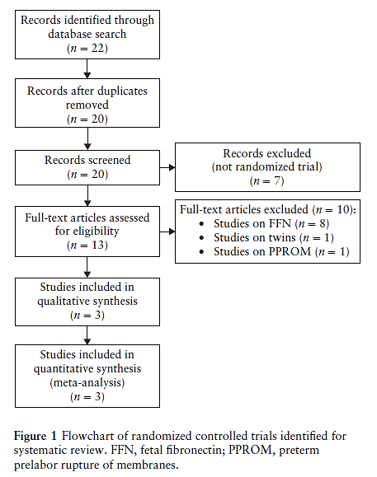
Cervical length and preterm labor
V Berghella et al., UOG 2017
Results: flowchart
Total 3 trials including 287 women
145 randomized to CL screening with knowledge of results
142 randomized to no knowledge of CL
Notes:
8

Slide 9
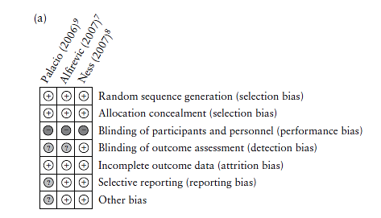
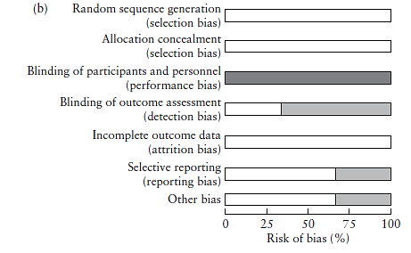
Cervical length and preterm labor
V Berghella et al., UOG 2017
Results: quality of studies
Low risk of bias

Slide 10
Cervical length and preterm labor
V Berghella et al., UOG 2017
Results: study characteristics

Slide 11
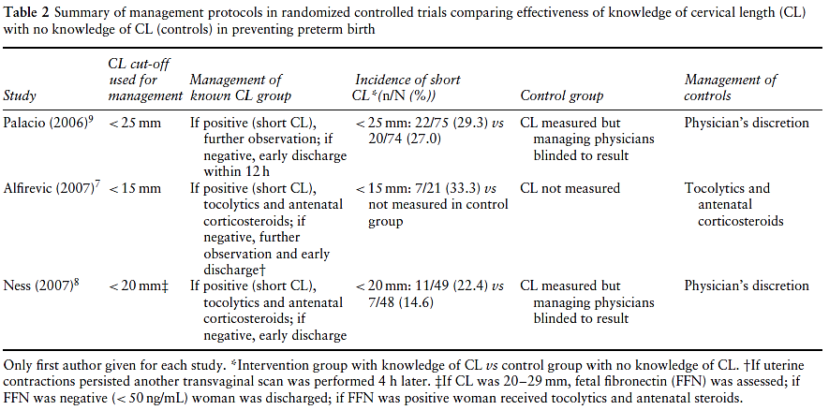
Cervical length and preterm labor
V Berghella et al., UOG 2017
Results: study protocols
Notes:
11

Slide 12
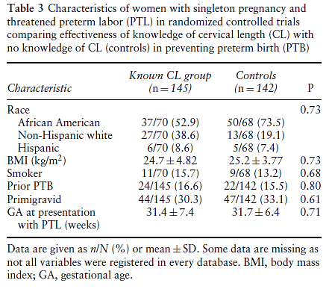
Cervical length and preterm labor
V Berghella et al., UOG 2017
Results: characteristics of women in the trials

Slide 13
Cervical length and preterm labor
V Berghella et al., UOG 2017
Results
Authors from all three trials provided entire database from their study.
There was no significant publication bias.
Study protocols for intervention/control groups differed among studies.
Important outcomes capturing neonatal morbidity were not reported.
Method for obtaining CL measurement was clearly described.
Statistical heterogeneity was low for primary and secondary outcomes.
For the primary and main secondary outcomes, the quality of evidence using the GRADE approach was graded as low (confidence in effect estimate is limited) due to serious imprecision (small numbers and low event rates with wide CI) and indirectness (different interventions).

Slide 14
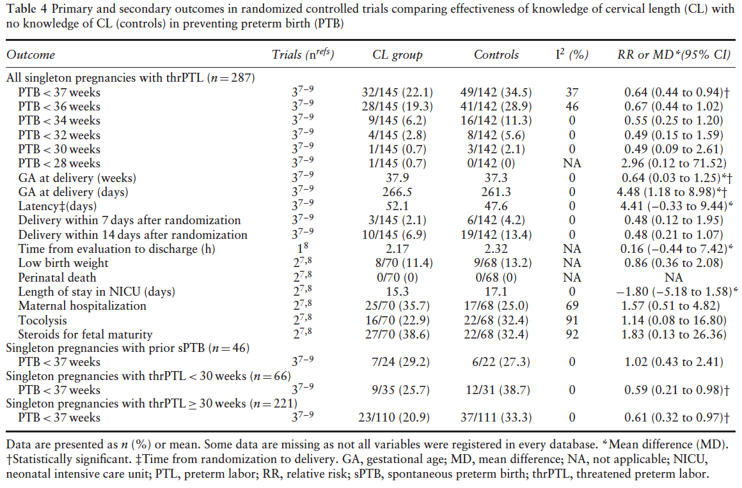
Cervical length and preterm labor
V Berghella et al., UOG 2017
Results
Significant reduction in CL group for PTB <37weeks;
RR, 0.64
(95% CI, 0.44-0.94)
Significant increase in CL group for
GA at delivery;
MD, 4.48
(95% CI,1.18–8.98) days

Slide 15
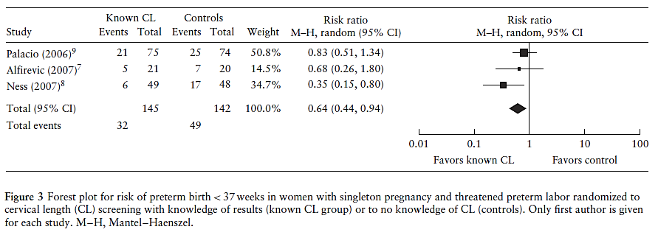
Cervical length and preterm labor
V Berghella et al., UOG 2017
Results: primary outcome preterm birth <37 weeks
36% reduction in risk of PTB <37 weeks with management based on knowledge of CL (event rate 22.1% vs 34.5%)

Slide 16
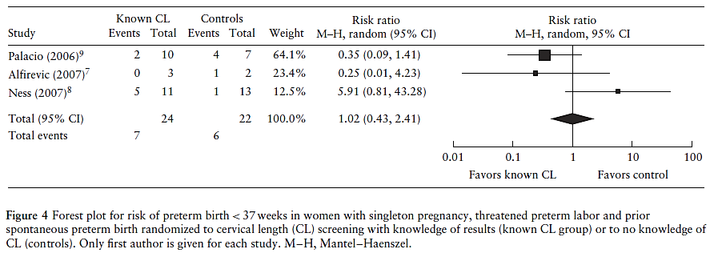
Cervical length and preterm labor
V Berghella et al., UOG 2017
Subgroup analysis: PTB <37 weeks in women with prior spontaneous PTB
No significant difference in subgroup of women with prior spontaneous PTB but there were significantly lower rates of PTB <37 weeks in CL group in those randomized at <30 weeks (RR, 0.59 (95%CI, 0.21–0.98) and at ≥ 30 weeks (RR, 0.61 (95% CI, 0.32–0.97); 221 women).

Slide 17
Cervical length and preterm labor
V Berghella et al., UOG 2017
Discussion
This IPD meta-analysis of three RCTs including 287 women showed that knowledge of CL in singleton gestations with threatened PTL between 24 and 35 weeks:
significantly reduced rate of PTB <37 weeks by 36%
resulted in a later gestational age at delivery
there were no significant differences for any other outcomes
The quality level of summary estimates, as assessed by GRADE, was low, indicating that the true effect may be substantially different from the estimate of effect.
Notes:
17

Slide 18
Cervical length and preterm labor
V Berghella et al., UOG 2017
Discussion: comparison with other studies
Findings of this systematic review differ from findings in other reviews:
A Cochrane review (5 RCTs) found that there was insufficient evidence to recommend routine screening with TVS CL in asymptomatic or symptomatic pregnant women. The review also included women with PROM and multiple pregnancy (Berghella et al., CDSR 2013).
Another meta-analysis (6 RCTs, 546 women) in singleton pregnancies with threatened PTL showed that FFN testing alone was not associated with prevention of spontaneous PTB or improvement in perinatal outcome but was associated with higher cost (Berghella et al., AJOG 2013).

Slide 19
Cervical length and preterm labor
V Berghella et al., UOG 2017
Discussion: strengths and limitations
Strengths
Individual level data from each trial allows for verification of published results, and more flexibility about inclusion and exclusion of individuals, choice of endpoints and subgroups.
Largest meta-analysis so far on this topic including all currently published trials.
Low influence of publication bias.
Limitations
Small number of trials, one trial published only as an abstract.
Small numbers of included women so unable to perform meaningful stratified meta-analysis in subgroups.
Difference in protocols among trials, e.g. cut-offs for CL for decision making.
Limited neonatal outcome data.
Differences in primary outcomes among studies.
Differences in/lack of definition of threatened PTL.

Slide 20
Cervical length and preterm labor
V Berghella et al., UOG 2017
Conclusions
There is significant association between knowledge of CL and lower incidence PTB <37 weeks and later gestational age at delivery in symptomatic singleton gestations with threatened PTL.
The one trial that was by itself associated with a significant reduction in PTB <37 weeks used a management protocol that recommended intervention (admission, tocolysis, steroids) for women with TVS CL <20 mm and for those with a CL of 20–29 mm with a positive FFN test, and recommended discharge for those with CL ≥ 30 mm. The authors suggest the use of this management protocol for women with threatened PTL between 23+7 and 33+6 weeks.

Slide 21
Cervical length and preterm labor
V Berghella et al., UOG 2017
Conclusions
The biological plausibility of reduction in PTB <37 weeks in the CL group is not completely clear, and may be due to
better use of interventions (admission, tocolysis, steroids) aimed at women with true PTL.
avoiding unnecessary intervention in those with CL ≥30 mm.
Tocolytics being more effective in those with contractions and short CL.
Avoiding serial digital examinations.
Further studies are needed to understand better whether and under what circumstances the predictive characteristics of TVS CL screening can be translated into better clinical management and better outcomes.

Slide 22
Cervical length and preterm labor
V Berghella et al., UOG 2017
Future perspectives
Future trials need to report important maternal and perinatal outcomes and cost-effectiveness.
Future trials should also report clear protocols for management based on CL results so that they can be evaluated and replicated.
Discussion points
How can a good test for prediction of PTB reduce the risk in the absence of effective interventions to prevent PTB?
Based on these findings, should CL screening be part of routine clinical care of women who present with threatened PTL?
Notes:
22

