Slide 1



UOG Journal Club: December 2017
Fetoscopic laser coagulation in 1020 pregnancies with twin–twin transfusion syndrome demonstrates improvement in double-twin survival rate
W. Diehl, A. Diemert, D. Grasso, S. Sehner, K. Wegscheider and K. Hecher
Volume 50, Issue 6, pages 728–735
Journal Club slides prepared by Dr Maddalena Morlando
(UOG Editor for Trainees)

Slide 2
Fetoscopic laser coagulation in 1020 pregnancies with twin–twin transfusion syndrome demonstrates improvement in double-twin survival rate
Diehl et al., UOG 2017
Since laser coagulation for TTTS was introduced in the early 1990s, most reports of effectiveness have been from single centers including fewer than 200 cases.
Laser therapy of TTTS leads to improvement in survival rates and long-term neurodevelopmental outcome.
However, laser therapy may lead to complications such as preterm prelabor rupture of membrane, twin anemia–polycythemia sequence (TAPS), reversal/recurrence of TTTS and fetal death.
While overall there is a significant trend of improvement in perinatal survival rates over the last 25 years, the reported outcomes show a large variation between individual centers.

Slide 3
Fetoscopic laser coagulation in 1020 pregnancies with twin–twin transfusion syndrome demonstrates improvement in double-twin survival rate
Diehl et al., UOG 2017
Objective
To investigate the growing experience and learning curve of fetoscopic laser coagulation of the placental vascular anastomoses in severe mid-trimester TTTS and its influence on perinatal outcome in a single-center setting.

Slide 4
Fetoscopic laser coagulation in 1020 pregnancies with twin–twin transfusion syndrome demonstrates improvement in double-twin survival rate
Diehl et al., UOG 2017
Methods
Pregnant women with severe mid-trimester TTTS who were referred for endoscopic laser coagulation of placental vascular anastomoses between January 1995 and March 2013 were included in the study.
All fetal and procedural data were entered prospectively into a fetal database, as were follow-up data as soon as they were available from the referral centers, where further care took place.
For blockwise comparison of data, the whole population was divided into five sequential groups, of 200 patients for the first four and 220 for the last one.
Diagnosis of TTTS was made according to established criteria, with polyhydramnios of the recipient fetus and anhydramnios of the stuck donor fetus, and staging was according to system of Quintero et al.

Slide 5
Fetoscopic laser coagulation in 1020 pregnancies with twin–twin transfusion syndrome demonstrates improvement in double-twin survival rate
Diehl et al., UOG 2017
Methods
All procedures were performed under local anesthesia. Before introduction of the 30◦ fetoscope in June 2001, the 0◦ fetoscope was used in 124 twin pregnancies with anterior placentae.
All laser procedures in the first two groups (n = 400) were performed by two operators at Barmbek Hospital, Hamburg, Germany, between 1995 and 2003. The vast majority were performed by the same surgeon (K.H.).
The following three groups (n=620) were treated at the University Medical Center Hamburg-Eppendorf, Hamburg, from 2004. In the third group, another operator was trained and performed 33 procedures, while in Groups 4 and 5 a fourth operator (W.D.) was trained and performed 174 procedures during that period under the supervision of the senior operator.

Slide 6
Fetoscopic laser coagulation in 1020 pregnancies with twin–twin transfusion syndrome demonstrates improvement in double-twin survival rate
Diehl et al., UOG 2017
Methods
Primary outcome was survival of two fetuses
Secondary outcome variables were survival of at least one fetus, gestation at delivery, interval between laser treatment and delivery, birth weight and neonatal morbidity.
Survival was defined as survival of the neonatal period at discharge from hospital.
Severe prematurity was defined as delivery <32 completed weeks’ gestation, and neonatal morbidity as intracerebral hemorrhage (Grades 3 and 4), periventricular leukomalacia, sepsis, bronchopulmonary dysplasia, necrotizing enterocolitis or any other severely debilitating disease.

Slide 7
Fetoscopic laser coagulation in 1020 pregnancies with twin–twin transfusion syndrome demonstrates improvement in double-twin survival rate
Diehl et al., UOG 2017
Results
1020 consecutive pregnant women with severe mid-trimester TTTS were included.
The yearly caseload more than doubled during the study period, from 43 cases in the first group to 91 in the last year.
Gestational age at laser therapy did not show a significant difference between the subgroups (mean gestational age 20.8 ± 2.2 weeks).
Significant differences between the treatment groups were observed for Quintero stages. More cases with Quintero Stage I were treated in the later than in the earlier groups and there was a significant reduction in the time needed for fetoscopy.

Slide 8
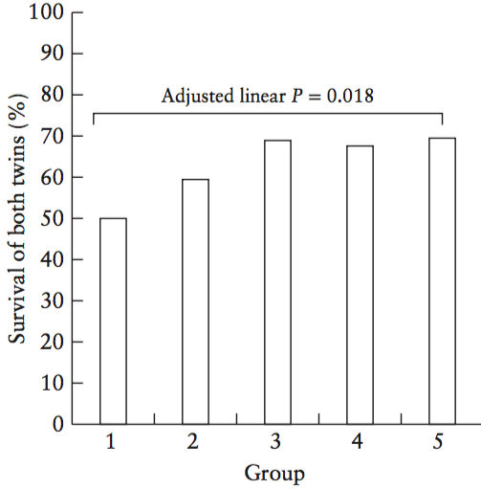
Fetoscopic laser coagulation in 1020 pregnancies with twin–twin transfusion syndrome demonstrates improvement in double-twin survival rate
Diehl et al., UOG 2017
Results
Double-twin survival was 50.0% (100/200) in first group and increased to 69.5% (153/220) in last group, reaching a plateau after the third group.
After adjusting for confounders, the linear trend was significant (linear P = 0.018).
There was a significant increase in survival of recipients, from 71.5% to 85.5% (P = 0.022). Survival of donors increased non-significantly, from 59.0% to 75.9% (P = 0.083).

Slide 9
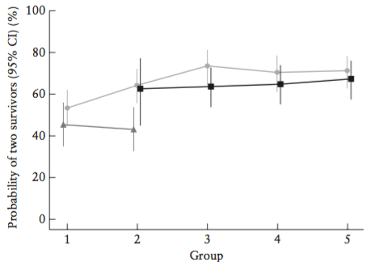
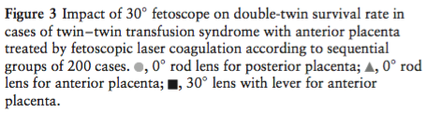
Fetoscopic laser coagulation in 1020 pregnancies with twin–twin transfusion syndrome demonstrates improvement in double-twin survival rate
Diehl et al., UOG 2017
Results
In the first two groups, 124 twin pairs had anterior placentae and were treated using 0◦ fetoscopes. These cases showed a double-twin survival rate of 44.4%.
After the 30◦ fetoscope became available, it was used for anterior placentae. This led to a significant increase in double-twin survival, to 65.1% (207/318) (over all groups P = 0.001).
There is no longer a significant difference in survival rate between anterior and posterior placental location.

Slide 10
Fetoscopic laser coagulation in 1020 pregnancies with twin–twin transfusion syndrome demonstrates improvement in double-twin survival rate
Diehl et al., UOG 2017
Results
For all successfully treated pregnancies, mean gestational age at delivery was 33.7 ± 3.2 weeks, with a time interval between laser treatment and delivery of 12.9 ± 4.0 weeks, and an incidence of severe prematurity at or before 32 weeks of 29% (262/905).
The mean birth weight of recipients was 2060 ± 600g and for donors it was 1770 ± 580g, without any significant differences between groups.
There was no significant difference in rates of severe neonatal morbidity between Groups 3, 4 and 5. Overall, severe neonatal morbidity occurred in 7% of both surviving recipients and donors for which neonatal follow-up reports were available.
Recurrent TTTS or TAPS was reported in 2.7% (17/619) of cases in these groups.

Slide 11
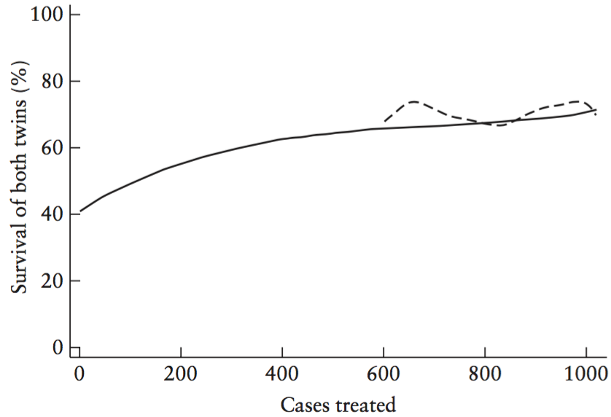


Fetoscopic laser coagulation in 1020 pregnancies with twin–twin transfusion syndrome demonstrates improvement in double-twin survival rate
Diehl et al., UOG 2017
Results
The success rate of double-twin survival for the lead surgeon reached a plateau of 69% after 600 procedures.
There was no difference between the success rates of the experienced surgeon and the trainee, who was trained hands-on and performed 174 procedures in the last two groups. This was also the case for the operator who performed only 33 procedures.

Slide 12
Fetoscopic laser coagulation in 1020 pregnancies with twin–twin transfusion syndrome demonstrates improvement in double-twin survival rate
Diehl et al., UOG 2017
Conclusions
The caseload per year doubled over the study period.
There was continuous increase in double-twin survival rate possibly due to growing experience and refinements in fetoscopic instruments and techniques.
After the introduction of 30◦ fetoscope for cases with anterior placenta, differences in survival rate according to placental location were eliminated.
With an experienced surgeon supervising hands-on training, trainees achieved the same double-twin survival rate from soon after starting to perform the procedure.
These data provide strong arguments for the centralization of minimally invasive intrauterine surgery in specialized high-volume centers.

Slide 13
Fetoscopic laser coagulation in 1020 pregnancies with twin–twin transfusion syndrome demonstrates improvement in double-twin survival rate
Diehl et al., UOG 2017
Strengths
This is the largest single-center study of perinatal outcome after laser therapy for severe TTTS, with practically 100% (1019/1020) follow-up. The authors report experience of almost 20 years, including the learning curve, new technical developments and training.
Limitations
Follow-up data of surviving neonates are not complete, thus, the incidence of long-term morbidity may be under-reported. In addition, the authors were not able to investigate the influence of different techniques, such as the selective sequential and the Solomon techniques.

Slide 14
Fetoscopic laser coagulation in 1020 pregnancies with twin–twin transfusion syndrome demonstrates improvement in double-twin survival rate
Diehl et al., UOG 2017
Discussion Points
Is it possible that improved survival in later groups was due to the inclusion of more Stage-I TTTS cases?
Does audit of local TTTS procedures match up to the reported outcomes in this study?
How can we improve the centralization of laser therapy in specialized high-volume centers?
How can we standardize the training of operators willing to perform laser therapy in order to achieve the same outcomes reported here?
Do we need to develop an evaluation tool to assess the level of competence of trainees performing laser therapy?

