Slide 1

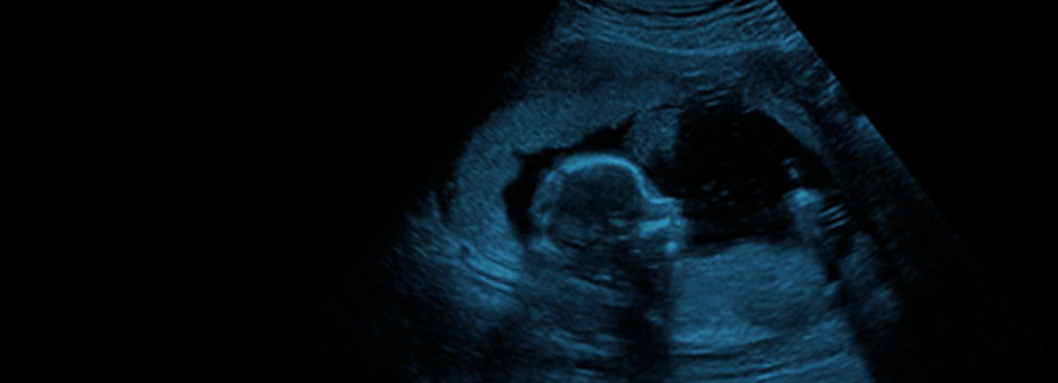



Exclusively for those in lower resource settings inc. South Africa​
Day 1: Gynecology & Early Pregnancy
reproductive health
early pregnancy complications
ultrasound in low-resource settings
IOTA terms and definitions
cervical cancer
Day 2: Obstetrics
management of pre-eclampsia
perinatal genetics
fetal echocardiography & neurosonography
multiple pregnancy
placenta accreta spectrum disorder
REGISTER FOR FREE NOW >

