Slide 2
World Congress 2023
The ISUOG World Congress 2023 will take place fully onsite at the COEX Center, Seoul, South Korea from 16-19 October 2023.
75+ hours of lectures, live scans and workshops
100+ leading global experts
2000+ delegates for networking and socialising
www.isuog.org/worldcongress

Slide 3
Topics Include
Fetal & Maternal Infections
Fetal Interventions
Fetal Growth
Early Pregnancy Complications
Managing Ovarian Masses
Pelvic Pain & Endometriosis
Reproductive Medicine
Ultrasound & Fertility Preservation
Urogynecology
www.isuog.org/worldcongress

Slide 4
Pre-Congress Courses
Three pre-Congress courses will be held on Sunday 15th October.
Latest insights into the selected topics for Congress attendees.
Gynecology course: Ovarian masses and endometriosis
Obstetrics course: Using ultrasound to get at the crux of the matter: fetal brain and heart
Genomics course: Ultrasound meets genomics in reproductive care
www.isuog.org/worldcongress

Slide 5
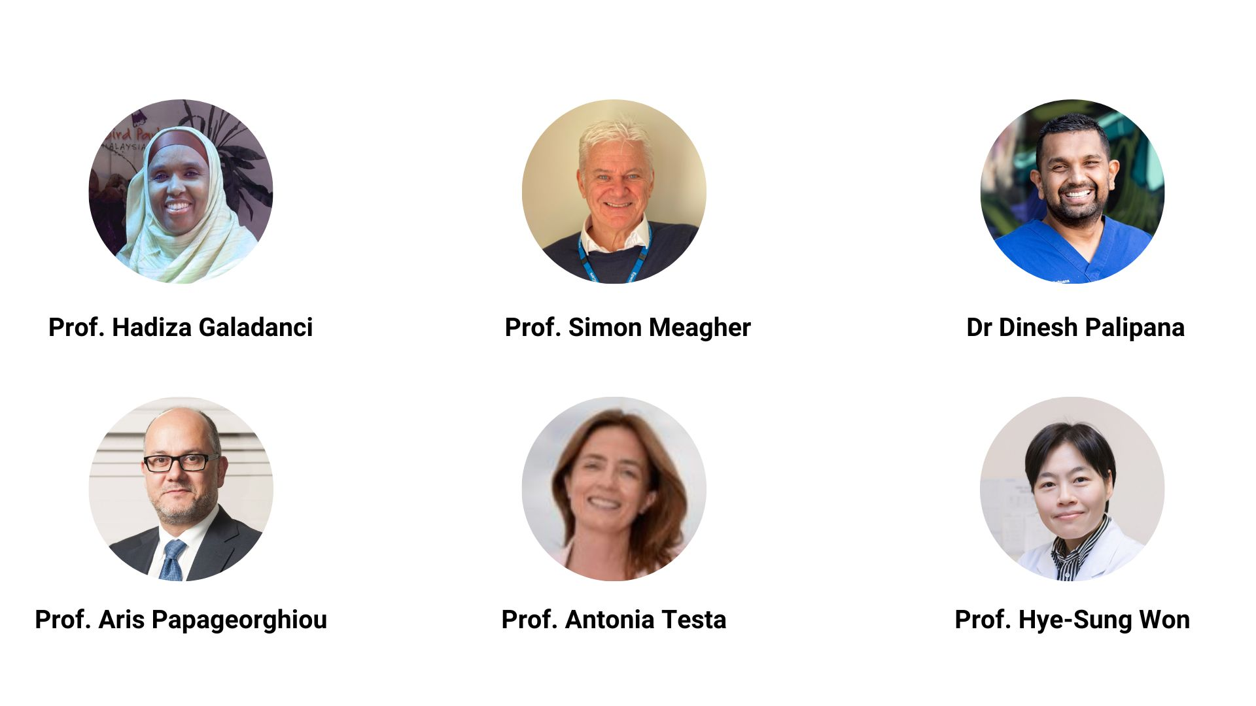
Plenary Speakers
www.isuog.org/worldcongress

Slide 6
Key Dates
16 August 2023: Early bird registration deadline
15 October 2023: Pre-Congress Courses
16-19 October 2023: World Congress
www.isuog.org/worldcongress

