Slide 1
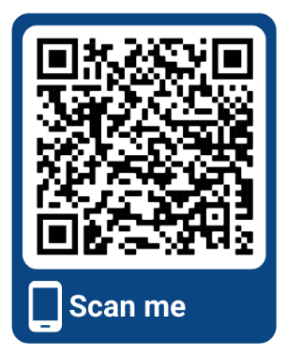
REGISTER NOW
Using ultrasound together with other technologies to improve the lifelong health of women and babies
Two streams of scientific content over two days, delivered through the ISUOG virtual platform
A mixture of lectures and practical, interactive training, including scan demonstrations, pattern recognition sessions and case report discussion
Leading international and local experts in obstetrics, gynecology and imaging
Live program delivered from 7:30 - 18:30 Calgary, Canada time (Mountain Daylight Time)
Content available on demand, at a time, pace and location to suit you until 17 May 2021
All non-member registration fees include a 12-month ISUOG basic membership
See you ONLINE in 2021! For more information, please visit:
https://www.isuog.org/events/international-symposia.html
Notes:
Holding slide as of 08/01/2021 IP

