Slide 1
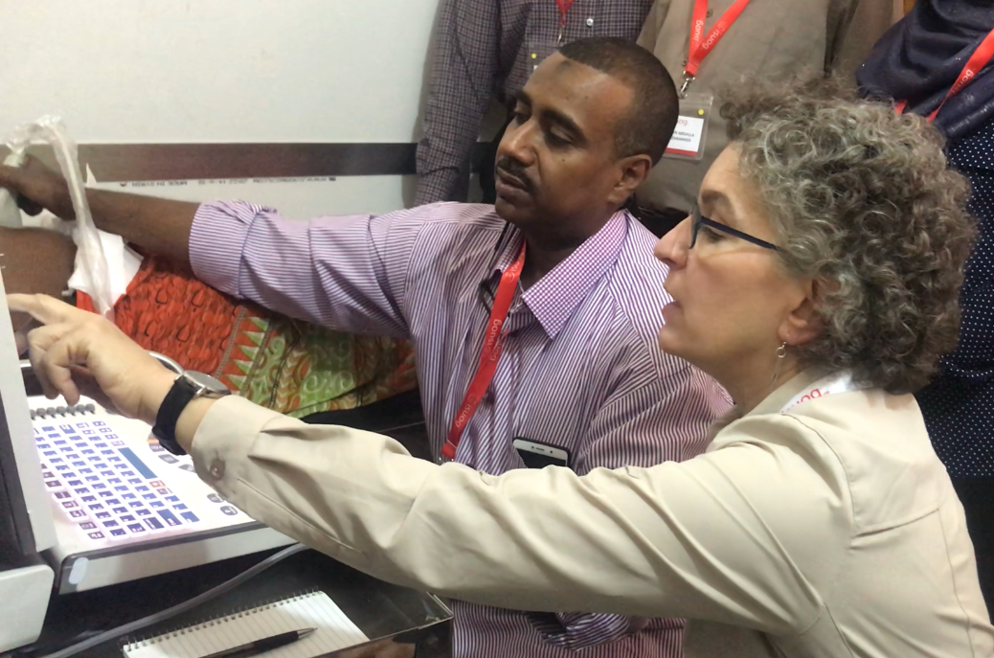

Improving women’s healthcare services in underserved regions to reduce maternal and neonatal mortality.
Mission
Vision
To increase access to and awareness of ultrasound, to provide effective training, to improve diagnosis and health outcomes
isuog.org/outreach

Slide 2
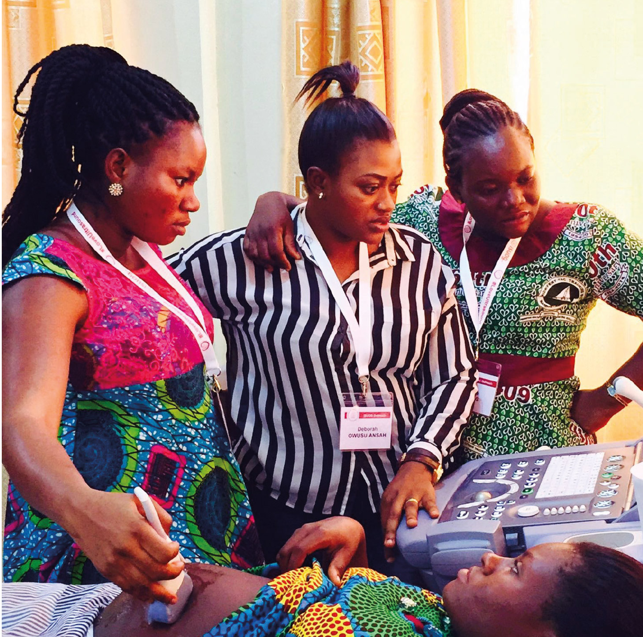
9
countries
8
programs
4
support programs
2
completed programs
isuog.org/outreach

Slide 3
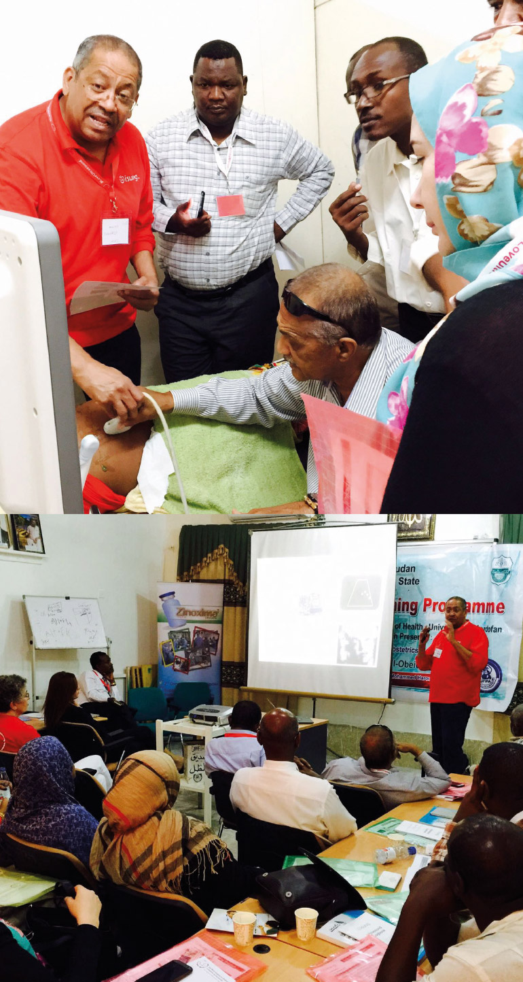



⁹⁵
²⁵²
⁹
^{volunteer trainers}
^{trainees from full programs}
trainees now trainers from full programs
“The eagerness to learn is palpable…how hard these men and women work. All of the trainees are Ob/Gyn or Radiology physicians with their own practices here in the city or in the surrounding state. After class ends, many of them see patients in their offices until all hours of the night and some of them even into the morning. Despite being very busy and probably sleep deprived, they pay attention, don’t fall asleep…”
- Dr Angela Ranzini, Outreach Trainer
isuog.org/outreach

Slide 4
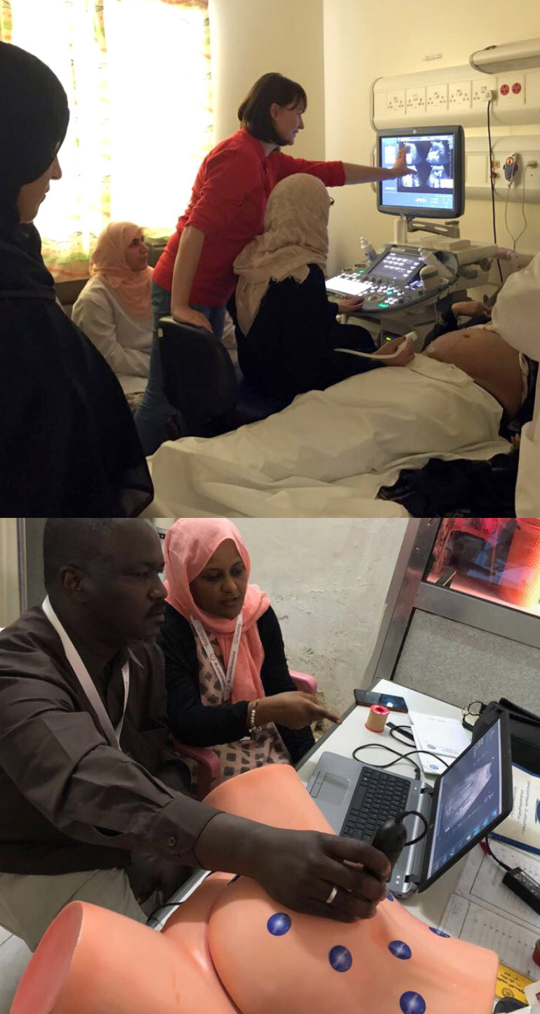
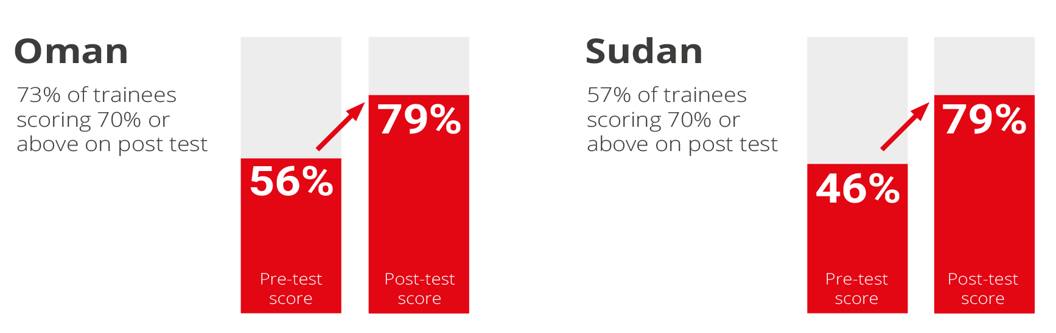
Learning
“ISUOG’s Education Committee had introduced for this project not only a theoretical assessment with pre and post-test questions, but also a pre and post practical assessment. This meant that on the first day the trainees had to show whether they could obtain five specific planes before any teaching was done and the same planes had to be demonstrated today by them after four days of theoretical training and practical hands-on sessions. And what a difference!”
- Dr Titia Cohen-Overbeek, Project Lead for Oman
isuog.org/outreach

Slide 5
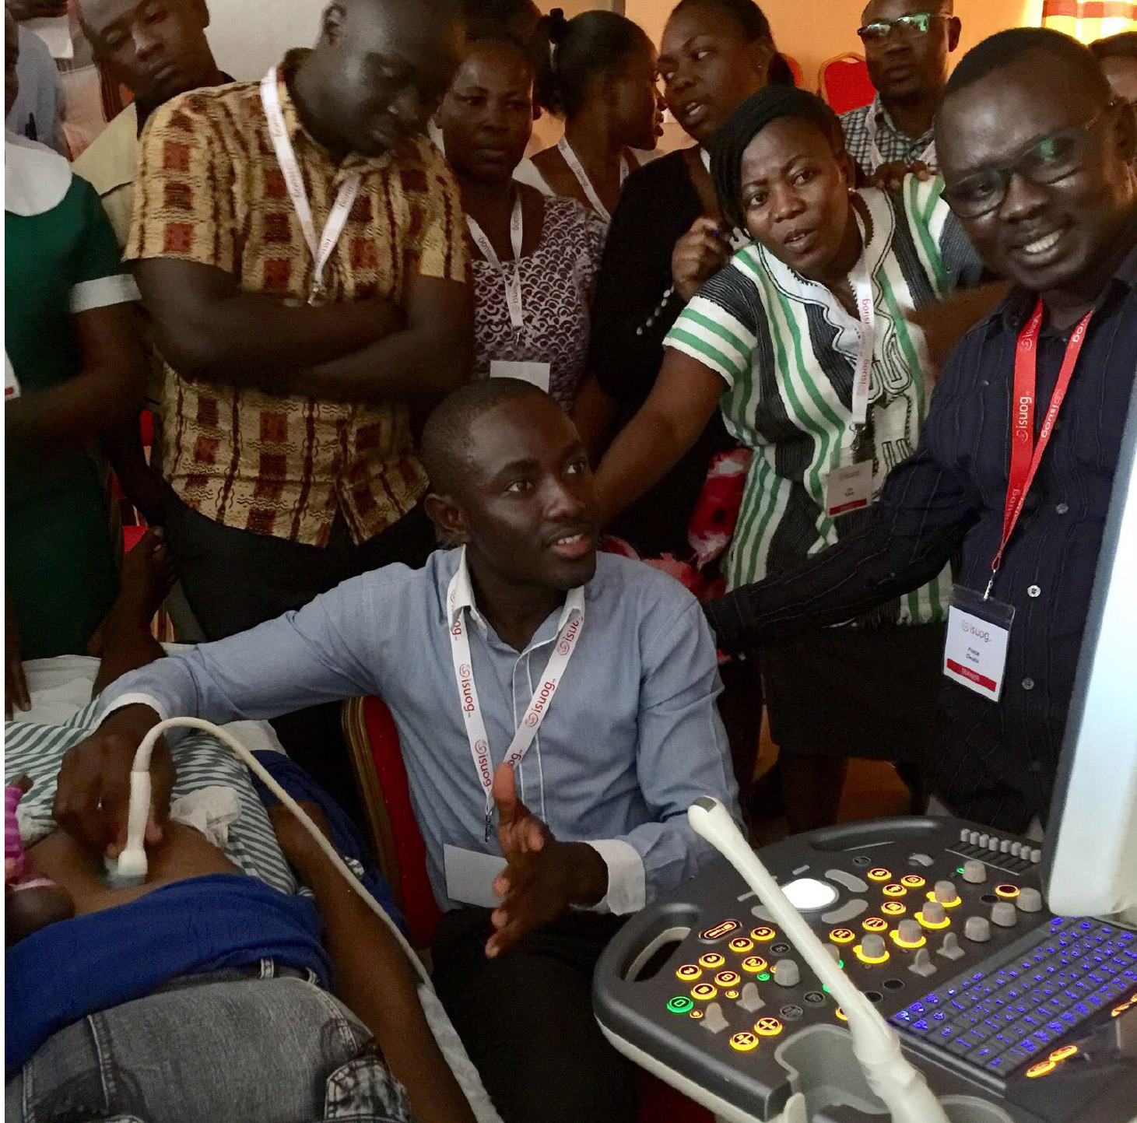


²¹
partnerships from full programs
¹⁰
Donated machines to full programs*
(in 2018: Partnerships active with 9 NGO and
^{3 ministries of health)}
* ISUOG no longer provides donations as per recent strategy update in 2015.
isuog.org/outreach

Slide 6
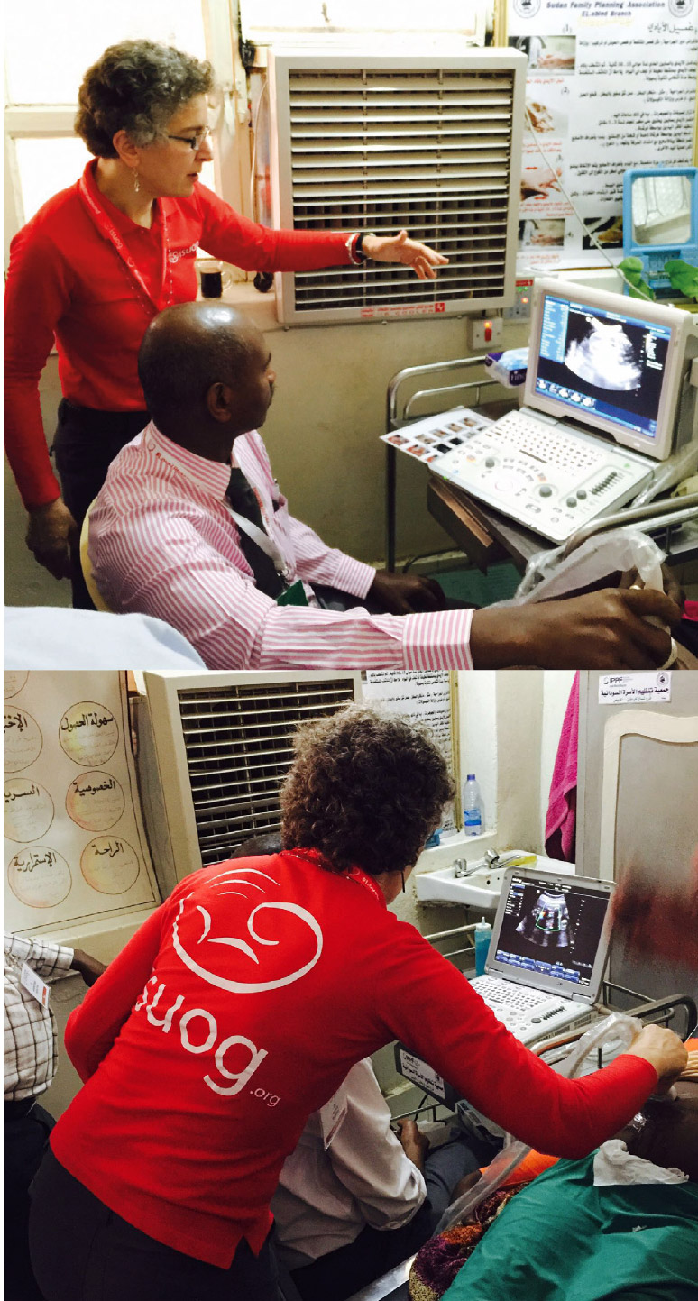
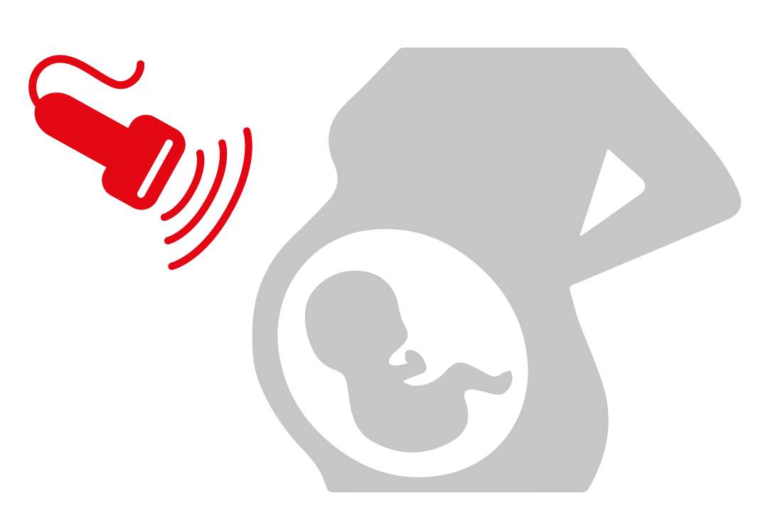
⁶⁴
women scans per day during training in full programs
“All trainees were engaged and motivated. It was inspiring to see how they were learning and helping each other. Mastora is a mother of three that had to travel for two hours to have her first ultrasound examination during her fourth pregnancy. She was found to be at her 30th week. The glance at her baby’s heart beating and movements lit her eyes. Fortunately, no abnormalities were noted.”
- Prof. Prof Hisham Mirgani Mubara
ISUOG Ambassador to the Middle East and Project Lead for Sudan
isuog.org/outreach

Slide 7
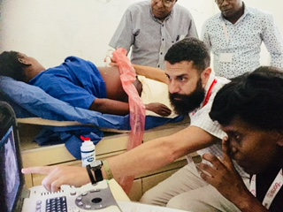
Success
“From my personal experience the ultrasound training brings pleasure to my profession, the pleasure of practicing it, making diagnosis. That’s why I looked forward to know more about it and master it perfectly in the best way and that's what led me to the ISUOG training. Because I want to be good at it and I can testify that I learned a lot. Now I do ultrasound with more precision, I know what to look for and how to look for it, it makes my practice more interesting and more fun. By practicing I continue to learn as well and feel more confident and that brings better satisfaction to my community. Hand's up for ISUOG and Thanks a lot!”
⁻ ^{Eunice Beausejour,} ^{OB/GYN Cap Haitian, Haiti}
isuog.org/outreach

