Slide 1

WELCOME TO

Slide 2

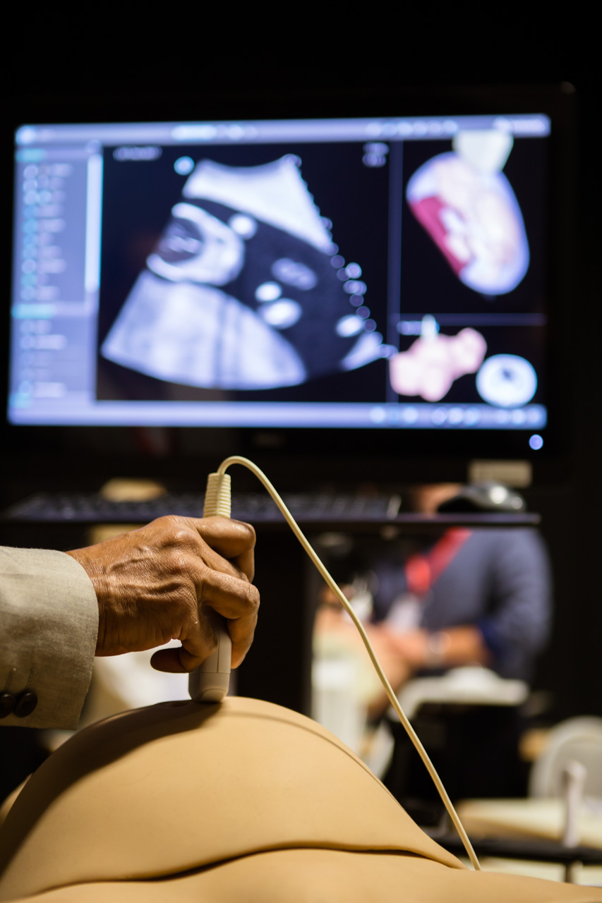

About ISUOG
ISUOG stands for International Society of Ultrasound in Obstetrics and Gynecology
ISUOG is a charitable organisation and the leading international society of experts in ultrasound for obstetrics and gynecology.
The Society includes Obstetricians and Gynaecologists, trainees, medical doctors, scientists, sonographers, radiologists, midwives and other health professionals who work to advance women’s health and well-being globally.

Slide 3
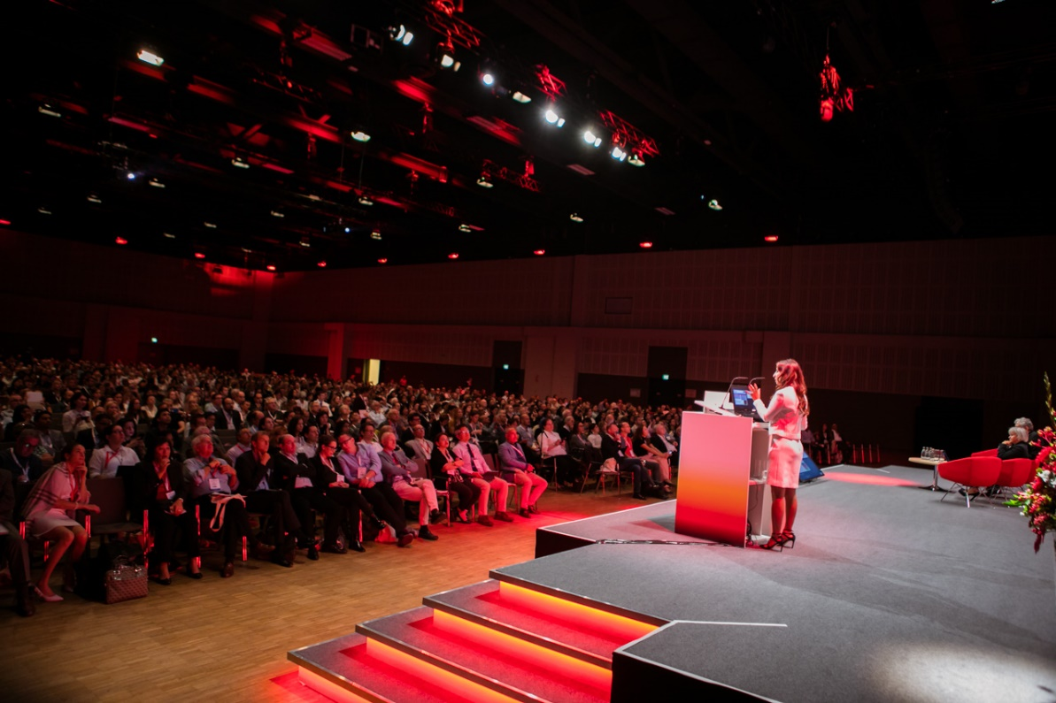
Our mission
Our mission is to improve women’s health through the provision, advancement and dissemination of the highest quality education, standards and research information around ultrasound in Obstetrics and Gynecology.
How?
We strive to achieve this through our education and training initiatives, our free access guidelines, advocacy though our events and social media platforms and by inspiring research though our publication and growing our reach.

Slide 4
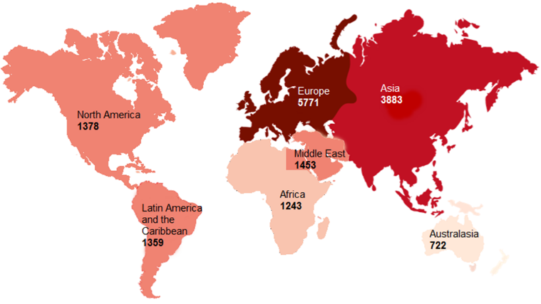

Our society is growing
We encourage members from all professions in the specialty, at all levels of training, internationally.
98% of our members would recommend membership to a colleague

Slide 5
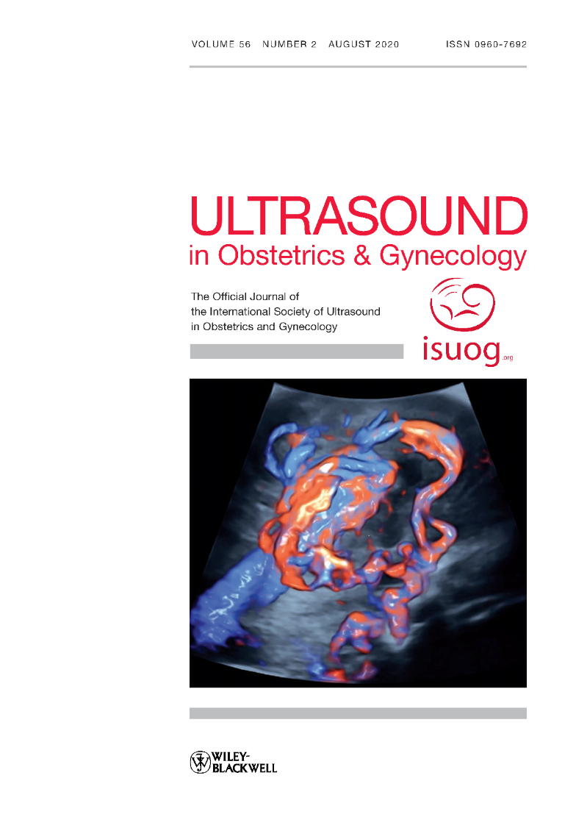
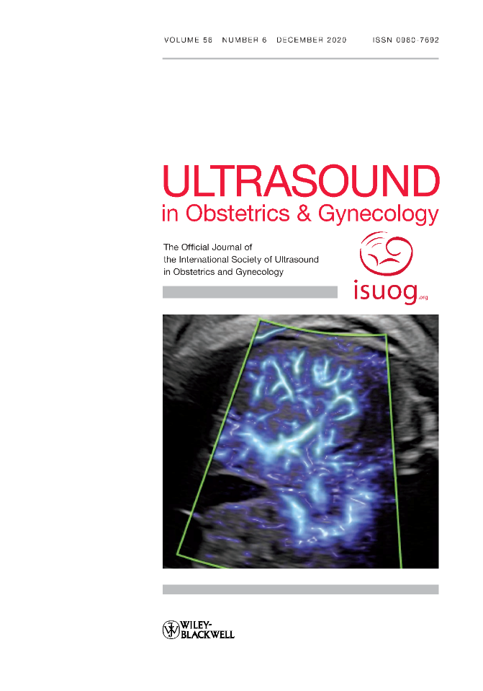


Research
leading peer-reviewed journal
Impact factor 8.678
6.6 million article downloads in 2021
Our Journal, Ultrasound in Obstetrics & Gynecology is the leading peer-reviewed journal on imaging within the field of obstetrics and gynecology.
The UOG journal includes monthly systematic reviews, referee commentaries and expert perspectives.
Have your work published in the UOG, the average Altmetric score was 125 for our top 10 articles in 2021

Slide 6







Trainee Membership
We offer free two-year membership through institutions. Ask your institution to email us on info@isuog.org
Benefits include
Online subscription to the UOG Journal.
Reduced fees to our education courses, World Congress and International Symposium events.
Access to over 1000 web resources.
And much more…

Slide 7


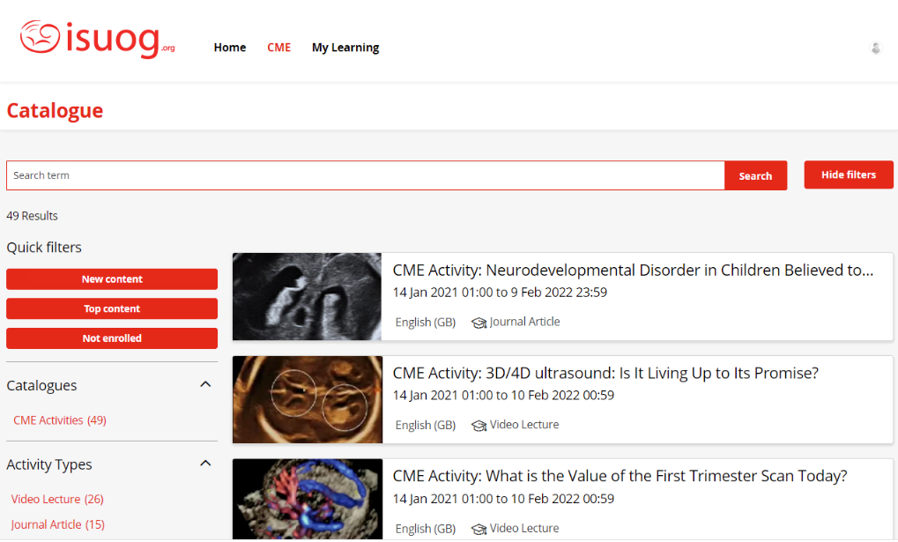
Online CME Platform
Our CME platform, ISUOG Academy has over 100 courses so far. The platform offers a mixture of learning tools such as videos, guidelines articles and lectures.
Activities include:
Practice Guidelines
Journal articles
Video lectures
Features include:
Responsive user experience
Structured learning
On the spot certification
Earn CME credit anytime, anywhere. The process is simple!

Slide 8
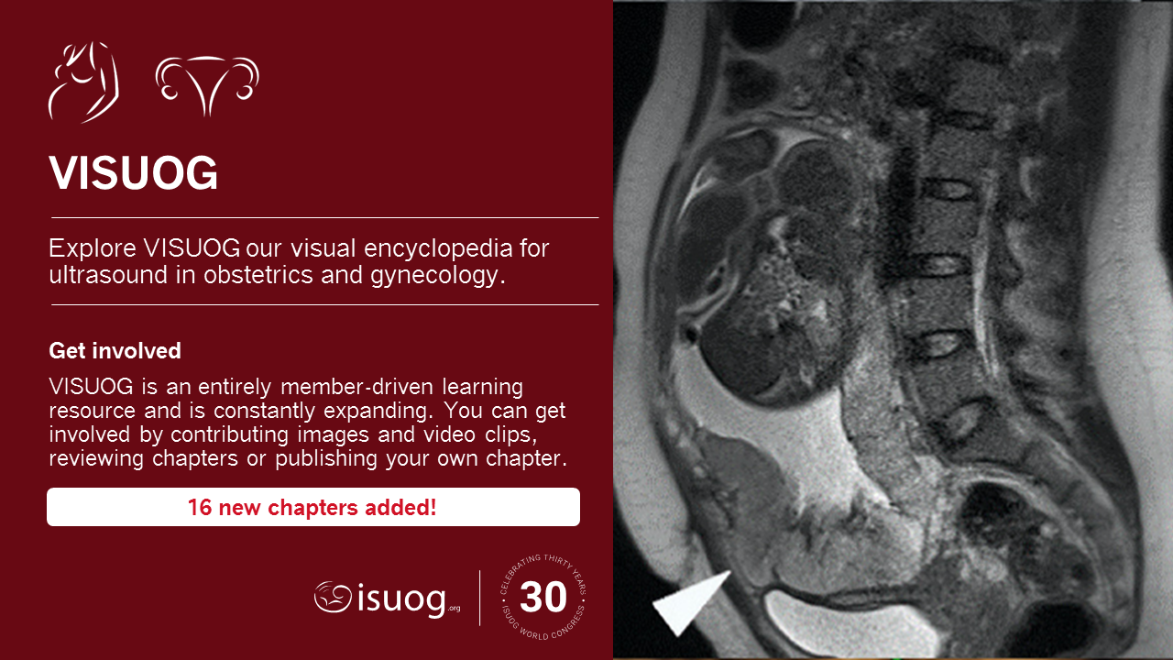

https://www.isuog.org/education/visuog.html

Slide 9
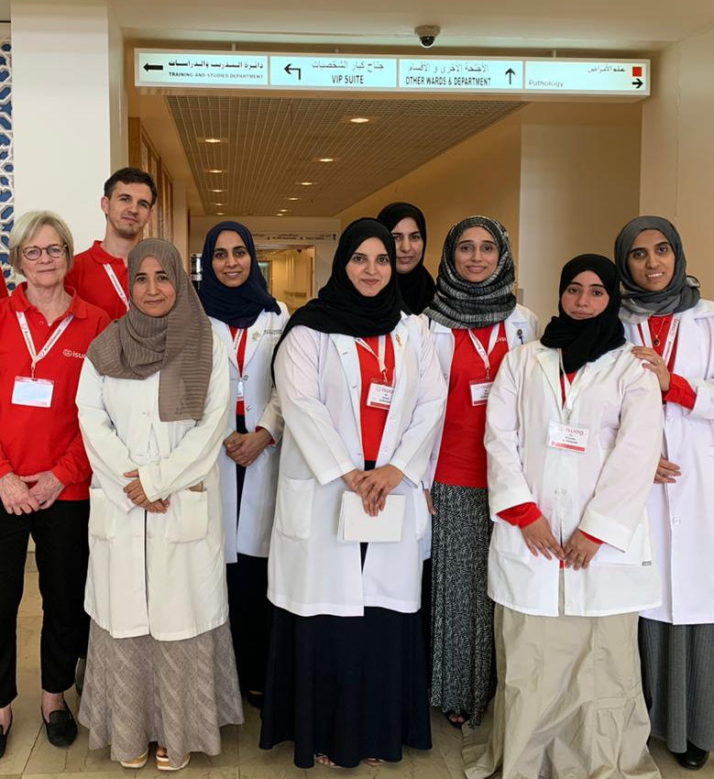
Outreach
ISUOG Outreach Vision: Every woman should undergo a safe and patient-centred quality ultrasound as part of their healthcare evaluation.
How?
ISUOG Outreach builds a sustainable national health structure for providing OBGYN Ultrasound to all women in a specific underserved country. Outreach helps a country to provide quality and accessible care to all its women through training their trainers to raising the level of their skills and knowledge. ISUOG Outreach also works with their Governments to ensure sustainability through post-program support.

Slide 10
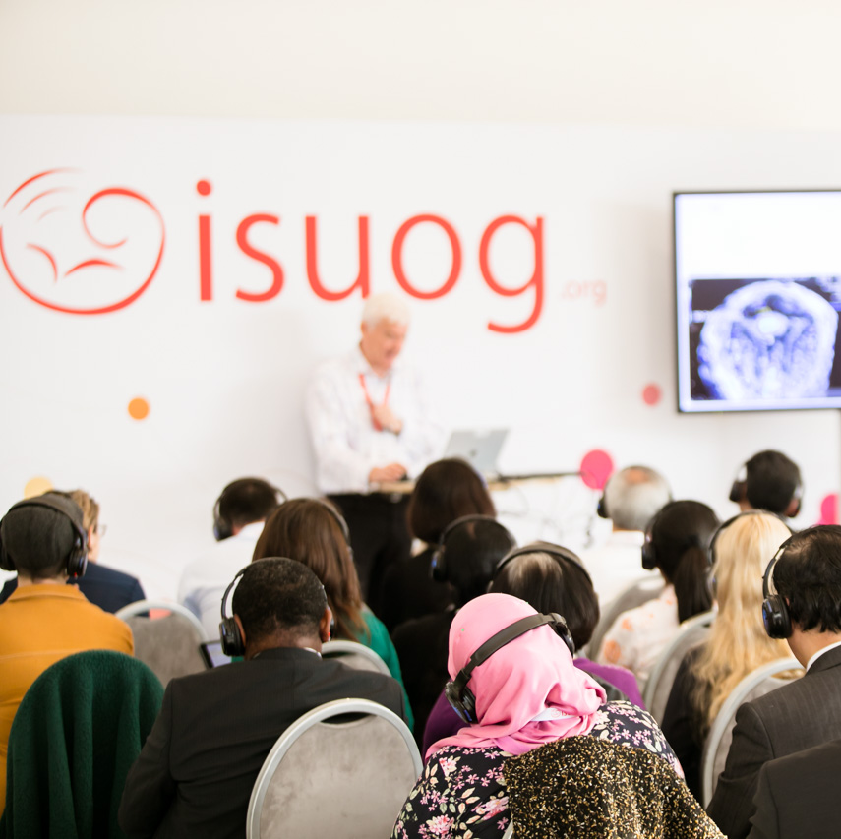
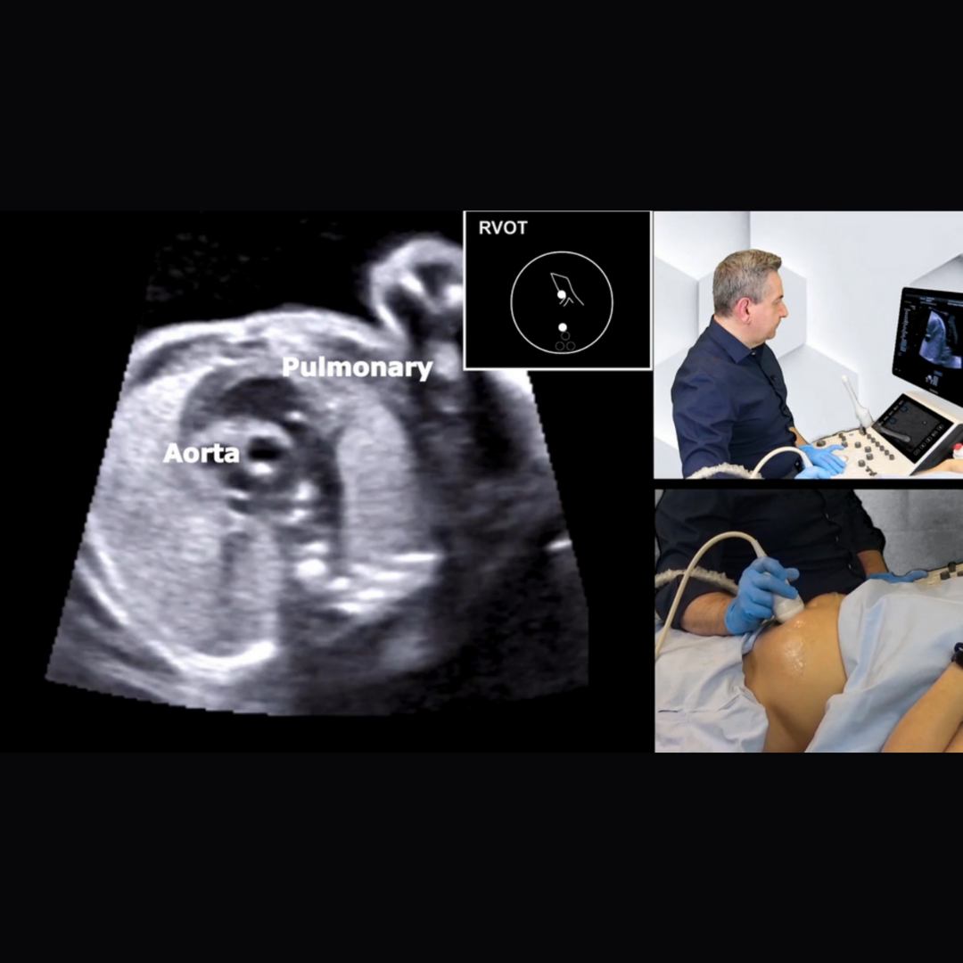
Basic Training
The Basic Training Task Force vision is that every ultrasound scan provider worldwide is competent, and the diagnosis of conditions is so effective that women’s health outcomes improve.
Our online Basic Training program provides trainees that are new to ultrasound an introduction to essential topics in obstetrics and gynecology.
Full curriculum of 30 lectures available for free
Developed by experts
Also available in English and Spanish
Lectures in Chinese, Portuguese & Russian
Online free access education
www.isuog.org/education/basic-training

Slide 11
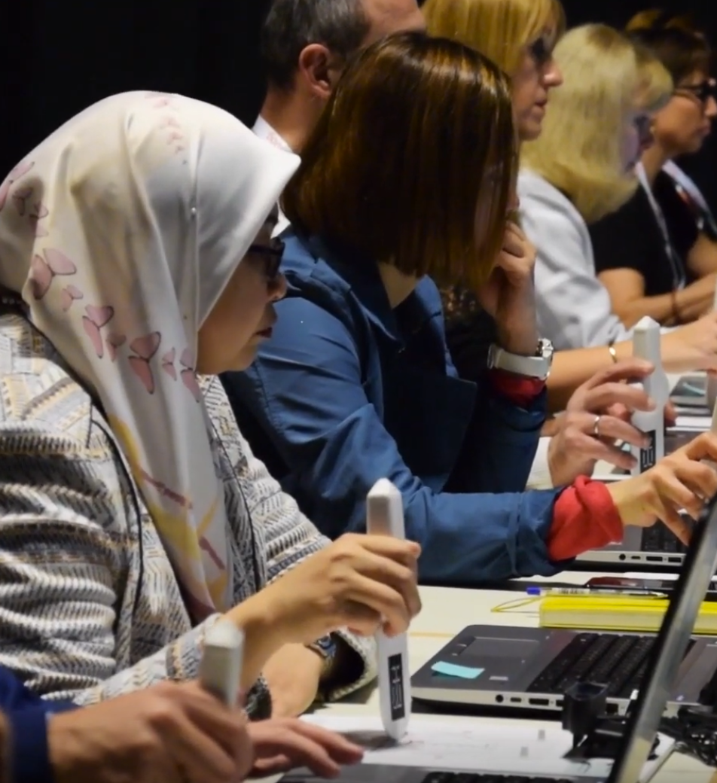
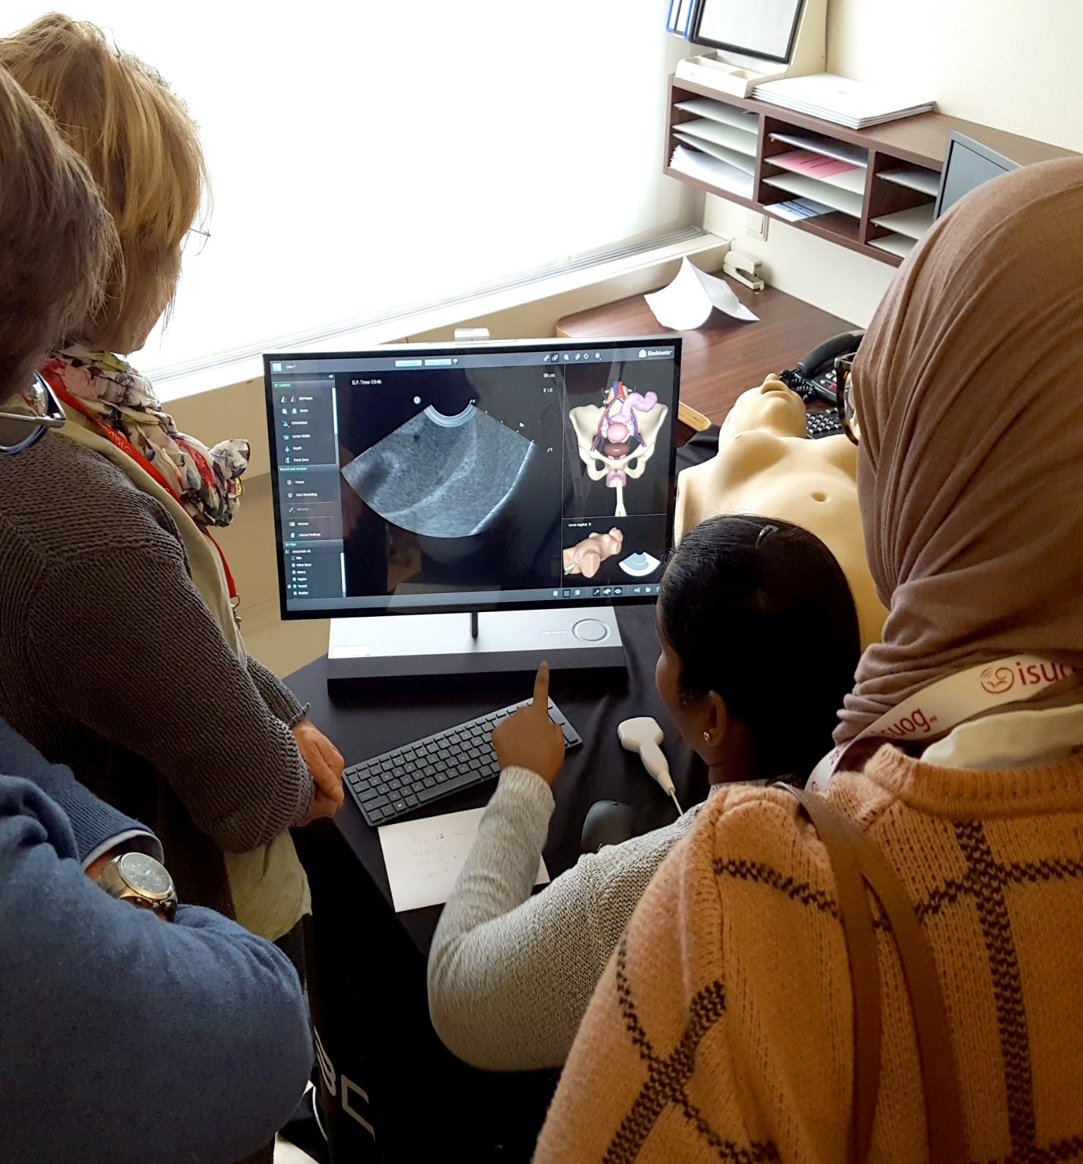
Run a BT
ISUOG now offers universities and training institutions the opportunity to run an ISUOG Basic Training program. ISUOG provides educational resources and administrative support at no cost.
Delivered by your own faculty in your own time
Resources and administrative support provided
Flexible and cost-efficient
Certification of completion can be obtained
Get in touch! Apply to run an ISUOG Basic Training Course today.

Slide 12
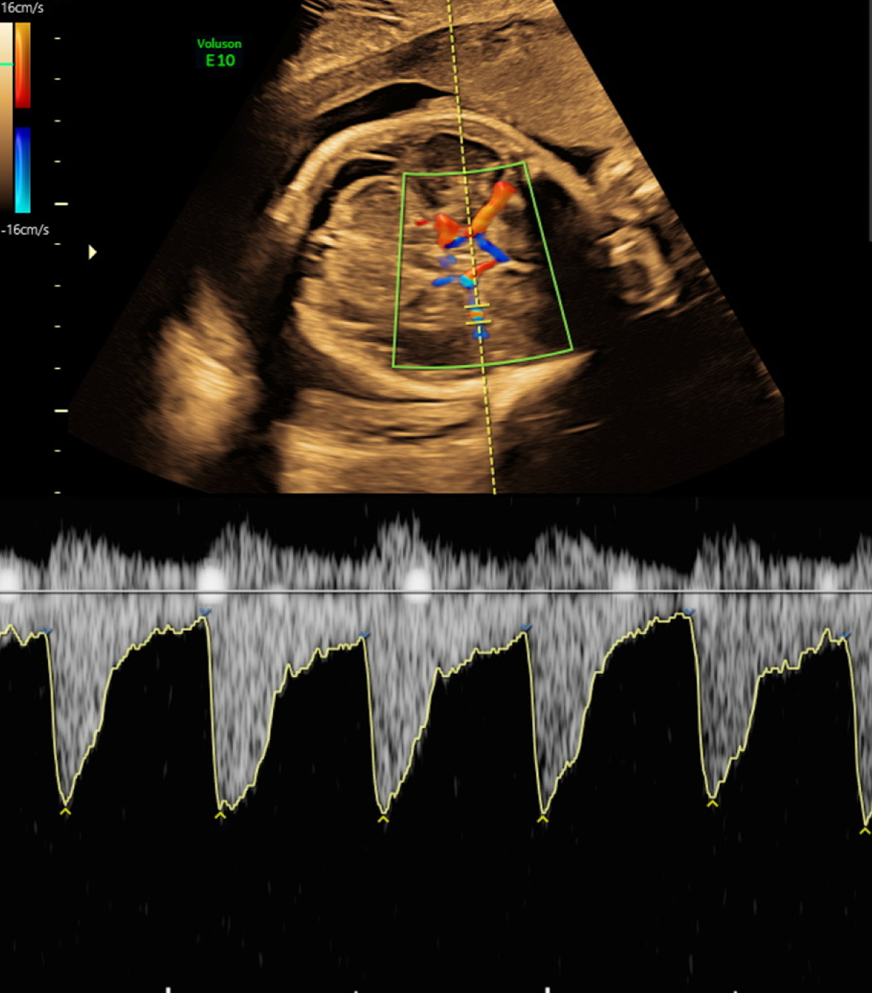
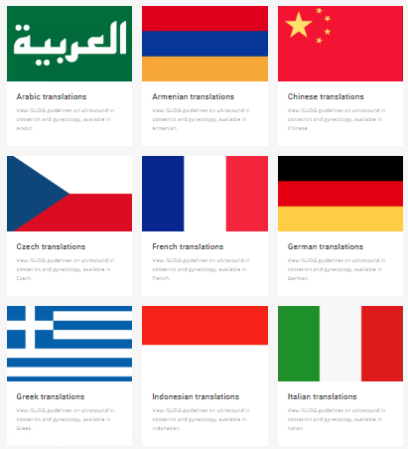
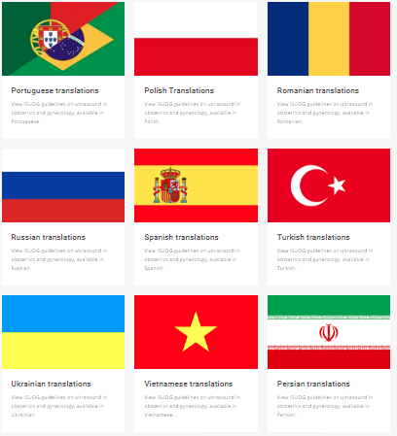
Run a BT
Practice Guidelines
The ISUOG Clinical Standards Committee (CSC) develops Practice Guidelines and Consensus Statements providing recommendations on how to improve and standardise medical care
16 Practice guidelines
10 Consensus statements
Translations in over 18 languages

Slide 13


Slide 14
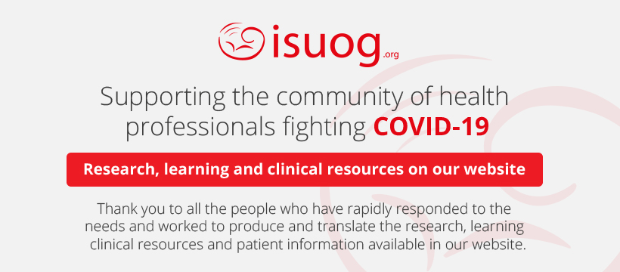
www.isuog.org/clinical-resources/coronavirus-covid-19-resources.html

