Slide 1



UOG Journal Club: April 2019
Reference ranges for Doppler indices of umbilical and fetal middle cerebral arteries and cerebroplacental ratio: systematic review
D. Oros, S. Ruiz-Martinez, E. Staines-Uria, A. Conde-Agudelo,
J. Villar, E. Fabre and A. T. Papageorghiou
Volume 53, Issue 4
Journal Club slides prepared by Dr Fiona Brownfoot
(UOG Editor for Trainees)

Slide 2
Reference ranges for Doppler indices of umbilical and fetal middle cerebral arteries and cerebroplacental ratio: systematic review
Oros et al., UOG 2019
Introduction
Doppler velocimetry is used to assess small-for-gestational-age (SGA) fetuses at risk of adverse perinatal outcome.
Doppler abnormalities in the umbilical artery (UA) are related closely to placental disease whilst changes in the fetal middle cerebral artery (MCA) reflect fetal cardiovascular adaptations to hypoxia or blood flow redistribution.
The ratio of MCA-PI to UA-PI (cerebroplacental ratio (CPR)) is an independent predictor of fetal compromise, Cesarean section and adverse perinatal outcome.
UA and MCA Doppler indices and CPR are currently used to modify the scheduling of antepartum surveillance and, in some cases, to time delivery of the compromised fetus.
References ranges for UA, MCA and CPR differ between studies.
Notes:
2

Slide 3
Reference ranges for Doppler indices of umbilical and fetal middle cerebral arteries and cerebroplacental ratio: systematic review
Oros et al., UOG 2019
Aim of the study
To evaluate reference ranges for UA and MCA Doppler indices and CPR. Specifically, to assess the methodological quality of studies on which these are based using a set of predefined quality criteria and to estimate the clinical impact of using different reference charts.
Notes:
3

Slide 4
Reference ranges for Doppler indices of umbilical and fetal middle cerebral arteries and cerebroplacental ratio: systematic review
Oros et al., UOG 2019
Methods
Study design
  Systematic review.
Study selection
  Studies were identified through a search of MEDLINE, EMBASE, CINAHL and the Web of Science databases, including studies reported from 1954 to December 2016 in English or Spanish.
  Included: Observational (cohort or cross-sectional) studies aimed to create reference ranges for UA and MCA Doppler indices and CPR.
  Excluded: Case–control studies, studies in which the primary aim was not to construct Doppler reference ranges or they were limited to pregnancies < 20 or > 40 weeks’ gestation.

Slide 5
Reference ranges for Doppler indices of umbilical and fetal middle cerebral arteries and cerebroplacental ratio: systematic review
Oros et al., UOG 2019
Methods
Inclusion criteria
  Made clear that women at high risk of pregnancy complications were not included and that women with abnormal outcome were excluded, i.e. an effort was made to include as normal an outcome as possible.
Exclusion criteria
  Multiple pregnancy; fetuses with congenital, structural or chromosomal anomaly; fetal death/stillbirth; women with disorders that may affect fetal growth or Doppler (at least should specify exclusion of women with pre-existing hypertension, diabetes mellitus, renal disease and smokers); pregnancy complications (at least pre-eclampsia, SGA/IUGR, prematurity, diabetes mellitus); delivery prior to 37 weeks.
Outcomes
  To evaluate reference ranges for UA and MCA Doppler indices and CPR.
  To assess the methodological quality of studies on which these are based.

Slide 6
Reference ranges for Doppler indices of umbilical and fetal middle cerebral arteries and cerebroplacental ratio: systematic review
Oros et al., UOG 2019
Methods
Methodological quality assessment
  The methodological quality of the full-text versions of eligible studies was assessed independently by the same reviewers and a medical statistician
  A list of methodological quality criteria (next 2 slides) was initially developed by one of the authors, modified for use in the setting of Doppler, and agreed by the team not involved in data extraction.
  Every study was assessed against each of the criteria within the checklist and was scored as either 0 or 1 if there was a high or low risk of bias, respectively. The overall quality score was defined as the sum of low risk of bias marks, with the range of possible scores being 0 – 24.
  Multiple regression analysis were performed to assess the association between quality score and study characteristics that were not part of the scoring algorithm.

Slide 7
Reference ranges for Doppler indices of umbilical and fetal middle cerebral arteries and cerebroplacental ratio: systematic review
Oros et al., UOG 2019
Methods – Risk of bias due to study design
Domain | Low risk of bias | High risk of bias
Study design | Clearly described as either cross-sectional or longitudinal | Not reported Mixture of cross-sectional and longitudinal data
Population | Women reported as coming from population of low risk of pregnancy complications | Women from unselected population; or selected; or at high risk of pregnancy complications
Prospective data collection | Prospective study and ultrasound data collected specifically for purpose of constructing charts of fetal Doppler | Retrospective study, data not collected specifically for purpose of constructing charts of fetal Doppler, or unclear (e.g. use of routinely collected data)
Specific scan | Specific scan for research purposes | Routine scan in context of pregnancy assessment
Sample size | A-priori determination or calculation of sample size and justification | Lack of a-priori sample size determination or calculation and justification
Recruitment period | Reported | Not reported
Consecutive enrolment | Consecutively included patients | Did not include patients consecutively
Inclusion/exclusion criteria | Made clear that women at high risk of pregnancy complications were not included and that women with abnormal outcome were excluded, | Study population included both low- and high-risk pregnancies
Method of dating pregnancy | Clearly described known LMP and sonogram before 14 weeks’ gestation | Not described clearly
Multicenter study | Study performed with more than one center collaborating | Performed at only one hospital

Slide 8
Domain
Reference ranges for Doppler indices of umbilical and fetal middle cerebral arteries and cerebroplacental ratio: systematic review
Oros et al., UOG 2019
Methods – Risk of bias due to reporting and statistical methods
Domain | Low risk of bias | High risk of bias
Perinatal outcome | Collected and reported prospectively | Not reported
Gestational age range | Reported | Not reported
Ultrasound machines and probe type used | Clearly specified | Not clearly specified
Reported sonographers | Number of sonographers reported | Not clearly specified
Sonographer experience | Experienced or specifically trained sonographers clearly reported | Not clearly specified
Blinded measurements | Sonographers were blinded | Not clearly specified
Ultrasound quality control measures | Should include the following: assessment of intraobserver variability; assessment of interobserver variability; image review; image scoring; image storage | Does not contain quality control measures
Protocol | Study described sufficient and unambiguous details of measurement techniques used for fetal Doppler parameters | Not described sufficiently and unambiguous details of measurement
Number of measurements taken for each Doppler variable | At least three measures per fetus per scan | Single measure or not specified
Angle correction | Clearly specified | Not clearly specified
Statistical methods | Clearly described and identified | Not clearly described and identified
Report of mean and SD of each measurement and sample size for each week of gestation | Presented in a table or clearly described | Not presented in a table or not clearly described
Report of regression equations for mean (and SD if relevant) for each measurement | Reported | Not reported
Scatter diagram | Study included Doppler chart with mean and SD or centiles (at least 5th, 50th and 95th centiles) | Doppler charts not included

Slide 9
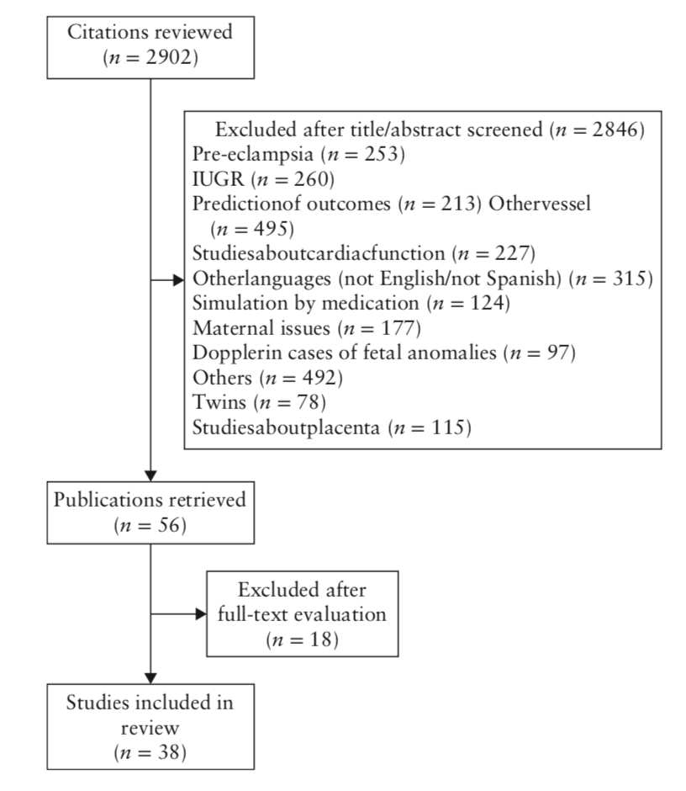
Reference ranges for Doppler indices of umbilical and fetal middle cerebral arteries and cerebroplacental ratio: systematic review
Oros et al., UOG 2019
Results
A total of 38 studies from 22 countries met the inclusion criteria and were included in the final analysis.
The median sample size of participating women was 206 (range, 13–2323; interquartile range (IQR), 70.75–675.25).
The median number of ultrasound examinations was 400 (range, 60–2323; IQR, 183.5–952).
The earliest included study was published in 1987 and the latest in 2016.
Notes:
*** The baseline characteristics table is now in the supp file which I don’t have access to.

Slide 10
Reference ranges for Doppler indices of umbilical and fetal middle cerebral arteries and cerebroplacental ratio: systematic review
Oros et al., UOG 2019
Results
Data collection was prospective in 34 studies, but in only 19 studies was data collection explicitly for research purposes.
Low-risk pregnancies were included in 22 (57.9%) studies.
Dopplers reported:
-UA and MCA Doppler reference ranges were reported in 30 and 19 studies, respectively.
-11 studies reported reference ranges for both UA and MCA.
-4 studies reported reference ranges for CPR.
-PI was reported in 31 studies.
-Resistance index in 22 studies.
-Systolic-diastolic ratio in 21 studies.
An equation for the mean and SD was reported in 23 of 38 studies, whereas printed charts of the median and centile curves were seen in 25 publications.

Slide 11
Reference ranges for Doppler indices of umbilical and fetal middle cerebral arteries and cerebroplacental ratio: systematic review
Oros et al., UOG 2019
Results
Overall mean quality score for the included studies was 51.4% (95% CI, 47.1–55.8%).
Quality scores for study design and statistical and reporting methods were 47.4% (95% CI, 42.6–52.1%) and 54.3% (95% CI, 48.8–59.7%), respectively.
The overall methodology score was similar for the studies focused on:
  -UA (median, 49.0%; range, 20.8 – 70.8%),
  -MCA (median, 55.0%; range, 29.1 – 79.1%),
  -CPR (median, 54.1%; range, 41.6–62.5%).
Year of publication (P = 0.506), sample size of participating women (P = 0.119), ultrasound examinations (P=0.215), study duration (P=0.251), teaching hospital (P=0.395), number of participating sites (P = 0.278) or number of sonographers (P = 0.447) were not significant predictors of quality score on univariate or multiple regression analysis.

Slide 12
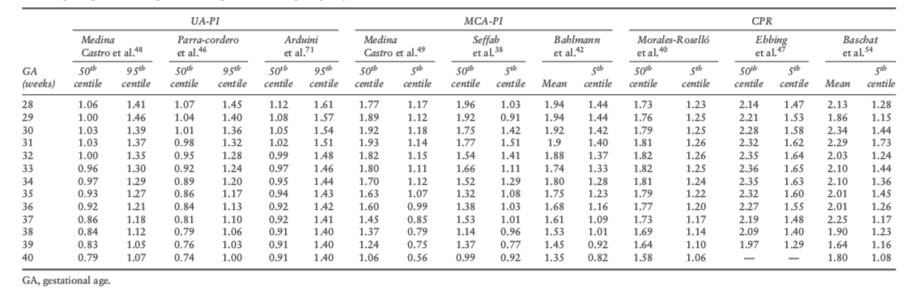
Reference ranges for Doppler indices of umbilical and fetal middle cerebral arteries and cerebroplacental ratio: systematic review
Oros et al., UOG 2019
Results
Despite high methodological quality, all studies reported quite variable reference ranges.

Slide 13
Reference ranges for Doppler indices of umbilical and fetal middle cerebral arteries and cerebroplacental ratio: systematic review
Oros et al., UOG 2019
Discussion
  There is considerable heterogeneity in the methodological quality of ultrasound studies aimed at creating reference ranges for UA and MCA Doppler indices and CPR.
  These differences may at least partly explain the differences in reported reference ranges and these may in turn explain some of the discrepancies seen in perinatal research based on Doppler.
  Even when assessing only those studies with the highest scores of methodological quality, clinical cut-offs varied significantly and could lead to important differences in clinical management, demonstrating that about 40–50% of fetuses may be misclassified by using one chart rather than another.
Study limitations
  Inclusion of studies published in only the English or Spanish language; it is possible that biological variations might account for differences in Doppler results.
Notes:
13

Slide 14
Reference ranges for Doppler indices of umbilical and fetal middle cerebral arteries and cerebroplacental ratio: systematic review
Oros et al., UOG 2019
Conclusion
This systematic review has identified many ultrasound studies with poor methodology and reporting of reference ranges for UA and MCA Doppler indices and CPR.
These should be taken into account in future studies and we recommend using a checklist of methodological good practices in further studies aimed at creating reference ranges for UA and MCA Doppler parameters and CPR.
Our aim was to recommend reference ranges for use in clinical services based on the lowest risk of methodological bias, however, even among these studies there are differences of clinical importance with what is considered normal and what is not; urgent research is needed to reach consensus on this issue or create charts of optimal quality for widespread use.

Slide 15
Reference ranges for Doppler indices of umbilical and fetal middle cerebral arteries and cerebroplacental ratio: systematic review
Oros et al., UOG 2019
Discussion points
Given the large variability between studies, perhaps Doppler indices change depending on the population.
It would be interesting to see whether the different Doppler ranges result in differences in the clinical outcome of the pregnancies.
Do fetal growth differences e.g. macrosomia change the Doppler range?
Notes:
15

