Slide 1

ISUOG World Congress 2024 Budapest
Venue floorplans
(subject to change)

Slide 2
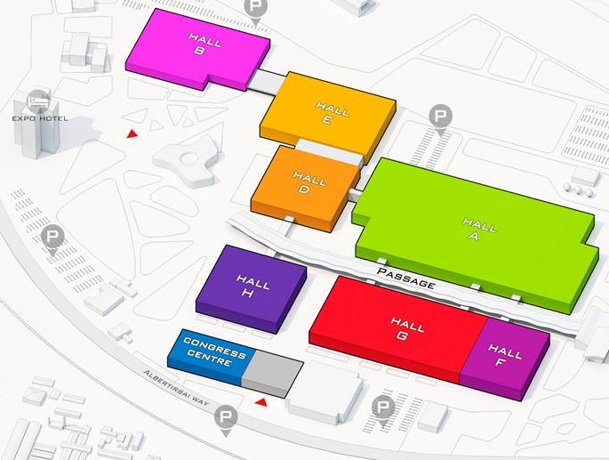

Venue: Hungexpo
Entrance – from Expo Hotel/by bus
Expo Hotel (staff/delegate hotel)
Not being used by ISUOG:
Hall A, B, D, E, F, G (delegates will not have access to these halls)
Session hall H
Session hall F1-3
Hospitality suites & access to mezzanine & plenary floors
Exhibition & catering & Forum (E 1-3)
Entrance - from street/taxis
Registration

Slide 3
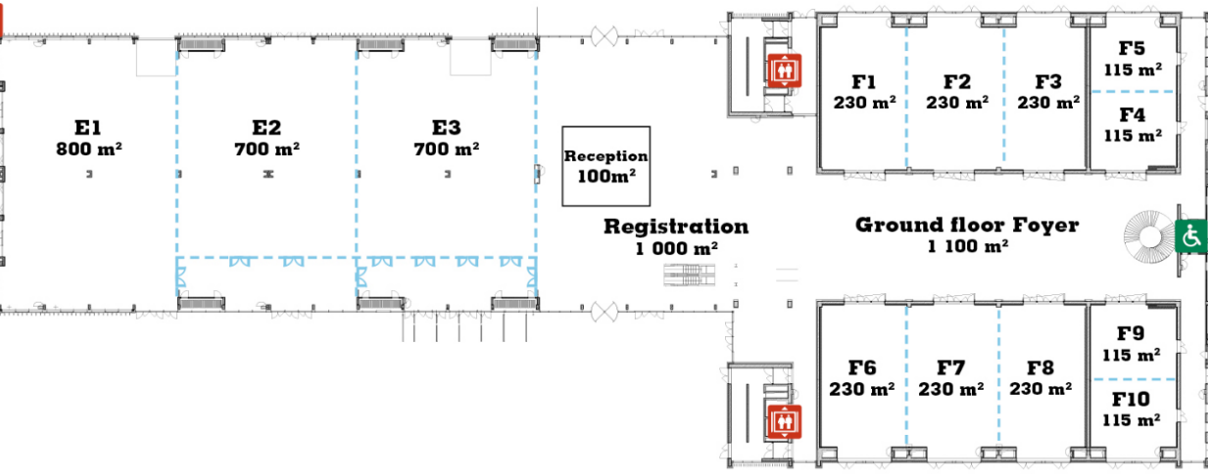
Key
Session halls/posters
Networking/industry areas
Registration, speaker preparation, Committee meeting room
Ground floor
Session hall H
Back of house:
Crew catering, registration office
Entrance
Prayer room (xx)
Lactation room (xx)
Toilets
Exhibition & catering & Forum
(E1-3)
Session hall F1-3
Canon hospitality suite (F4-5)
Catering overflow
Registration
Toilets
Voluson™ Club Lounge, GE HealthCare (F6)
Voluson™ Meet the Expert Sessions, GE HealthCare (F7)
Samsung hospitality suite (F8)
The SUITE Lounge, Samsung (F9-10)
Congress centre
Elevators
Entrance

Slide 4
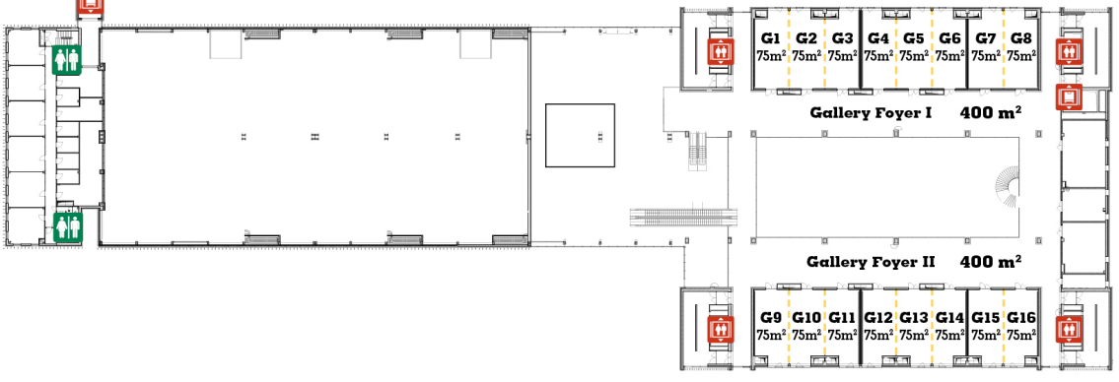
Gallery/mezzanine floor
Edit suite
ISUOG office
Gyne PCC (14 Sep)
After:
G4: Private (CEO/Governance)
G5: Model waiting room
G6: Meeting room
Speaker preparation (G1)
Committee meeting room
(G7-8)
Posters
Posters
Philips hospitality suite (G9-11)
SonoScape hospitality suite (G12-14)

Slide 5
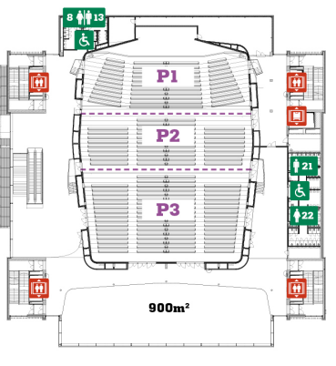
Plenary floor
Band back stage space
Scan demonstration area
Catering back-of-house
Session hall P1-2
Session hall P3
Day 2-3 only
Catering overflow

