Slide 1
UOG Journal Club: November 2016
Effects of intrauterine retention and postmortem interval on body weight following intrauterine death: implications for assessment of fetal growth restriction at autopsy
J Man, JC Hutchinson, M Ashworth, AE Heazell, S Levine and NJ Sebire Volume 47, Issue 11; Date: November, pages 574–578
Journal Club slides prepared by Dr Maddalena Morlando
(UOG Editor for Trainees)

Slide 2
Effects of intrauterine retention and postmortem interval on body weight following intrauterine death: implications for assessment of fetal growth restriction at autopsy
Man et al., UOG 2016
Depending on the classification system used, 15% to 60% of stillbirths remain unexplained, after autopsy examination.
Much of this difference is related to the variable attribution of fetal growth restriction (FGR) as a cause of death.
FGR implies pathological restriction of growth, whereas small-for-gestational age (SGA) simply describes an infant below an arbitrary centile (5th or 10th).
Distinguishing SGA from FGR is challenging, especially at postmortem examination, due to maceration from the period of retention within the uterus post-death - the intrauterine interval (IUI).
Furthermore, the period of time between delivery and postmortem examination - the postmortem interval (PMI) - may also vary.

Slide 3
Effects of intrauterine retention and postmortem interval on body weight following intrauterine death: implications for assessment of fetal growth restriction at autopsy
Man et al., UOG 2016
Objectives
1. To investigate the frequency of SGA among stillborn infants.
2. To address the role that secondary changes, such as fetal maceration, as a result of IUI and PMI, may have on the interpretation of birth weight.

Slide 4
Effects of intrauterine retention and postmortem interval on body weight following intrauterine death: implications for assessment of fetal growth restriction at autopsy
Man et al., UOG 2016
Methods
Detailed autopsy and antenatal details from intrauterine deaths between 2005-2013 at Great Ormond Street and St George’s Hospitals, London.
Neonatal growth charts published by the WHO were used to determine normal expected weight centiles for fetuses born ≥24 weeks’ gestation.
These data were used to determine the expected birth weight for gestation in each case, from which the delta birth weight value was calculated
Delta birth weight was expressed as number of standard deviations (SDs) by which the observed birth weight differed from the expected (50th centile) birth weight, adjusted for fetal sex.

Slide 5
Effects of intrauterine retention and postmortem interval on body weight following intrauterine death: implications for assessment of fetal growth restriction at autopsy
Man et al., UOG 2016
Results - SGA
Among a total of 1064 intrauterine death autopsies, there were 533 stillbirths delivered ≥24 weeks of gestation with a recorded birth weight.
Of these, 192 (36%) had an unadjusted birth weight <10th centile and were thus classified as SGA based on WHO live birth charts
Around half (n=90, 47%) of the cases of SGA had no other specific identifiable cause of death at autopsy.

Slide 6
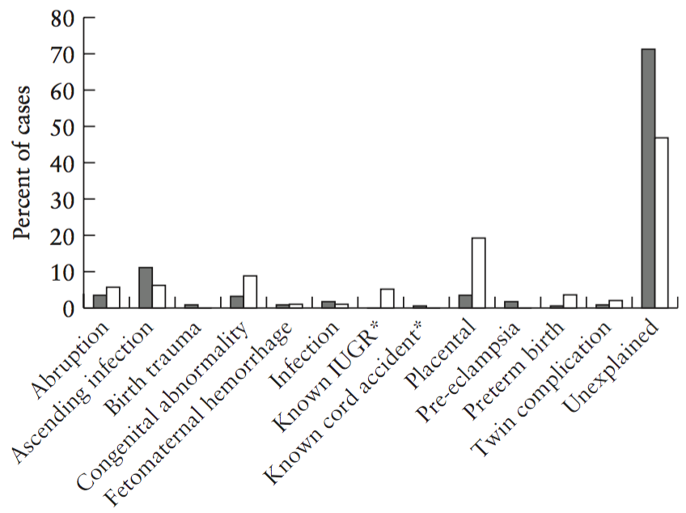
Effects of intrauterine retention and postmortem interval on body weight following intrauterine death: implications for assessment of fetal growth restriction at autopsy
Man et al., UOG 2016
Results - SGA
Ninety (27%) of the 335 cases of stillbirth with an otherwise unexplained cause of death and no pathological findings at autopsy were SGA.
The most common specific category of death was placental abnormality (19%), typical of pathological FGR and maternovascular malperfusion

Slide 7
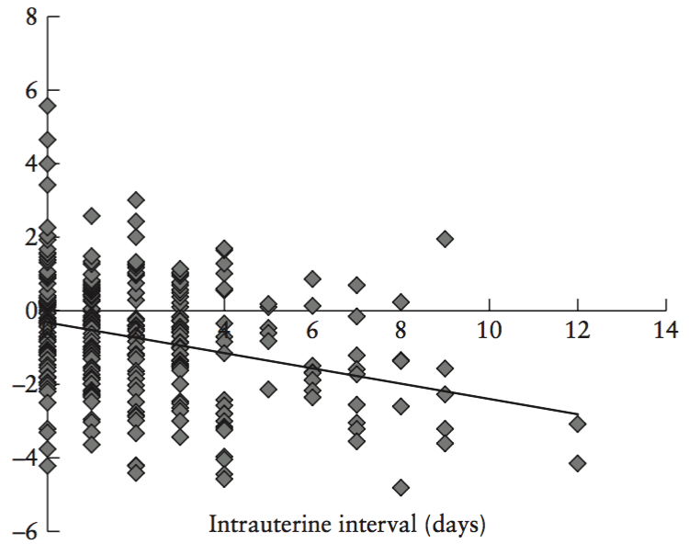
Effects of intrauterine retention and postmortem interval on body weight following intrauterine death: implications for assessment of fetal growth restriction at autopsy
Man et al., UOG 2016
Results - Maceration
86% of SGA vs 76% of non-SGA showed maceration (z=2.74, p=0.01).
Based on 308 cases ≥24 weeks, there was a significant linear relationship between IUI and delta birth weight (p<0.0001).
As IUI increased, delta birth weight decreased, indicating that, with increasing IUI, fetuses lose body weight in utero.

Slide 8
Effects of intrauterine retention and postmortem interval on body weight following intrauterine death: implications for assessment of fetal growth restriction at autopsy
Man et al., UOG 2016
Results - Maceration
During an average IUI of 3–4 days, there was an artifactual reduction by 0.8 SD of expected weight.
The proportion of SGA cases in stillbirths ≥ 24 weeks was
21% for 0 days IUI
30% for 1–2 days IUI
45% for >2 days IUI
There were significantly more fetuses with an IUI >2 days in the SGA group (z=3.01, p=0.003)
45%
30%
21%

Slide 9
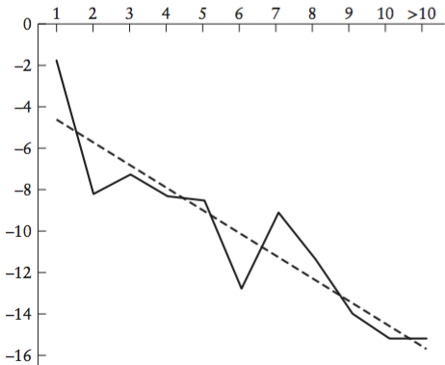
Effects of intrauterine retention and postmortem interval on body weight following intrauterine death: implications for assessment of fetal growth restriction at autopsy
Man et al., UOG 2016
Results – Postmortem interval
Based on 615 cases across all gestational ages, the percentage change in fetal weight during the period between birth and autopsy (PMI) was calculated.
There was an average 12% reduction in fetal weight during the period of fetal refrigeration pending autopsy, with a median PMI of 7 days.
As PMI increased, the proportion of fetal weight loss increased (P=0.0001).

Slide 10
Effects of intrauterine retention and postmortem interval on body weight following intrauterine death: implications for assessment of fetal growth restriction at autopsy
Man et al., UOG 2016
Conclusions
Based on unadjusted birth weight using standard infant weight charts, 36% of stillbirths ≥ 24 weeks of gestation are classified as SGA.
Fetuses lose weight in utero in relation to increasing IUI as the process of maceration occurs. After a delay between death and delivery of 3–4 days, there is an artifactual reduction in birth weight of around 0.8 SD.
Fetuses also lose weight between delivery and autopsy, even when refrigerated. By 7 days post-delivery there has been an additional 12% loss of body weight.
Using unadjusted birth weight there is erroneous overestimation of the proportion of SGA fetuses, and the likely true proportion of pathological FGR with SGA in stillborn infants is likely to be around 20% rather than 35%.

Slide 11
Effects of intrauterine retention and postmortem interval on body weight following intrauterine death: implications for assessment of fetal growth restriction at autopsy
Man et al., UOG 2016
Strengths
This is the first study to provide quantitative data regarding the effects of maceration. This is the largest dataset available presenting detailed stillbirth autopsy data collected and recorded in a dedicated research database.
Limitations
The retrospective nature of the study, an issue which is intrinsic to all studies of stillbirth, since this represents a rare event and hence is generally unsuitable for prospective studies to address reasonably.

Slide 12
Prevention of pre-eclampsia by low-molecular-weight
heparin in addition to aspirin: a meta-analysis
Roberge et al., UOG 2016
Discussion Points
How should we classify otherwise unexplained stillbirths with borderline autopsy biometric measurements?
How should we objectively identify FGR at autopsy regardless of fetal weight?
Would it ever been possible to correlate clinical and sonographic findings with a range of autopsy features?

Slide 13
UOG Journal Club: November 2016
Organ weights and ratios for postmortem identification of fetal growth restriction: utility and confounding factors
J Man, JC Hutchinson, M Ashworth, I Jeffrey, AE Heazell, and NJ Sebire Volume 48, Issue 5; Date: November, pages 585–590
Journal Club slides prepared by Dr Maddalena Morlando
(UOG Editor for Trainees)

Slide 14
Organ weights and ratios for postmortem identification of fetal growth restriction: utility and confounding factors
Man et al., UOG 2016
Guidelines regarding autopsy in stillborn infants recommend the weighing of all organs.
Intrauterine fetal growth restriction (FGR) has been suggested as a possible important contributor to stillbirth, but there are difficulties in establishing this diagnosis after death.
There are few published studies examining the effects of cause of intrauterine death on organ weights and hence the potential usefulness of organ weight metrics for determining cause or mode of death.
Postmortem brain:liver weight ratio is commonly used as a marker of nutrition in fetuses for diagnosis of FGR, but little information is available regarding effects of intrauterine retention, fetal maceration and postmortem interval on the brain:liver weight ratio.

Slide 15
Organ weights and ratios for postmortem identification of fetal growth restriction: utility and confounding factors
Man et al., UOG 2016
Objectives
To examine whether there are significant relationships between gestational-age-adjusted and sex-adjusted fetal organ weights at autopsy, and cause of intrauterine death and changes due to intrauterine retention.
To determine whether the brain:liver weight ratio is a reliable marker of FGR as the cause of intrauterine death.

Slide 16
Organ weights and ratios for postmortem identification of fetal growth restriction: utility and confounding factors
Man et al., UOG 2016
Methods
Detailed autopsy and antenatal details from intrauterine deaths between 2005 and 2013 at Great Ormond Street Hospital and St George’s Hospital, London.
Adjusted (delta) organ weights were calculated by plotting separately female and male brain, liver, thymus, heart, combined kidney, combined lung, spleen and combined adrenal gland weights against gestational age.
Polynomial regression was used to determine best fit and to calculate expected (50th centile) organ weights for sex and gestation.
Delta values for each organ were calculated as: (observed organ weight – expected organ weight)/SD, allowing comparison of organ weights between different clinical groups, gestational age and fetal sex.

Slide 17
Organ weights and ratios for postmortem identification of fetal growth restriction: utility and confounding factors
Man et al., UOG 2016
Methods
Adjusted organ weights and body:organ weight ratios were compared in fetuses that were SGA at autopsy vs fetuses that were not, and in macerated vs non-macerated fetuses.
SGA was defined as birth weight <10th centile of the expected normal range for fetal sex and gestational age (using WHO reference range).
Cause of death was assigned according to predefined objective criteria.
Maceration was recorded when macroscopic skin and soft tissue changes were identified by external examination at autopsy.

Slide 18
Organ weights and ratios for postmortem identification of fetal growth restriction: utility and confounding factors
Man et al., UOG 2016
Results - SGA
There were 1064 autopsies for investigation of intrauterine death.
The weights of the majority of organs in SGA fetuses were significantly lower than in non-SGA fetuses (all p<0.05).
Body:organ weight ratios were significantly greater in cases of SGA compared with non-SGA fetuses (p<0.001 for all), indicating that the thymus, liver and spleen were disproportionately small in SGA fetuses.

Slide 19
Organ weights and ratios for postmortem identification of fetal growth restriction: utility and confounding factors
Man et al., UOG 2016
Results - Maceration
The majority of organs were significantly lighter in macerated compared with non-macerated fetuses (p<0.01 for all).
Body:organ weight ratios for most organs were significantly greater in macerated compared with non-macerated fetuses (p<0.01 for all), demonstrating that macerated fetuses had disproportionately lighter organs compared with body weight.
Internal organs lose weight more than do the musculoskeletal elements of the body during the period of retention following intrauterine death.

Slide 20
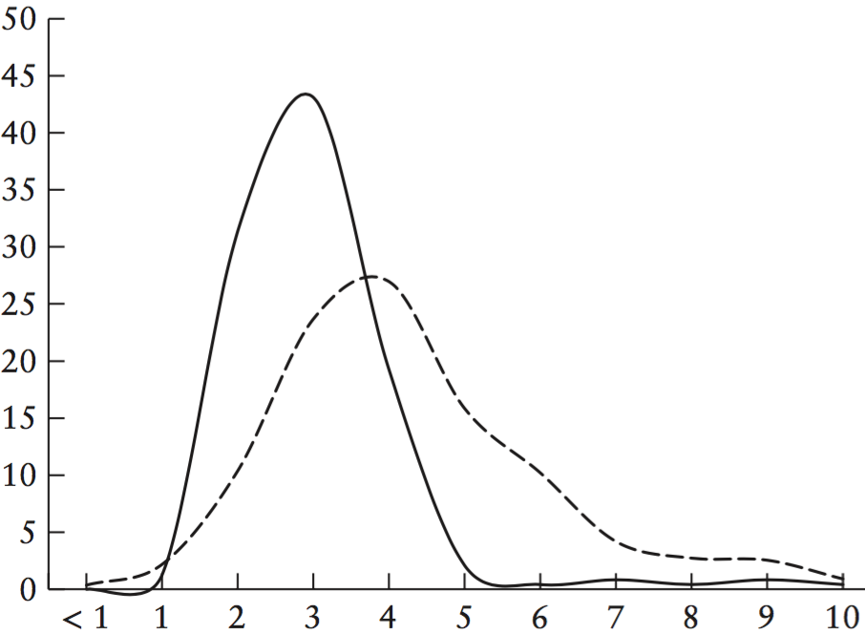
Organ weights and ratios for postmortem identification of fetal growth restriction: utility and confounding factors
Man et al., UOG 2016
Results - Maceration
The brain:liver weight ratio was significantly greater in macerated compared with non-macerated fetuses (P<0.0001).
With maceration, the fetal liver loses weight disproportionately relative to the brain.
In macerated fetuses the brain:liver weight ratio should be adjusted by 0.8 – 1 to take into account secondary effects of maceration.
no maceration
maceration

Slide 21
Organ weights and ratios for postmortem identification of fetal growth restriction: utility and confounding factors
Man et al., UOG 2016
Results
The brain:liver weight ratio was significantly greater in SGA fetuses compared with non-SGA fetuses (p<0.0001), indicating that the liver disproportionately fails to gain weight more than the brain in SGA.
However, when SGA cases were separated into cases with FGR-associated placental pathology and those without such placental changes, there was a significant difference in their brain:liver weight ratio (p<0.0001). Median (range), 6.10 (0.51 – 10.00) vs 3.58 (1.17 – 9.88)

Slide 22
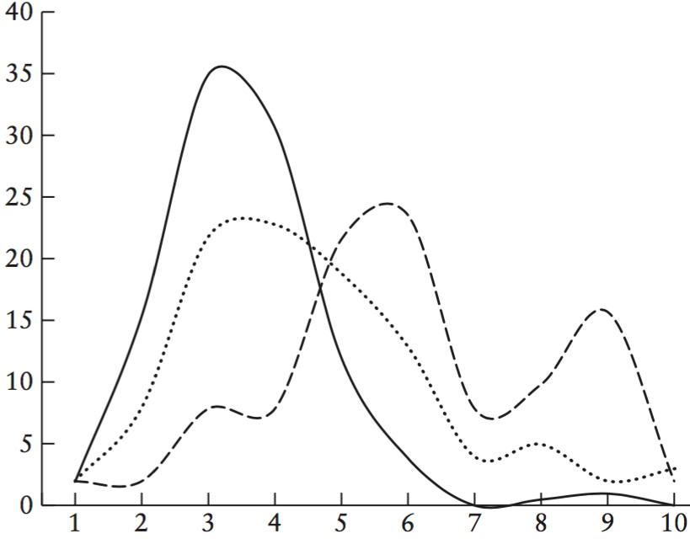
Organ weights and ratios for postmortem identification of fetal growth restriction: utility and confounding factors
Man et al., UOG 2016
Results
AGA
median value: 3
SGA
with placental cause of death
median value: 6
This indicates that ‘pathological’ SGA (FGR) due to placental pathology is associated with lighter livers in relation to brain compared with SGA cases without placental abnormalities.
SGA
with NO placental pathology
median value: 3

Slide 23
Organ weights and ratios for postmortem identification of fetal growth restriction: utility and confounding factors
Man et al., UOG 2016
Results
A brain:liver weight ratio of 6 differentiated placental FGR from SGA without significant placental pathology, with a sensitivity of 53% and specificity of 80%.
A brain:liver weight ratio of 6 would identify SGA with placental disease vs all other causes of death with a sensitivity of 55% and specificity of 92%.
However, there was no brain:liver weight ratio that absolutely distinguished these groups; some cases of ‘placental FGR’ had a brain:liver ratio of 2–3, whilst some cases with no evidence of placental disease or other pathology had ratios > 6.

Slide 24
Organ weights and ratios for postmortem identification of fetal growth restriction: utility and confounding factors
Man et al., UOG 2016
Conclusions
Changes with intrauterine retention after death lead to loss of fetal weight, with preferential weight loss of visceral organs such as the liver.
Maceration affects the brain:liver weight ratio and adjustment should be made for such changes during interpretation of ratios.
The brain:liver weight ratio in non-SGA fetuses has a median normal value of around 2.5–3 but the normal range extends to 5.
The brain:liver weight ratio can be used to distinguish non-FGR-SGA from FGR, and intrauterine deaths with placental pathologies from other causes of death, with a ratio of 6 providing optimal sensitivity and specificity. However, there is no ratio value that identifies FGR unequivocally.

Slide 25
Organ weights and ratios for postmortem identification of fetal growth restriction: utility and confounding factors
Man et al., UOG 2016
Strengths
This is the first study to provide quantitative data regarding the effects of maceration. This is the largest dataset available (five times larger than that of the previous largest study) presenting detailed stillbirth autopsy data collected and recorded in a dedicated research database. This is the first study to evaluate pathologically determined mechanisms in SGA fetuses rather than using weight < 10th centile as an ‘outcome’.
Limitations
The retrospective nature of the study, an issue which is intrinsic to all studies of stillbirth, since this represents a rare event and hence is generally unsuitable for prospective studies to address reasonably.

Slide 26
Organ weights and ratios for postmortem identification of fetal growth restriction: utility and confounding factors
Man et al., UOG 2016
Discussion Points
The association between organ weight ratios and placental findings, demonstrates the presence of FGR. How can we prove that FGR was the cause of death?
As we are erroneously overestimating the frequency of pathological FGR, how should we objectively identify FGR at autopsy regardless of fetal weight?
Would it ever be possible to correlate clinical and sonographic findings with a range of autopsy features?

