Slide 1

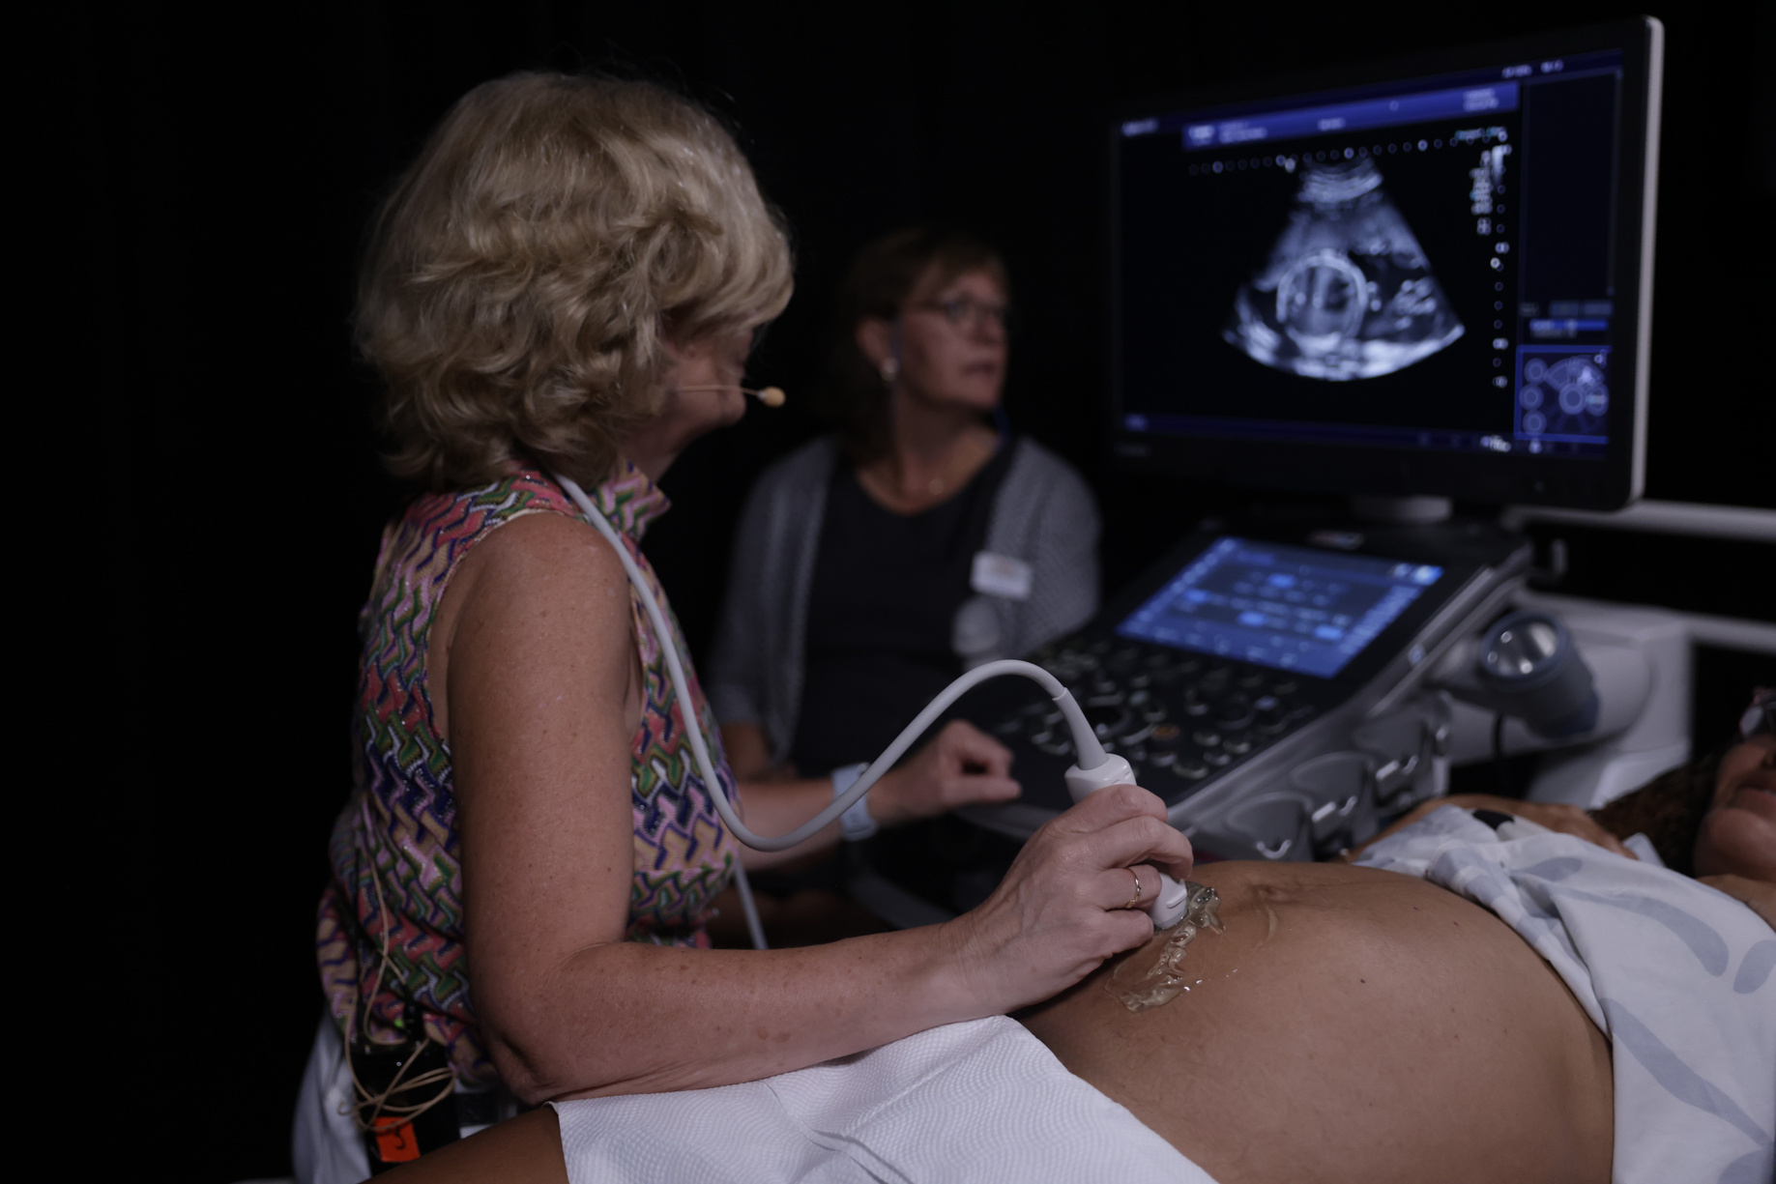
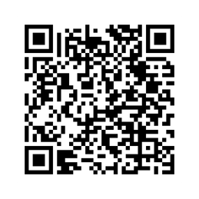
Attend the 36th ISUOG World Congress to:
36TH ISUOG WORLD CONGRESS
ON ULTRASOUND IN OBSTETRICS & GYNECOLOGY
Immerse yourself in our 4-day scientific program. ​
Hear the latest updates from world-renowned experts. ​
Share knowledge, ideas and expertise that relates to your practice. ​
Network with your professional peers from around the world.​
LONDON, UK 4-7 SEPTEMBER 2026
98% of 2025 attendees would recommend the Congress to a colleague.
Discounted rates are available for ISUOG members, trainees, sonographers, abstract submitters and those residing in non-high-income countries.
EARLY-BIRD DEADLINE
6 JULY 2026
Deadline will not be extended*
REGISTER NOW

