Slide 1
UOG Journal Club: April 2018
Effectiveness of 12–13-week scan for early diagnosis of fetal congenital anomalies in the cell-free DNA era
M. J. A. KENKHUIS, M. BAKKER, F. BARDI, F. FONTANELLA, M. K. BAKKER,
J. H. FLEURKE-ROZEMA and C. M. BILARDO
Volume 51, Issue 4, pages 463–469
Journal Club slides prepared by Dr Fiona Brownfoot
(UOG Editor for Trainees)

Slide 2
Effectiveness of 12–13-week scan for early diagnosis of fetal congenital anomalies in the cell-free DNA era
Kenkhuis et al., UOG 2018
Introduction
Non-invasive whole-genome sequencing (cell-free DNA testing) is being offered as a primary screening test for aneuploidy in The Netherlands.
As this screening test does not require a 12-week ultrasound assessment, the relevance of this scan is being questioned.
This article seeks to explore the relevance of the 12–13-week ultrasound by assessing the proportion of congenital anomalies detected at 12–13 weeks compared with those detected at the 20-week ultrasound.
Notes:
2

Slide 3
Effectiveness of 12–13-week scan for early diagnosis of fetal congenital anomalies in the cell-free DNA era
Kenkhuis et al., UOG 2018
Aim of the study
To examine the proportion and type of congenital anomalies, both chromosomal and structural detected by an early scan (12–13 weeks’ gestation; new strategy), compared with the 20-week scan (current strategy).
Secondary aims were to evaluate the incidence of false-positive findings and ultrasound markers at both scans, and parental choice regarding termination of pregnancy (TOP).
Notes:
3

Slide 4
Effectiveness of 12–13-week scan for early diagnosis of fetal congenital anomalies in the cell-free DNA era
Kenkhuis et al., UOG 2018
Methods
Study design
Prospective, observational, multicenter.
Setting
Two hospitals (University Medical Centre in Groningen and Isala Hospital in Zwolle) and six ultrasound practices in the provinces of Groningen and Overijssel, The Netherlands.
Participants
Women opting for combined testing or women with an increased a-priori risk of congenital anomalies (positive family history, diabetes etc) were offered a 12–13-week scan and enrolled in this study between November 2012 and December 2015.

Slide 5
Effectiveness of 12–13-week scan for early diagnosis of fetal congenital anomalies in the cell-free DNA era
Kenkhuis et al., UOG 2018
Methods
12–13-week ultrasound
Scans were performed transabdominally unless the transvaginal route was preferred or considered necessary.
All sonographers underwent additional training to improve their skills
The anatomical survey was performed following a structured protocol aimed at diagnosing severe anomalies considered ‘not to be missed’.
For each scan an extra 15 min was scheduled, in addition to the 30 min allocated for the combined testing.
20-week ultrasound
All women were offered a 20-week anomaly scan as part of the usual care.

Slide 6
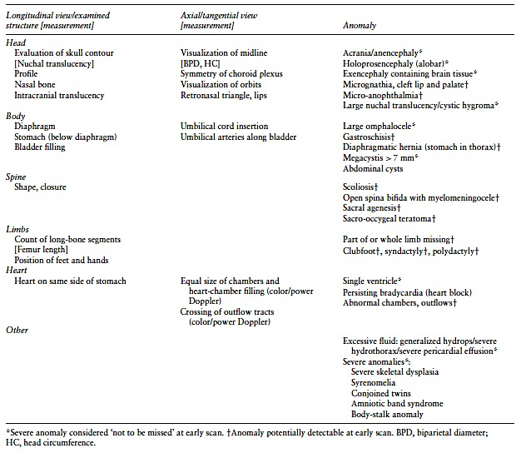
Effectiveness of 12–13-week scan for early diagnosis of fetal congenital anomalies in the cell-free DNA era
Kenkhuis et al., UOG 2018
Structures that should be investigated and anomalies that should be seen at the 12–13-week scan.

Slide 7
Effectiveness of 12–13-week scan for early diagnosis of fetal congenital anomalies in the cell-free DNA era
Kenkhuis et al., UOG 2018
Methods
Data extraction
All study data were extracted from local databases.
Data collection
Pregnancy outcomes were obtained from the hospital databases, returned follow-up forms provided to patients or referring midwives and physicians.
Outcome
The outcome measure was diagnosis of congenital anomalies at the 12-13 week ultrasound compared with diagnosis at the 20 week ultrasound.

Slide 8
Effectiveness of 12–13-week scan for early diagnosis of fetal congenital anomalies in the cell-free DNA era
Kenkhuis et al., UOG 2018
Results
Baseline characteristics
5534 women were included in this study: 5237 opted for the first-trimester combined screening and 297 were at increased risk of fetal anomalies
Primary outcome
Structural anomalies: 51 structural anomalies were diagnosed in chromosomally normal fetuses, 45.1% at the 12–13-week scan and 54.9% at the 20-week scan.
Chromosomal anomalies: 34 chromosomal anomalies were diagnosed. In 97.1% (33/34) of these, the NT or combined test were abnormal and in 91.2% (31/34) the diagnosis was made in the first trimester.
Notes:
*** The baseline characteristics table is now in the supp file which I don’t have access to.

Slide 9
Effectiveness of 12–13-week scan for early diagnosis of fetal congenital anomalies in the cell-free DNA era
Kenkhuis et al., UOG 2018
Results
Secondary outcomes
False-positives (anomaly not detected in a subsequent scan) were found in:
0.1% (5/5534) at 12–13-weeks and 0.6% (30/5014) at 20-weeks.
Isolated ultrasound markers were observed in:
0.6% (31/5534) at 12–13-weeks and 3.0% (152/5014) at 20-weeks.
Pregnancy outcomes:
Spontaneous pregnancy loss occurred in 37/5534 (0.7%) cases.
Of the cases with anomalies, parents opted for TOP in 91.2% (31/34) of pregnancies with chromosomal anomalies and 43.1% (22/51) of pregnancies with structural anomalies.
The majority of terminations for structural anomaly followed a diagnosis at 12–13-week scan (65.2%) compared with diagnosis at the 20-week scan (25%).
Notes:
*** The baseline characteristics table is now in the supp file which I don’t have access to.

Slide 10
Effectiveness of 12–13-week scan for early diagnosis of fetal congenital anomalies in the cell-free DNA era
Kenkhuis et al., UOG 2018
Discussion
Findings
A 12–13-week ultrasound assessment can detect 63.5% of the prenatally diagnosed anomalies with a false-positive rate of 0.1%, compared with 36.4% of anomalies at the 20-week scan with false-positive rate of 0.6%.
Termination rate after first- and second-trimester diagnosis of an anomaly was 83.3% and 26%, respectively.
Study limitations
Sonographers had extra training and required additional time to perform the 12–13-week scan. It would be interesting to see whether the anomaly detection rate would be similar if ultrasounds were performed by a general sonographer population.
Notes:
10

Slide 11
Effectiveness of 12–13-week scan for early diagnosis of fetal congenital anomalies in the cell-free DNA era
Kenkhuis et al., UOG 2018
Discussion
Implications for practice
The 12–13-week ultrasound will detect 40-50% of structural anomalies and a large proportion of these pregnancies will undergo termination.
50% of pregnancies with an elevated nuchal translucency had associated structural anomalies, confirming its value as a marker of abnormal development.
Conclusion
Implications for practice
A high proportion of fetal anomalies will be detected at 12–13 weeks gestation and participants are highly likely to terminate the pregnancy.

Slide 12
Effectiveness of 12–13-week scan for early diagnosis of fetal congenital anomalies in the cell-free DNA era
Kenkhuis et al., UOG 2018
Discussion points
Should the non-invasive perinatal testing be postponed until after the 12–13-week ultrasound scan as patients with fetuses with anomalies may opt to terminate?
If the early scan is accurate at diagnosing certain structural anomalies, could the 20-week ultrasound be targeted to the brain and heart which are developing organs in which findings at the earlier scan are not possible or are often missed?
Notes:
12

