Slide 1



UOG Journal Club: September 2018
Longitudinal growth assessment for prediction of adverse perinatal outcome in fetuses suspected to be small-for-gestational age
Caradeux J, Eixarch E, Mazarico E, Basuki TR, Gratacos E, Figueras F
Volume 52, Issue 3, pages 325–331
Journal Club slides prepared by Dr Erkan Kalafat
(UOG Editor for Trainees)

Slide 2
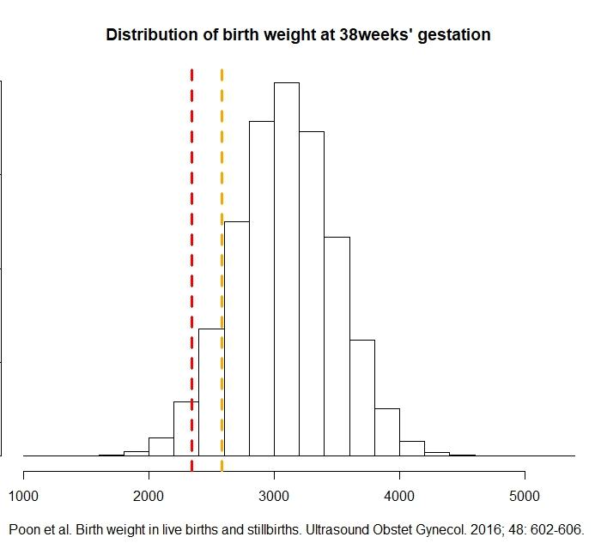
Longitudinal growth assessment for prediction of adverse perinatal outcome in fetuses suspected to be small-for-gestational age
Caradeux et al., UOG 2018
Introduction
Fetal growth restriction (FGR) is an indicator of adverse pregnancy outcome including stillbirth, intrapartum fetal compromise, perinatal morbidity and mortality.
Depending on the definition & cut-off used, 3–10% of all pregnancies would appear to be at risk.
Yet the incidence of adverse outcome is much smaller.
10% of the population under risk (cutoff= 2579 gr )
3% of the population under risk
(cutoff = 2342 gr )

Slide 3

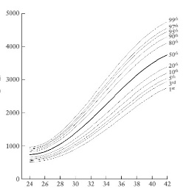
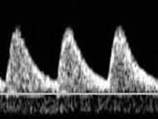
Longitudinal growth assessment for prediction of adverse perinatal outcome in fetuses suspected to be small-for-gestational age
Caradeux et al., UOG 2018
Introduction
Late FGR definition*
There is a need for adjunct markers to identify small-for-gestational-age (SGA) fetuses at greater risk of adverse outcome.
Doppler parameters such as umbilical artery (UA) pulsatility index (PI) or cerebroplacental ratio (CPR) have been suggested as candidates.
Growth velocity has also been implicated as a marker for adverse outcome.
Abdominal circumference (AC) Estimated fetal weight (EFW) < 3rd centile
OR
two of the following
UA-PI > 95th CPR < 5th
AC/EFW crossing centiles > 2 quartiles on growth centiles
AC/EFW < 10th centile
*Gordijn et al. Consensus definition of fetal growth restriction: a Delphi procedure. Ultrasound Obstet Gynecol. 2016; 48: 333-339.

Slide 4
Longitudinal growth assessment for prediction of adverse perinatal outcome in fetuses suspected to be small-for-gestational age
Caradeux et al., UOG 2018
Study Aim
To evaluate the utility of longitudinal assessment by means of estimated fetal weight (EFW) change in velocity for the prediction of adverse perinatal outcome in suspected late-SGA fetuses.
Inclusion criteria
Exclusion criteria
EFW < 10th centile according to local reference values (customized growth chart).
FGR diagnosis made after 32 weeks’ gestation.
Congenital malformation, including chromosomal aneuploidy, infection or maternal use of an illicit substance.

Slide 5
Longitudinal growth assessment for prediction of adverse perinatal outcome in fetuses suspected to be small-for-gestational age
Caradeux et al., UOG 2018
Methods
Study center: Fetal i+D Fetal Medicine Research Center, Barcelona.
Recruitment period: 2008–2016.
Local screening protocol:
Low risk for FGR (fundal-height measurement)
If diagnosed
with late FGR during screening, invite for participation in the study
26w
32w – 34w
High risk for FGR (serial ultrasound)
28w
32w
37w

Slide 6
Longitudinal growth assessment for prediction of adverse perinatal outcome in fetuses suspected to be small-for-gestational age
Caradeux et al., UOG 2018
Study follow-up protocol
1 week
2 weeks
Doppler
Doppler
Doppler
EFW & Doppler
EFW & Doppler
Enrolled in study
Suspected late FGR
(EFW < 10th centile
diagnosed > 32 weeks)
Induction at 37 weeks if CPR (< 5th) measured twice (12 h apart). Induction at 40w otherwise.
Doppler / every week
EFW / every 2 weeks

Slide 7
Longitudinal growth assessment for prediction of adverse perinatal outcome in fetuses suspected to be small-for-gestational age
Caradeux et al., UOG 2018
Outcome measures
Adverse perinatal outcome (Primary)
Non-reassuring fetal status requiring emergency Cesarean section.
5-min Apgar score < 7 or neonatal metabolic acidosis at birth (defined as presence of pH ≤ 7.10 and base excess > 12 mEq/L at birth).
Need for admission to neonatal intensive care unit.
Perinatal death.
Adverse neonatal outcome (Auxillary)
Neonatal intensive care unit for neonatal hypoglycemia (defined as a plasma glucose level of < 30 mg/dL in the first 24 h postpartum).
Neonatal hyperbilirubinemia (defined as a peak serum concentration > 95th centile).
Transient tachypnea (defined as onset of tachypnea (> 60/min) within 6 h after birth with any of the following: expiratory grunting, flaring of the nostrils or costal retractions).

Slide 8
Longitudinal growth assessment for prediction of adverse perinatal outcome in fetuses suspected to be small-for-gestational age
Caradeux et al., UOG 2018
Results

Slide 9
Longitudinal growth assessment for prediction of adverse perinatal outcome in fetuses suspected to be small-for-gestational age
Caradeux et al., UOG 2018
Results
Statistically significant differences between study groups:
GA at delivery.
EFW z-score at diagnosis.
EFW z-score at last ultrasound.
Uterine, umbilical and middle cerebral artery PI z-scores.
CPR z-score.
EFW z-velocity in lowest decile.
FGR and SGA incidence.

Slide 10
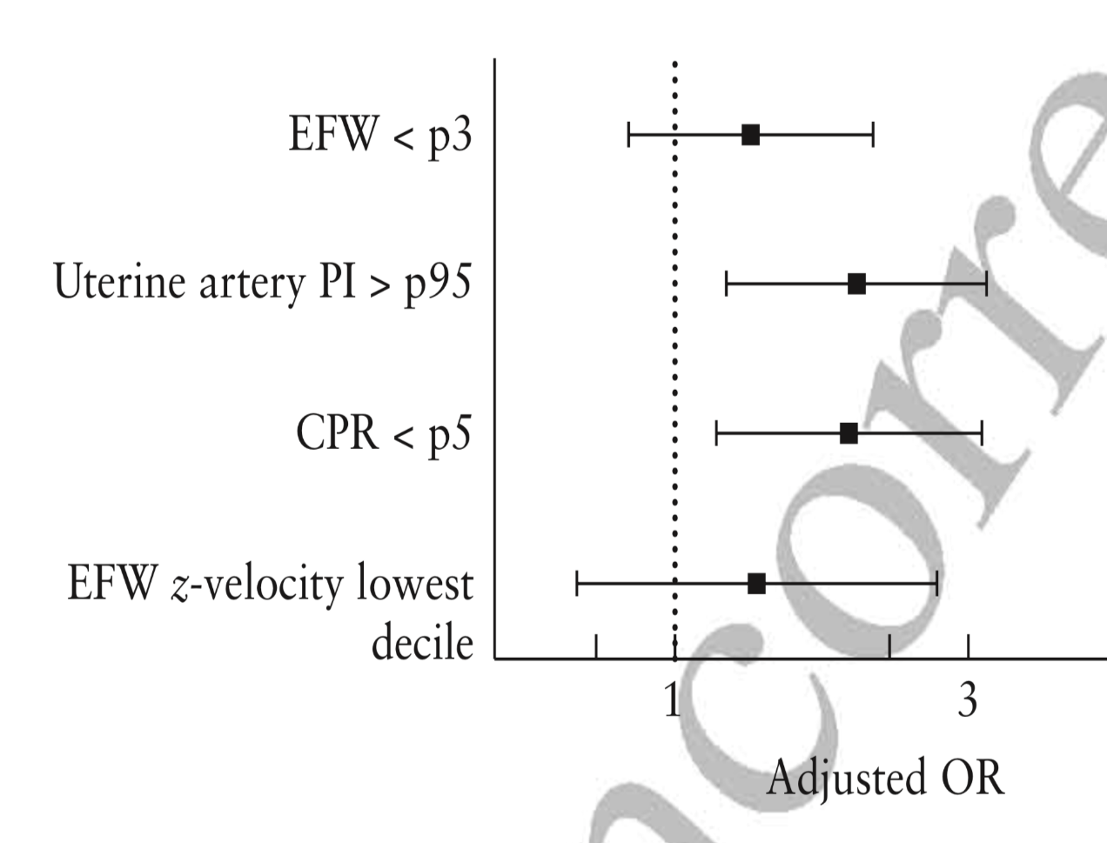
Longitudinal growth assessment for prediction of adverse perinatal outcome in fetuses suspected to be small-for-gestational age
Caradeux et al., UOG 2018
Results
OR: 1.36 (0.85–2.19) | P = 0.204
OR: 2.05 (1.24–3.40) | P = 0.005
OR: 2.00 (1.19–3.35) | P = 0.009
OR: 1.39 (0.69–2.81) | P = 0.354
Statistically significant
Results of multivariate logistic regression model:
According to adjusted ORs only, UA-PI > 95th and CPR < 5th were independently associated with adverse outcome.

Slide 11
Longitudinal growth assessment for prediction of adverse perinatal outcome in fetuses suspected to be small-for-gestational age
Caradeux et al., UOG 2018
Results
Results of multivariate logistic regression models:
Whether Doppler parameters were used as continuous or categorical variables, the significance of the results did not change across different models.
Fetal growth parameters (EFW or growth velocity) did not attain statistical significance.

Slide 12
Longitudinal growth assessment for prediction of adverse perinatal outcome in fetuses suspected to be small-for-gestational age
Caradeux et al., UOG 2018
Discussion
What do we know already?
Fetal growth velocity is implicated as a marker of adverse outcome and it was included as an auxiliary criterion for late FGR diagnosis in a recent Delphi consensus by Gordijn et al..
The literature is conflicted about the value of growth velocity in improving the detection of adverse outcome and also about how best to evaluate growth velocity (conditional growth, growth rate or velocity, individualized growth trajectories).
The studies of Sovio et al. and Karlsen et al. suggest growth velocity may improve the detection of adverse outcome in suspected SGA fetuses.
However, the value of growth velocity in addition to Doppler assessment has been scarcely evaluated.
What are the implications of current study?
Fetal growth velocity may not improve the detection of adverse perinatal outcome in suspected late FGR fetuses when used in addition to Doppler evaluation.

Slide 13
Longitudinal growth assessment for prediction of adverse perinatal outcome in fetuses suspected to be small-for-gestational age
Caradeux et al., UOG 2018
Strong points and limitations
Strengths
Prospective design limits the effect of intervention bias and also allows interpreting its impact on the results.
Largest published cohort so far which had longitudinal assessment.
Limitations
Results only apply to late FGR and not early FGR.
Longitudinal assessment only took two measurements into account (first and last).
Effect of longitudinal change was only evaluated via z-velocity change (more methods are available).
The effect of maternal characteristics was not evaluated.
Abdominal circumference change velocity was not evaluated.

Slide 14
Longitudinal growth assessment for prediction of adverse perinatal outcome in fetuses suspected to be small-for-gestational age
Caradeux et al., UOG 2018
Conclusion
Longitudinal assessment of fetal growth by means of EFW z-velocity does not add value to Doppler criteria in predicting adverse perinatal outcome in SGA-suspected fetuses.

Slide 15
Longitudinal growth assessment for prediction of adverse perinatal outcome in fetuses suspected to be small-for-gestational age
Caradeux et al., UOG 2018
Discussion Points
Considering that ultrasound measurements (biometry or Doppler) are subject to inter- and intra-rater variability and that short scanning intervals can lead to false-positive results:
What is the ideal time frame for scanning intervals?
What are the best methods for longitudinal assessment of fetal growth (growth velocity, conditional centiles, etc)?
What is the possible effect of intervention bias (delivering according to a study protocol or unblinded assessment) on results?

