Slide 1



UOG Journal Club: January 2020
Comparative analysis of 2-year outcomes in GRIT and TRUFFLE trials
W. GANZEVOORT, J. G. THORNTON, N. MARLOW, B. THILAGANATHAN,
B. ARABIN, F. PREFUMO, C. LEES and H. WOLF,
for the GRIT Study Group and the TRUFFLE Study Group
Volume 55, Issue 1, pages 68–74
Journal Club slides prepared by Dr Alessandra Familiari
(UOG Editor for Trainees)

Slide 2
Comparative analysis of 2-year outcomes in GRIT and TRUFFLE trials
Ganzevoort w et al, UOG 2020
Introduction
There is uncertainty over the optimal indication for timing of delivery in early-onset fetal growth restriction (FGR).
Trials in this patient group are challenging to conduct because of the high risk of adverse pregnancy outcome.
Only two large randomized trials have evaluated timing of delivery in early-onset preterm FGR: the Growth Restriction Intervention Study (GRIT) and the Trial of Umbilical and Fetal Flow in Europe (TRUFFLE).
An individual patient data meta-analysis (IPD-MA) would be the optimal solution to analyze the existing data from these two large cohorts.
Notes:
2

Slide 3
Comparative analysis of 2-year outcomes in GRIT and TRUFFLE trials
Ganzevoort w et al, UOG 2020
Aim of the study
The objective of this study was to evaluate and compare
the effect on perinatal outcome of different fetal monitoring strategies for early-onset FGR employed in GRIT and TRUFFLE, in order to identify the optimal method for fetal monitoring in these high-risk pregnancies.
Notes:
3

Slide 4
Comparative analysis of 2-year outcomes in GRIT and TRUFFLE trials
Ganzevoort w et al, UOG 2020
Methods
Individual cohort study
Differences in inclusion criteria and study period between the two trials precluded an IPD-MA so a cohort analysis of individual participant data from the GRIT and TRUFFLE studies was performed.
Women were grouped according to intervention and monitoring methodinto: immediate delivery (GRIT) or delayed delivery with monitoring with conventional cardiotocography (CTG), or computerized CTG (cCTG) only (GRIT and TRUFFLE), or cCTG and ductus venosus (DV) Doppler (TRUFFLE). All women randomized between 26 and 32 weeks’ were included.
Primary Outcome
Survival without neurodevelopmental impairment (NDI) at 2 years of age.

Slide 5
Comparative analysis of 2-year outcomes in GRIT and TRUFFLE trials
Ganzevoort w et al, UOG 2020
Results
238 women from GRIT and 502 women from TRUFFLE were included.
Gestational age at inclusion and at delivery, and birth weight, were similar between all subgroups.
More women had absent or reversed end-diastolic (ARED) flow at study entry in GRIT than in TRUFFLE (70% vs 41%; P < 0.01). If later measurements were included, rates of umbilical artery ARED flow were comparable between the groups (64% on average).
Because the study periods of GRIT and TRUFFLE differed (1993–2001 vs 2005–2010) and study period and monitoring strategy were strongly associated, it was not appropriate to combine these in one regression analysis, thus separate regression analyses for monitoring method and for year of inclusion were performed.

Slide 6
Comparative analysis of 2-year outcomes in GRIT and TRUFFLE trials
Ganzevoort w et al, UOG 2020
Results
The interval to delivery was shorter in the GRIT delayed-delivery groups than in the TRUFFLE groups (median 3 days vs 8 days; P < 0.01).
Fetal death rate was comparable between GRIT and TRUFFLE, but neonatal or late death was more frequent in GRIT (18% vs 6%; P < 0.01).
Fetal death rate was similar in women monitored by conventional CTG and in those monitored by cCTG in GRIT (4.8% vs 5.5%), but perinatal mortality was lower in the GRIT cCTG group (13% vs 23%), although the difference did not reach statistical significance.
The rate of survival without NDI at 2 years was lowest in the immediate-delivery group and in pregnancies monitored by CTG without STV, with a higher rate in the cCTG groups and the highest rate in the cCTG + DV Doppler group.
Notes:
6

Slide 7
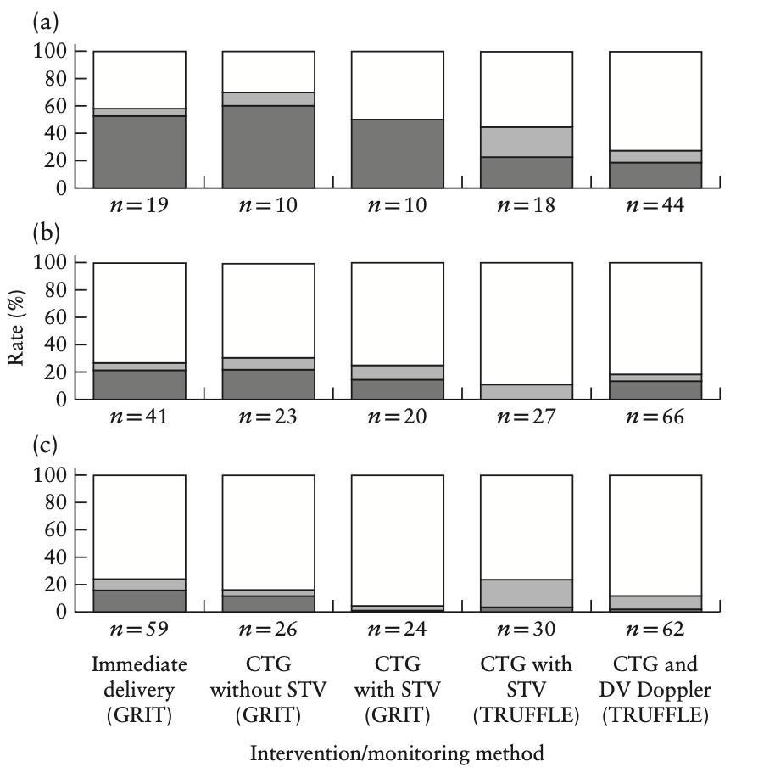
Comparative analysis of 2-year outcomes in GRIT and TRUFFLE trials
Ganzevoort w et al, UOG 2020
Results
Rates of normal development (white), NDI (light grey) and perinatal death (dark grey ) by 2 years of age in children born from pregnancies complicated by early-onset FGR included in GRIT and TRUFFLE studies, randomized at:
(a)26–27 weeks,
(b) 28–29 weeks,
(c) 30–31 weeks,
according to intervention/
monitoring method.
STV, short-term variation in fetal heart rate.

Slide 8
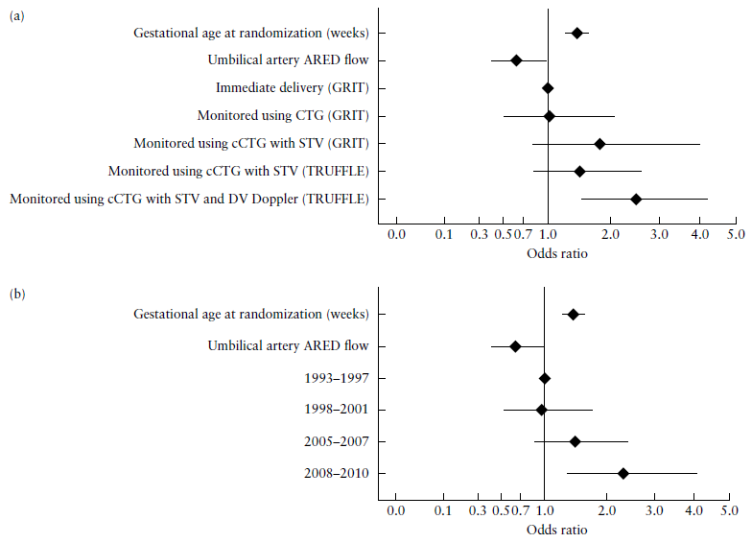
Comparative analysis of 2-year outcomes in GRIT and TRUFFLE trials
Ganzevoort w et al, UOG 2020
Results
Odds ratios for survival without NDI at 2 years in children born from pregnancies complicated by early-onset FGR included in GRIT and TRUFFLE studies, calculated using multivariable regression model including (a) intervention/monitoring method (AUC, 0.69 (95% CI, 0.64–0.74)); (b) year of
inclusion (AUC, 0.68 (95% CI, 0.63–0.73)).

Slide 9
Comparative analysis of 2-year outcomes in GRIT and TRUFFLE trials
Ganzevoort w et al, UOG 2020
Discussion
The rate of survival without NDI at 2 years was highest in the group of fetuses monitored by cCTG + DV Doppler.
A decreasing perinatal death rate was observed across the groups at different gestational ages at inclusion, which was most apparent for those included at the lowest gestational age (26–27 weeks).
Additional parameters associated significantly with survival without NDI at 2 years were gestational age at randomization, umbilical artery ARED flow, birth weight and birth-weight Z-score.
Notes:
9

Slide 10
Comparative analysis of 2-year outcomes in GRIT and TRUFFLE trials
Ganzevoort w et al, UOG 2020
Strengths and limitations
This is the first work providing a comparative analysis of the effect on perinatal outcome of different monitoring techniques for early-onset FGR in the two existing randomized controlled trials (GRIT and TRUFFLE).
A limitation of the study is that it was not possible to perform an IPD-MA.
Conclusion
This analysis supports the idea that the optimal method for fetal monitoring in pregnancies complicated by early-onset FGR is a combination of cCTG and DV Doppler assessment.

Slide 11
Comparative analysis of 2-year outcomes in GRIT and TRUFFLE trials
Ganzevoort w et al, UOG 2020
Discussion points
Does this paper change the present clinical practice in managing early-onset FGR pregnancies?
Should we rely first of all on the gestational age at diagnosis and the presence of umbilical artery ARED flow when planning the correct strategy of monitoring a FGR fetus?
Given the superiority of cCTG over conventional CTG for FGR, should we consider using the latter in all pregnancies?
Is a study needed to better define cCTG and DV criteria for delivery?
There is a need of an interventional trial taking into account fixed strategies and data regarding important factors such as corticosteroid and magnesium sulfate administration. Do these factor have an impact on decision-making ?
Notes:
11

