Slide 1
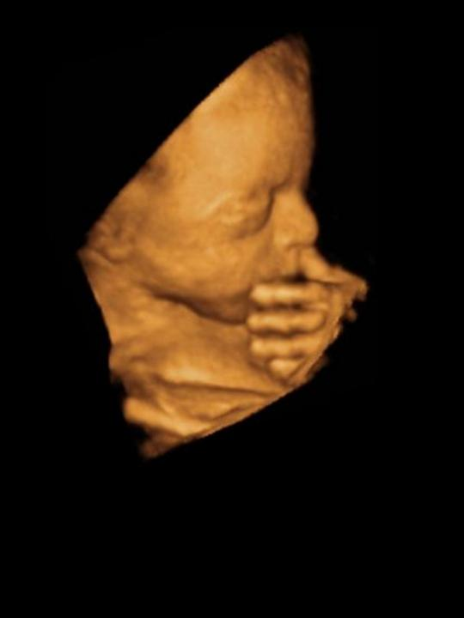
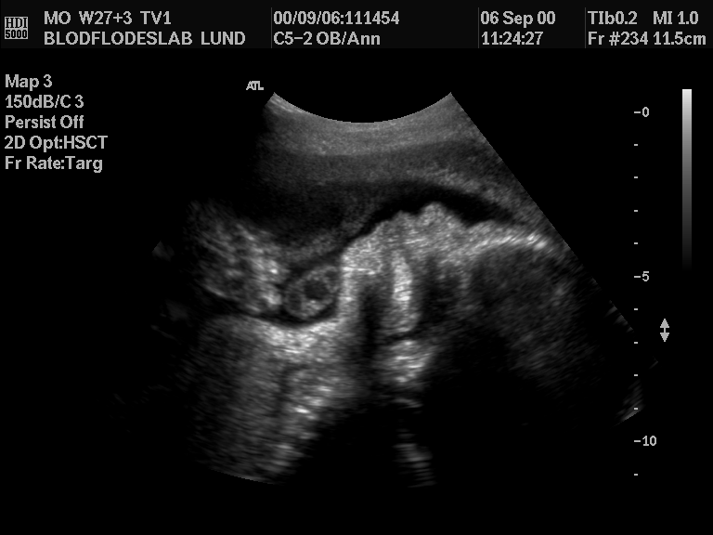
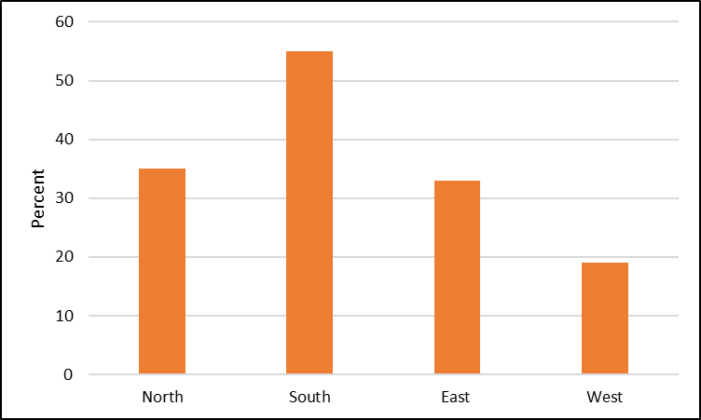
Poster number (eg P03.19, or OP02.06).
Title of your poster.
Names of presenters. Up to three lines of text in 18pt
Introduction
You have just one slide in which to present your poster. Be concise and remember ‘less is more’! This template gives ideal space and layout for presentation on the equipment provided.
Typography
Any easy-read-typeface can be used in your poster but ‘fussy’ fonts should be avoided.
This template uses “Arial” in 10pt – you should use no less than 9pt. Use a slightly larger type-face for the subtitles and clear spaces between blocks of text. Use colour sparingly!
Pictures
Images from Excel or PowerPoint, CDR, WMF, EMF, CGM and EPS-files, JPG, GIF, TIF, BMP are all fine. You may use video format however you must upload video files separately as it will not be embedded within your PPT file whereas simple PPT slides and image files will automatically appear as you originally intended.
Skip tables?
Diagrams are faster for your audience to take in than tables. Try to convert your data to simple diagrams.
Layout
You don’t have to make your poster completely symmetric, but do keep it balanced.
Keep the poster elements in a logical reading order and use the “full screen” option for editing.
Figure 1. “italic” text may help to separate figures from the main text.
Figure 2. Choose only the best pictures and limit the number
Conclusion
For many Congress participants, the ‘conclusions’ may be the most important element of a poster. You may feature this part with a larger type size – or give it a different colour.
Figure 3. An un-complex diagram

