Slide 1


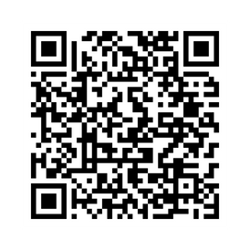
ISUOG WORLD CONGRESS
6–9 SEPTEMBER 2026
DUBAI, UAE
Why submit an abstract to ISUOG 2026?
Raise your professional profile: Access a global audience, disseminate your research ideas and gain exposure.
Get published in UOG: The influential research journal has a global impact factor of 6.3 and has reached 6.28 million downloads in 2024.
Attend World Congress: Benefit from discounted registration fees.
Make a difference: Increase the knowledge of professionals in the field and make a difference in the lives of patients across the world.
ABSTRACT SUBMISSION DEADLINE
17 MARCH 2026
SUBMIT NOW

