Slide 1



How to perform ultrasound in labor: the fetal occiput position
Aly Youssef, Tullio Ghi, Gianluigi Pilu
Department of Obstetrics and Gynecology
Sant’Orsola-Malpighi University Hospital
University of Bologna
Italy

Slide 2
How to: determine the fetal occiput position in labor
Indication: before performing instrumental delivery, delayed labor progress especially in advanced labor, suspected fetal malposition
Machine settings: routine obstetric third trimester setting

Slide 3
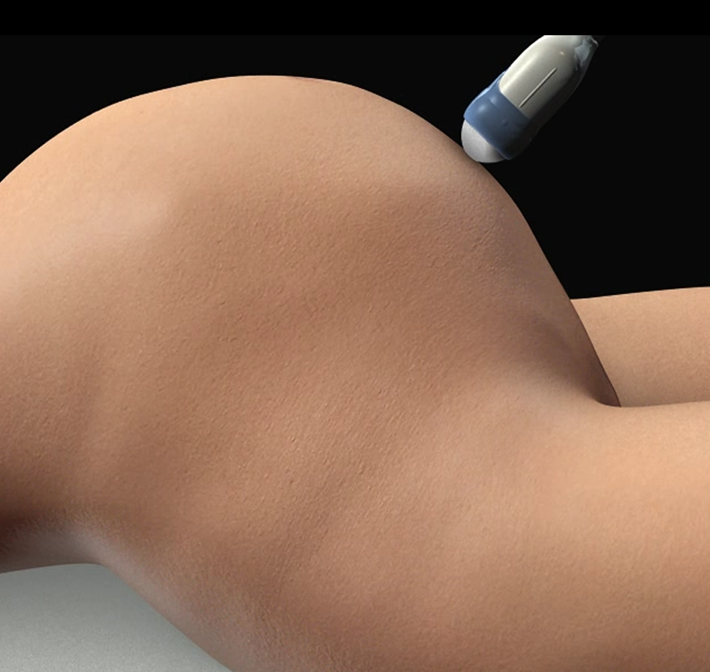
The fetal spine position identification
1

Slide 4
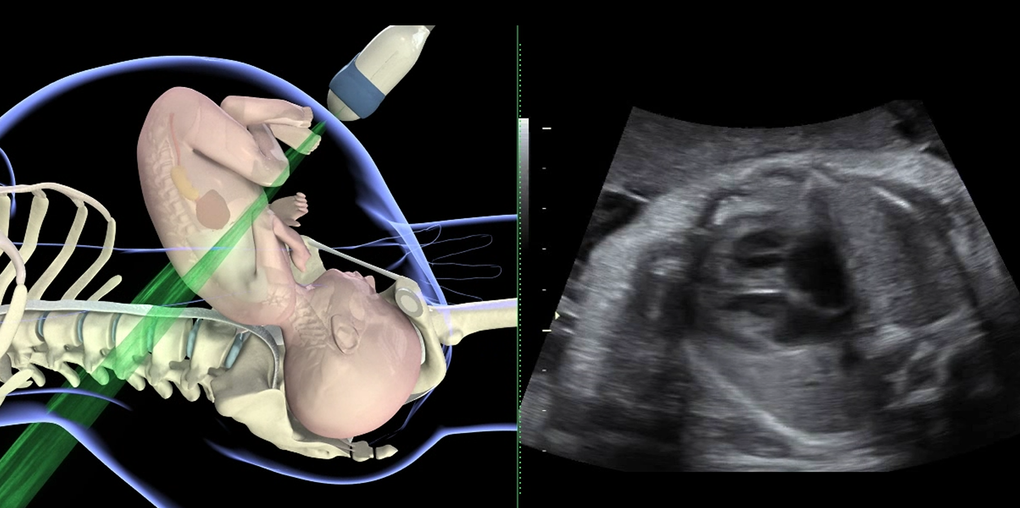
The fetal spine position identification:
posterior spine
spine
2

Slide 5
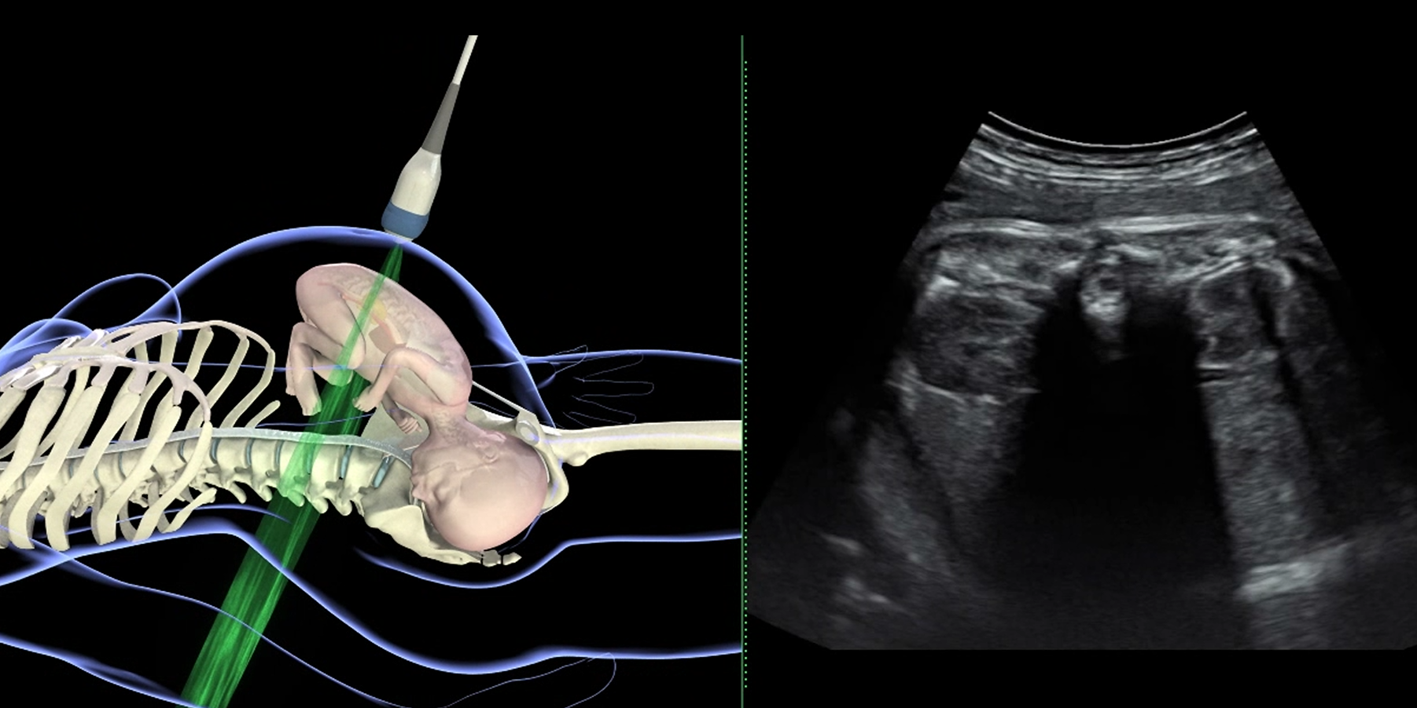
The fetal spine position identification:
anterior spine
spine
3

Slide 6
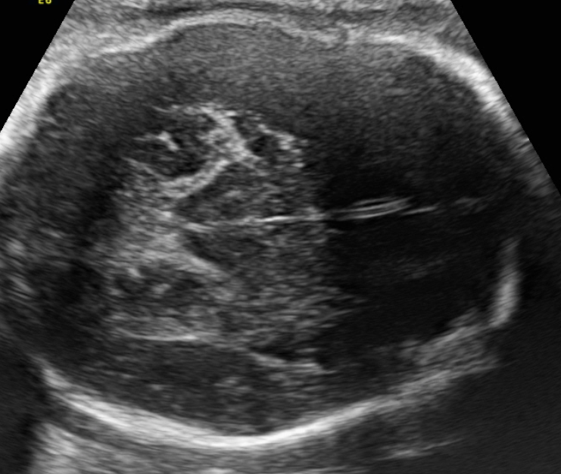
The fetal head: landmarks for occiput position identification
MIDLINE
THALAMI
OCCIPUT
4

Slide 7
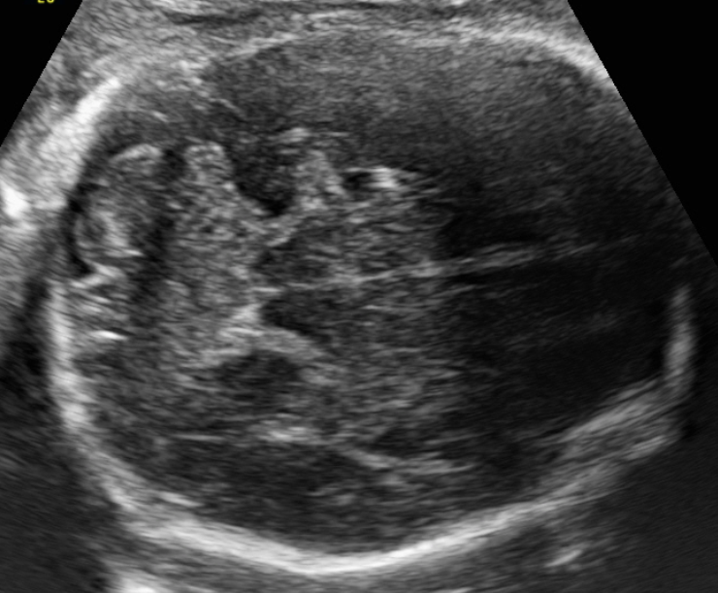
The fetal head: landmarks for occiput position identification
CEREBELLUM
MIDLINE
OCCIPUT
5

Slide 8
orbits
The occiput posterior position
6

Slide 9
The occiput anterior position
cervical spine
occiput
7

