Slide 1
WELCOME TO

Slide 2
About
ISUOG stands for International Society of Ultrasound in Obstetrics and Gynecology
ISUOG is a charitable organisation and the leading international society of experts in ultrasound for obstetrics and gynecology.
The Society includes Obstetricians and Gynaecologists, trainees, medical doctors, scientists, sonographers, radiologists, midwives and other health professionals who work to advance women’s health and well-being globally.

Slide 3
Our mission
Our mission is to improve women’s health through the provision, advancement and dissemination of the highest quality education, standards and research information around ultrasound in Obstetrics and Gynecology.
How?
We strive to achieve this through our education and training initiatives, our free access guidelines, advocacy though our events and social media platforms and by inspiring research though our publication and growing our reach.

Slide 4
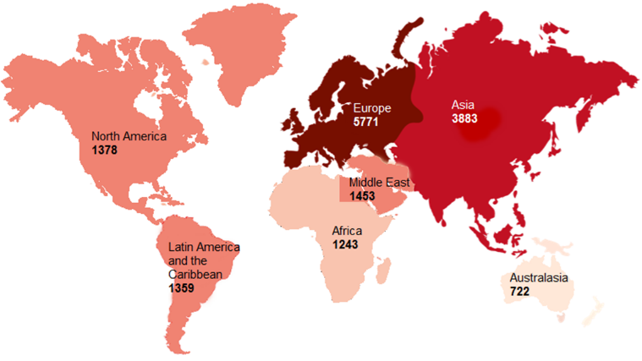
Our society is growing
We encourage members from all professions in the specialty, at all levels of training, internationally.
98% of our members would recommend membership to a colleague

Slide 5
Membership
ISUOG membership provides you with access to a wealth of educational resources and experts in their field, but also to a global network of like-minded individuals with a shared passion and vision to improve women’s health.
Benefits include
Free CME Activities
Discounts to our events and courses
Access to VISUOG chapters
On-demand lectures
An online community forum to network
Join our
international
community

Slide 6
Trainee Membership
We offer free two-year membership through institutions. Ask your institution to email us on info@isuog.org
Benefits include
Online subscription to the UOG Journal.
Reduced fees to our education courses, World Congress and International Symposium events.
Access to over 1000 web resources.
And much more…

Slide 7
18 March 2024
Abstract submission deadline
June 2024
Abstract notifications
14 July 2024
Early bird deadline
14 September 2024
Pre-Congress courses
15-18 September 2024
Congress
Submit Your Abstract

Slide 8
Las clases magistrales regionales
La ISUOG se complace en asociarse con la FECOLSOG (la Federación Colombiana de Obstetricia y Ginecología) para impartir clases magistrales regionales antes de su congreso anual.
Las clases magistrales tendrán lugar el 22 de mayo de 2024 antes del Congreso Nacional de Obstetricia y Ginecología de FECOLSOG que se celebrará del 23 al 25 de mayo de 2024.
Dos clases magistrales disponibles:
Ecografía y valoración de masas anexiales, endometriosis y complicaciones en el primer trimestre
Grandes síndromes obstétricos y últimos avances en ecografía
Regístrese antes de la fecha de reserva anticipada del 26 de abril para obtener tarifas reducidas

Slide 9
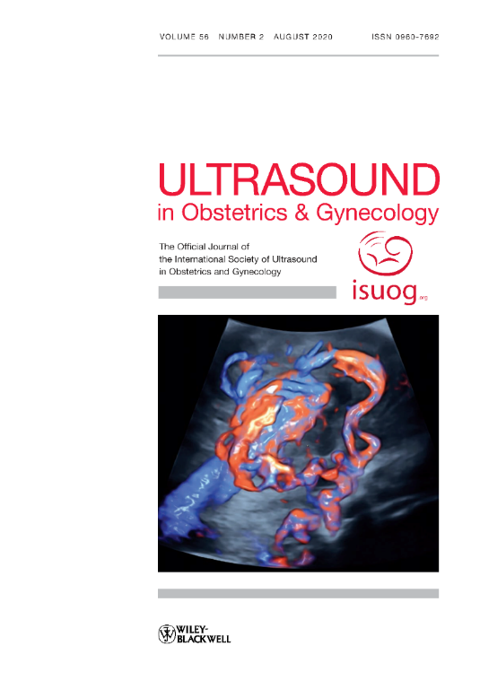
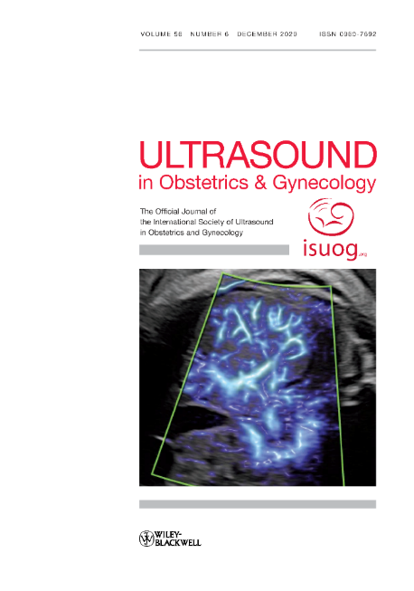
Research
leading peer-reviewed journal
Impact factor 7.1
6.2 million article downloads in 2023
Our Journal, Ultrasound in Obstetrics & Gynecology is the leading peer-reviewed journal on imaging within the field of obstetrics and gynecology.
The UOG journal includes monthly systematic reviews, referee commentaries and expert perspectives.
Have your work published in the UOG, the average Altmetric score was 106 for our top 10 articles in 2022

Slide 10
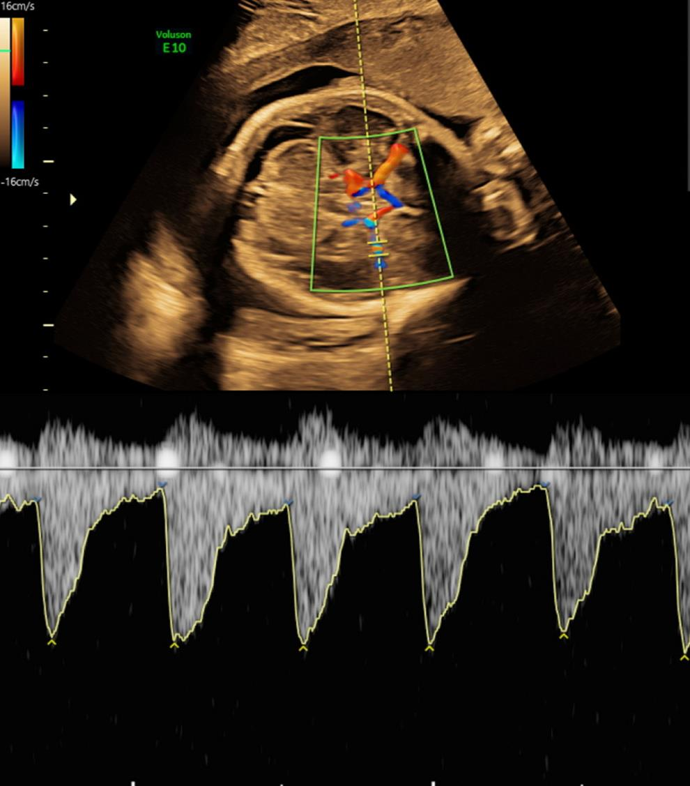
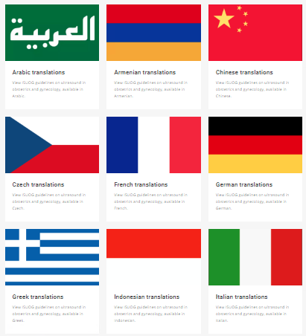
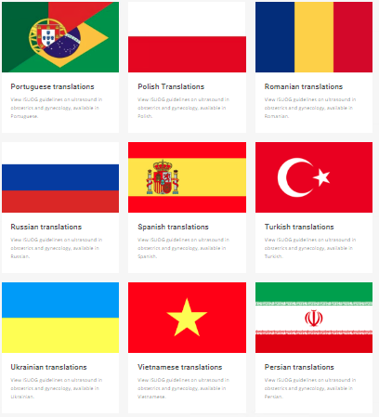
Run a BT
Practice Guidelines
The ISUOG Clinical Standards Committee (CSC) develops Practice Guidelines and Consensus Statements providing recommendations on how to improve and standardise medical care
17 Practice guidelines
10 Consensus statements
Translations in over 18 languages

Slide 11
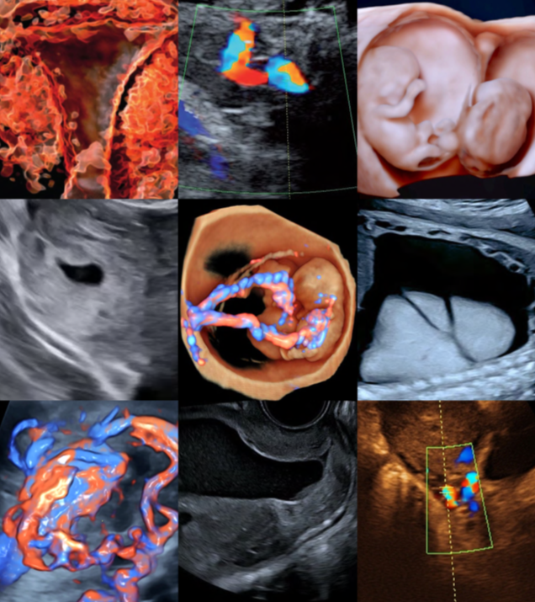
Education
ISUOG provides education for practitioners and trainees at all levels.
Enhance your skills and knowledge in ultrasound in obstetrics and gynecology through our lectures and courses delivered by leading names in the field.
Our educational courses deliver the latest developments and best practices, plus debates on key topics affecting obstetrics and gynecology practitioners across the globe.
Visit www.isuog.org/education

Slide 12
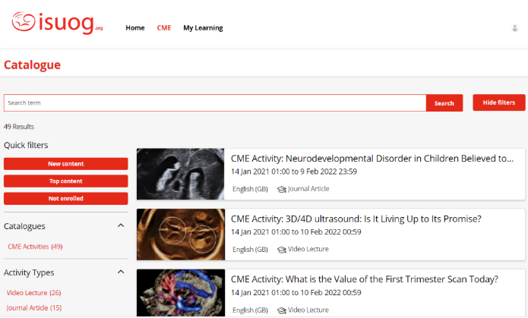
Online CME Platform
Our CME platform, ISUOG Academy has over 100 activities so far. The platform offers a mixture of learning tools such as videos, guidelines articles and lectures.
Activities include:
Practice Guidelines
Journal articles
Video lectures
Features include:
Responsive user experience
Structured learning
On the spot certification
Earn CME credit anytime, anywhere. The process is simple!

Slide 13
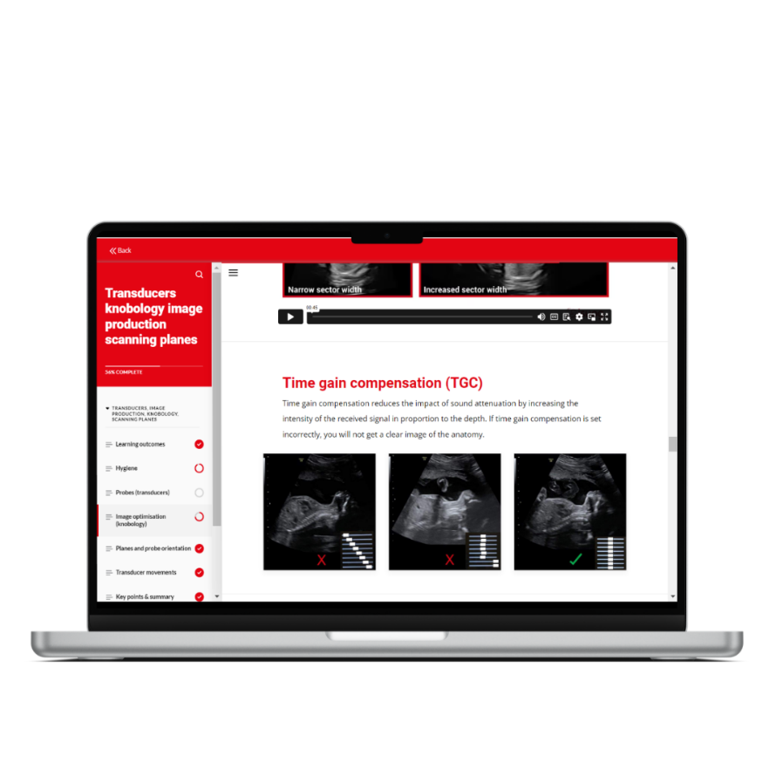
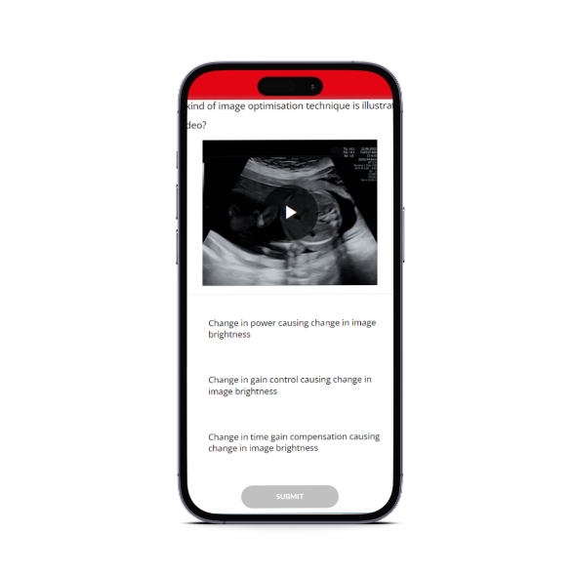
Basic Training Online Program
New foundational program of ultrasound in obstetrics and gynecology!
12 months’ access
30 interactive courses
Test your knowledge as you learn
ISUOG Certificate
EACCME Certificate for 30 CME credits
New and updated images and videos
Live demonstration videos and simulations
Illustrations, research data, supplementary reading, and more.
Visit www.isuog.org/education/basic-training for more details and pricing

Slide 14
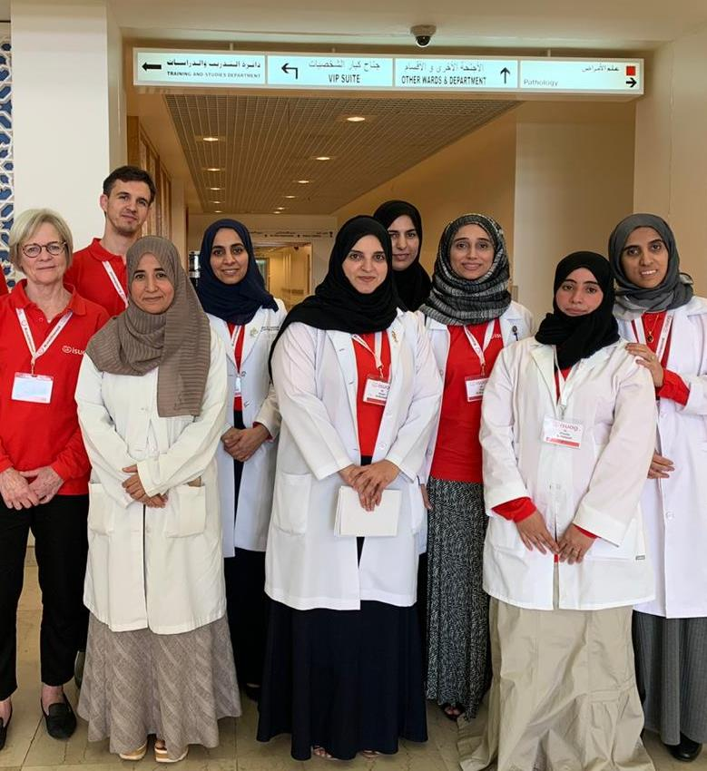
Outreach
ISUOG Outreach Vision: Every woman should undergo a safe and patient-centred quality ultrasound as part of their healthcare evaluation.
How?
ISUOG Outreach builds a sustainable national health structure for providing OBGYN Ultrasound to all women in a specific underserved country. Outreach helps a country to provide quality and accessible care to all its women through training their trainers to raising the level of their skills and knowledge. ISUOG Outreach also works with their Governments to ensure sustainability through post-program support.

Slide 15
https://www.isuog.org/education/visuog.html

Slide 16
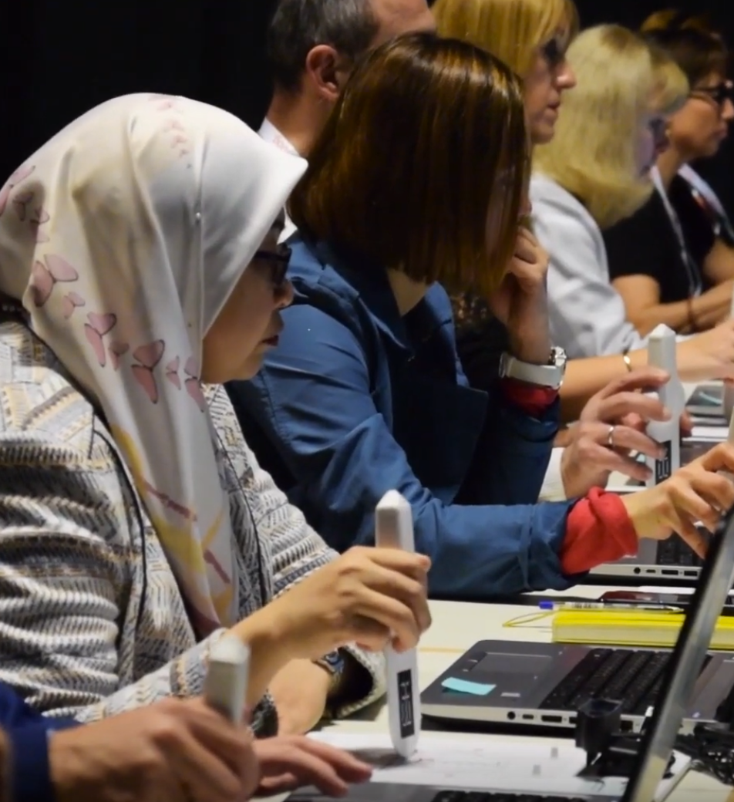
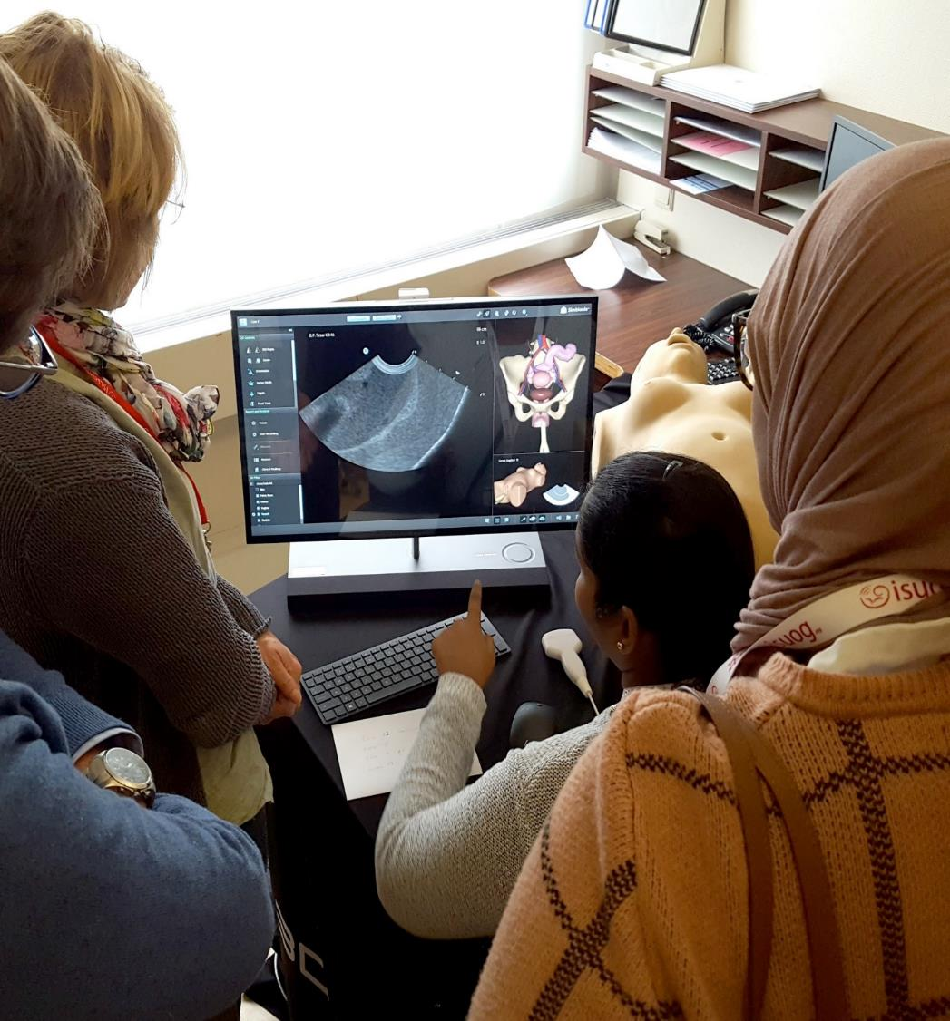
Run a BT
ISUOG now offers universities and training institutions the opportunity to run an ISUOG Basic Training program. ISUOG provides educational resources and administrative support at no cost.
Delivered by your own faculty in your own time
Resources and administrative support provided
Flexible and cost-efficient
Certification of completion can be obtained
Get in touch! Apply to run an ISUOG Basic Training Course today.

