Slide 1



UOG Journal Club: October 2017
ASPRE trial: performance of screening for preterm pre-eclampsia
D.L. Rolnik, D. Wright, L.C. Poon, A. Syngelaki, N. O’Gorman, C. De Paco Matallana, R. Akolekar, S. Cicero, D. Janga, M. Singh, F.S. Molina, N. Persico, J.C. Jani, W. Plasencia, G. Papaioannou, K. Tenenbaum-Gavish, K.H. Nicolaides
October 2017, Volume 50, Issue 4, pages 492–495
Journal Club slides prepared by Dr Fiona Brownfoot
(UOG Editor for Trainees)

Slide 2
ASPRE trial: performance of screening for preterm pre-eclampsia
D.L. Rolnik et al., UOG 2017
Aim of the study
To assess the accuracy of the previously reported first-trimester model of screening for pre-eclampsia (PE) in the screened population of the ASPRE study.
Notes:
2

Slide 3
ASPRE trial: performance of screening for preterm pre-eclampsia
D.L. Rolnik et al., UOG 2017
Methods
Study design
  Prospective, multicenter study
Setting
  Thirteen hospitals in five different countries including the UK, Spain, Italy, Belgium, Greece and Israel (February to September 2015).
Participants
  Included: women presenting for a booking visit for routine care with a singleton pregnancy at 11+0 to 13+6 weeks gestation
  Excluded: Maternal age <18 years or major structural anomaly on ultrasound. Pregnancies ending with no follow up or in termination or miscarriage were also excluded.

Slide 4
ASPRE trial: performance of screening for preterm pre-eclampsia
D.L. Rolnik et al., UOG 2017
Methods
Test methods
  The index test was the algorithm using maternal factors, MAP, UtA-PI, PAPP-A and PlGF.
    Maternal factors were recorded
    MAP (MoM) was measured by validated automated devices
    Colour Doppler ultrasound was used to measure left and right uterine artery average PI value
    Serum PAPP-A and PlGF were measured on the DELFIA Xpress random access platform
  This was carried out at 11+0 to 13+6 weeks gestation
  The target condition was preeclampsia
  Women at high risk of >1:100 were invited to participate in a double blind trial of aspirin 150mg daily compared to placebo from 11–14 weeks until 36 weeks’ gestation

Slide 5
ASPRE trial: performance of screening for preterm pre-eclampsia
D.L. Rolnik et al., UOG 2017
Methods
Outcome
  PE defined using ISSHP guidelines
      Hypertension with a systolic of ≥ 140 and/or a diastolic of ≥ 90 on at least two occasions 4 h apart
      Proteinuria ≥300mg in 24hrs or at least ++ on dipstick analysis of urine
      Superimposed preeclampsia was defined as significant proteinuria on a background of chronic hypertension
  In the screened population, the false positive rate and detection rates for delivery with preeclampsia < 37 weeks and ≥ 37 weeks gestation were estimated after adjustment for the effect of aspirin (62% reduction in those treated with aspirin)

Slide 6
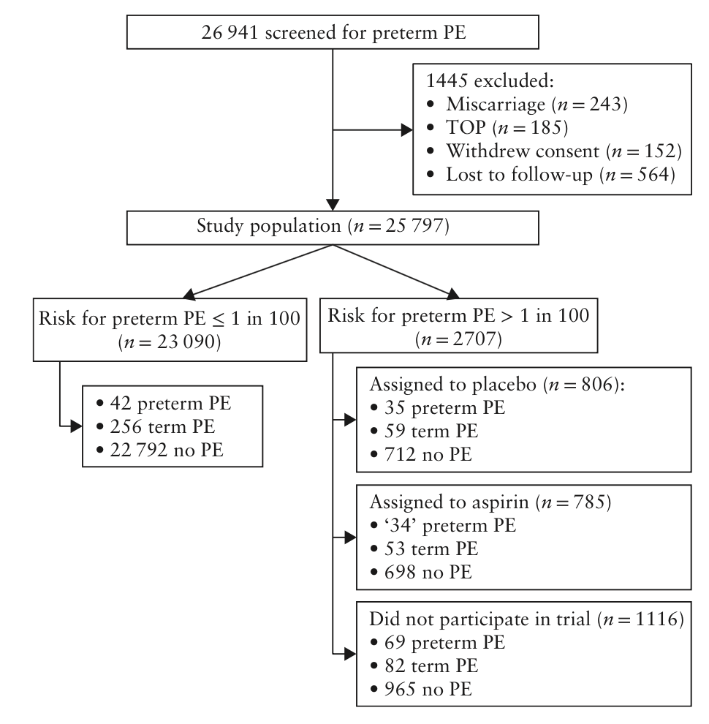
ASPRE trial: performance of screening for preterm pre-eclampsia
D.L. Rolnik et al., UOG 2017
Results
Flowchart summarizing screening for preterm PE
  26 941 women were included in this study
  2707 (10%) were screen positive with a risk of PE >1:100
PE risk:
  Placebo group (n=806)
    4.3% preterm PE
    7.3% term PE
  Treatment group (n=785)
    4.3% preterm PE (adjusted by 62% given this was the effect of reducing PE risk by administering aspirin)
    6.8% term PE
  Did not participate in the trial (n=1116)
    6.1% preterm PE
    7.3% term PE
Notes:
*** The baseline characteristics table is now in the supp file which I don’t have access to.

Slide 7
ASPRE trial: performance of screening for preterm pre-eclampsia
D.L. Rolnik et al., UOG 2017
Results
Primary outcome
  Risk of PE in the study population:
    0.7% preterm PE
    1.7% term PE
    97.6% no PE
  Risk of PE using the first-trimester algorithm screen using a risk cut-off of 1 in 100
    Detection rate was
      76.7% (138/180) for preterm PE
      43.1% (194/450) for term PE
    Screen-positive rate of 10.5%
    False-positive rate of 9.2%

Slide 8
ASPRE trial: performance of screening for preterm pre-eclampsia
D.L. Rolnik et al., UOG 2017
Comparison of the detection rate and false positive rate of the screening algorithm used in the ASPRE trial compared to the population the algorithm was developed in
 | Detection rate |  | False-positive rate
 | Preterm PE | Term PE
ASPRE cohort | 77% | 43% | 9.2%
Population used to develop the screening model | 77% | 38% | 10%
Notes:
8

Slide 9
ASPRE trial: performance of screening for preterm pre-eclampsia
D.L. Rolnik et al., UOG 2017
Discussion
Findings
  The estimated detection rate of screening by maternal factors, MAP, UtA-PI, PAPP-A and PlGF for the ASPRE population compared to the population used to develop the algorithm respectively was:
    77% and 77% for preterm PE
    43% and 38% for term PE
    False-positive rate 9.2% and 10%
Study limitations
  This study demonstrated a reduced risk of PE in those administered aspirin. Therefore, the incidence of PE in this group was reduced. This group was therefore adjusted to take this into account
  This was not a non-intervention validation study
Notes:
9

Slide 10
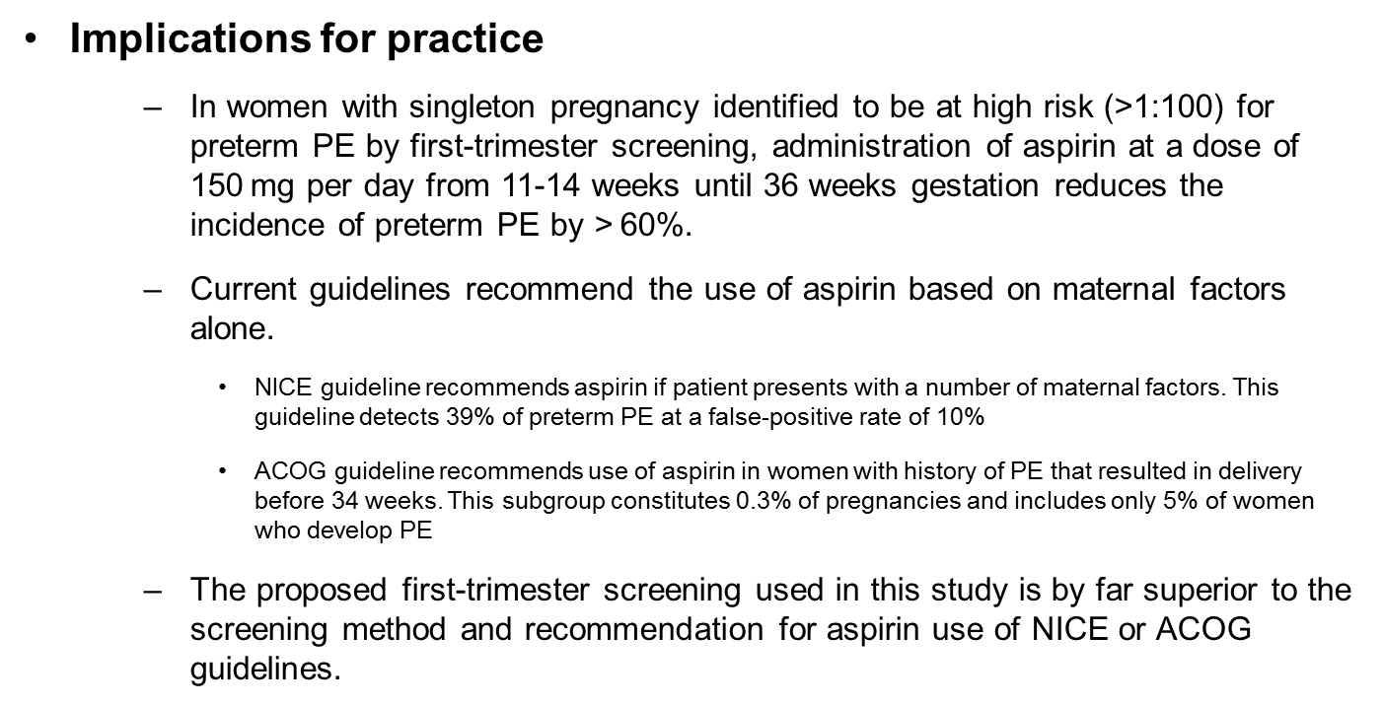
ASPRE trial: performance of screening for preterm pre-eclampsia
D.L. Rolnik et al., UOG 2017
Discussion
Implications for practice
  In women with singleton pregnancy identified to be at high risk (>1:100) for preterm PE by first-trimester screening, administration of aspirin at a dose of 150 mg per day from 11-14 weeks until 36 weeks gestation reduces the incidence of preterm PE by > 60%.
  Current guidelines recommend the use of aspirin based on maternal factors alone.
    NICE guideline recommends aspirin if patient presents with a number of maternal factors. This guideline detects 39% of preterm PE at a false-positive rate of 10%
    ACOG guideline recommends use of aspirin in women with history of PE that resulted in delivery before 34 weeks. This subgroup constitutes 0.3% of pregnancies and includes only 5% of women who develop PE
  The proposed first-trimester screening used in this study is by far superior to the screening method and recommendation for aspirin use of NICE or ACOG guidelines.

Slide 11
ASPRE trial: performance of screening for preterm pre-eclampsia
D.L. Rolnik et al., UOG 2017
Conclusions
Use of the first-trimester algorithm in the ASPRE cohort results in comparable detection rates of preterm PE to that detected in the original population it was developed in.

Slide 12
ASPRE trial: performance of screening for preterm pre-eclampsia
D.L. Rolnik et al., UOG 2017
Discussion points
What is your current screening policy for PE
How effective is this current policy in detecting PE?
What cut-off or trigger is used to implement aspirin prophylaxis?
What are the implications of the current study findings?
Why would you introduce multimarker screening using MAP, UtA Doppler, PAPP-A and PlGF?
What barriers are there to implementing such a screening programme?
Notes:
12

