Slide 1
Title area of
The crest of your unit, university or hospital to go here
slide to go in this area
Presenter in bold
Other authors in regular
Fetal Medicine Unit
Department of Obstetrics and Gynecology
St. Elsewhere University Hospital

Slide 2
Results 2
25
normal T21
Frequency (%)
20
Use images to illustrate your presentation
Include basic numbers before going to complicated results
Graphs:
15
10
5
0
-1
0 1 2 3 4 5
Nuchal translucency deviation (mm)
6
60
50
40
30
20
10
0
-0.5
Likelihood Ratio
ensure the axes are labelled
avoid using overcomplicated graphs or figures
0 0.5 1 1.5 2 2.5
Nuchal translucency deviation (mm)

Slide 3
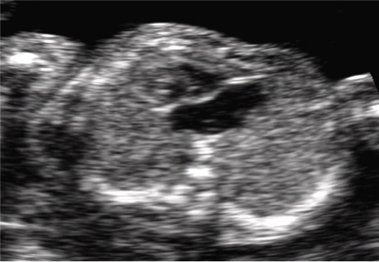
Results 3
For pictures:
Ensure highest possible resolution
Crop the image to the area of interest
Ensure patient anonymity

Slide 4
Title area of
The crest of your unit, university or hospital to go here
slide to go in this area
Presenter in bold
Other authors in regular
Fetal Medicine Unit
Department of Obstetrics and Gynecology
St. Elsewhere University Hospital

Slide 5
Results 2
25
normal T21
Frequency (%)
20
Use images to illustrate your presentation
Include basic numbers before going to complicated results
Graphs
15
10
5
0
-1
0 1 2 3 4 5
Nuchal translucency deviation (mm)
6
ensure the axes are labelled
avoid using overcomplicated graphs or figures
60
50
40
30
20
10
0
-0.5
Likelihood Ratio
0 0.5 1 1.5 2 2.5
Nuchal translucency deviation (mm)

Slide 6
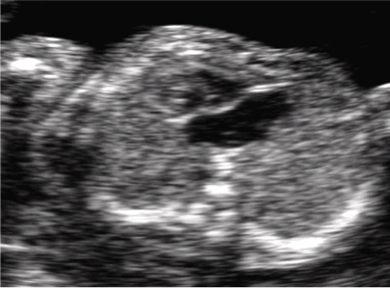
Results 3
For pictures
ensure highest possible resolution
crop the image to the area of interest
ensure patient anonymity

Slide 7
Title area of
The crest of your unit, university or hospital to go here
slide to go in
this area
Presenter in bold
Other authors in regular
Fetal Medicine Unit
Department of Obstetrics and Gynecology
St. Elsewhere University Hospital

Slide 8
Results 2
25
normal T21
Use images to illustrate your presentation
Include basic numbers before going to complicated results
Graphs:
Frequency (%)
20
15
10
5
0
-1
0 1 2 3 4 5
Nuchal translucency deviation (mm)
6
ensure the axes are labelled
avoid using overcomplicated graphs or figures
60
50
40
30
20
10
0
-0.5
Likelihood Ratio
0 0.5 1 1.5 2 2.5
Nuchal translucency deviation (mm)

Slide 9
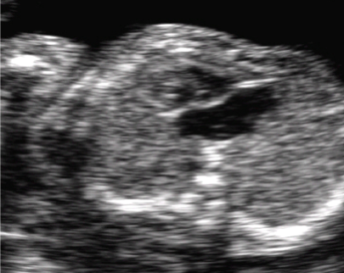
Results 3
For pictures:
Ensure highest possible resolution
Crop the image to the area of interest
Ensure patient anonymity

