Slide 1



UOG Journal Club: June 2020
Role of Doppler ultrasound at time of diagnosis of late-onset fetal growth restriction in predicting adverse perinatal outcome: prospective cohort study
G. RIZZO, I. MAPPA, V. BITSADZE, M. SŁODKI, J. KHIZROEVA,
A. MAKATSARIYA and F. D’ANTONIO
Volume 55, Issue 6, Pages 793–798
Journal Club slides prepared by Dr Yael Raz
(UOG Editor for Trainees)

Slide 2
Role of Doppler ultrasound at time of diagnosis of late-onset fetal growth restriction in predicting adverse perinatal outcome: prospective cohort study
Rizzo et al., UOG 2020
Introduction
Late-onset fetal growth restriction (FGR) is defined as the inability of the fetus to reach its growth potential, diagnosed after 32 weeks of gestation.
Although to a lesser extent compared with early-onset disease, late-onset FGR is associated with an increased risk of short- and long-term adverse outcomes compared with normally grown fetuses.
Identification of fetuses at higher risk of perinatal compromise is crucial in order to improve the outcome of pregnancies affected by late-onset FGR.
Blood flow in the umbilical artery (UA) represents the clinical standard for the identification and management of pregnancies affected by early FGR but is usually normal in fetuses with late-onset disease.

Slide 3
Role of Doppler ultrasound at time of diagnosis of late-onset fetal growth restriction in predicting adverse perinatal outcome: prospective cohort study
Rizzo et al., UOG 2020
Introduction
Reduced impedance to flow in the fetal cerebral circulation, expressed as low pulsatility index (PI) in the middle cerebral artery (MCA) or cerebroplacental ratio (CPR), has been shown to be associated with abnormal acid–base status and admission to the neonatal special care unit.
Increased resistance in the uterine arteries has been associated with a higher risk of Cesarean section (CS) for fetal distress.
Assessment of blood flow in the umbilical vein (UVBF) has been shown to provide better identification of late-onset FGR fetuses at higher risk of perinatal compromise.
Few data are available on the actual diagnostic performance of ultrasound in predicting adverse pregnancy outcome when using a given parameter or when combining different Doppler indices.
There is limited evidence on whether integrating Doppler assessment of umbilical vein flow may improve the predictive accuracy of Doppler ultrasound in identifying late-onset FGR fetuses at higher risk of perinatal compromise.

Slide 4
Role of Doppler ultrasound at time of diagnosis of late-onset fetal growth restriction in predicting adverse perinatal outcome: prospective cohort study
Rizzo et al., UOG 2020
Aims of the study
Primary aims
Explore the strength of association between fetoplacental Doppler indices at the time of diagnosis and adverse perinatal outcome in pregnancies complicated by late-onset FGR and determine their predictive accuracy.
Secondary aim
Elucidate whether a multiparametric diagnostic model including the most commonly used fetoplacental Doppler indices improves the diagnostic performance of Doppler ultrasound in detecting adverse perinatal outcome in pregnancies complicated by late-onset FGR.

Slide 5
Role of Doppler ultrasound at time of diagnosis of late-onset fetal growth restriction in predicting adverse perinatal outcome: prospective cohort study
Rizzo et al., UOG 2020
Methods
Single-institute prospective study.
Recruited were consecutive singleton pregnancies complicated by late-onset FGR diagnosed between October 2017 and December 2018.
FGR was defined as ultrasound-estimated fetal weight (EFW) or abdominal circumference (AC) <3rd centile using local population charts or EFW or AC <10th centile associated with UA-PI >95th centile or CPR <5th centile.
Pregnancies complicated by FGR diagnosed <32 weeks of gestation and those affected by congenital infections or chromosomal or structural anomalies were excluded from the analysis.

Slide 6
Role of Doppler ultrasound at time of diagnosis of late-onset fetal growth restriction in predicting adverse perinatal outcome: prospective cohort study
Rizzo et al., UOG 2020
Methods
Primary outcome was a composite adverse perinatal outcome (CAPO), including at least one of the following complications: emergency CS for fetal distress, 5-min Apgar score <7, UA pH <7.10 and neonatal admission to the special care unit.
After diagnosis of late-onset FGR, pregnancies were managed by the attending obstetricians, who were not involved in the process of diagnosis and were unaware of the Doppler data except for UA-PI.
Fetal growth was reassessed at 2-week intervals.
Induction of labor was performed immediately in cases of maternal medical complications (i.e. pre-eclampsia or gestational hypertension) or reduced amniotic fluid volume, fetal movement or fetal growth and at gestational ages beyond 39 weeks.

Slide 7
Role of Doppler ultrasound at time of diagnosis of late-onset fetal growth restriction in predicting adverse perinatal outcome: prospective cohort study
Rizzo et al., UOG 2020
Results
261 pregnancies fulfilled the entry criteria during the study period. Eighteen were excluded due to missing data (n=8) or loss to follow-up (n=10), leaving 243 pregnancies available for analysis.
CAPO occurred in 32.5% (95% CI, 26.7–38.8%) of cases. The prevalence of emergency CS for fetal distress, umbilical artery pH <7.10 and neonatal admission to the special care unit were 74.5%, 25.1% and 15.2%, respectively.
Mean gestational age at delivery and birth weight were lower in pregnancies with CAPO compared to those without, while there were no differences between the two study groups in maternal age, body mass index, smoking status, ethnicity or the occurrence of hypertensive disorders.

Slide 8
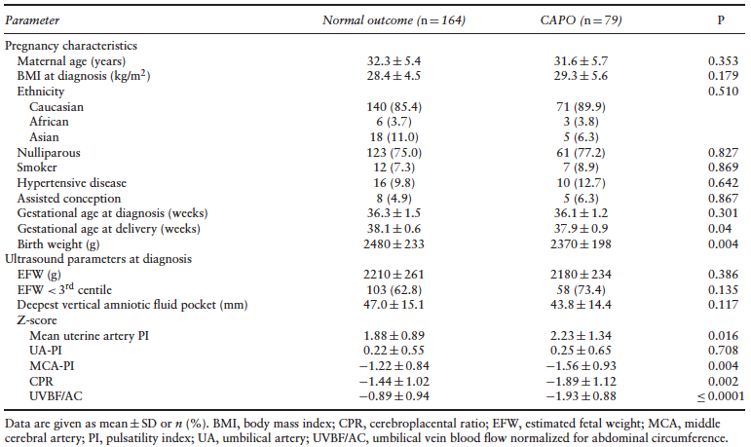
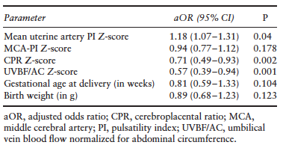
Role of Doppler ultrasound at time of diagnosis of late-onset fetal growth restriction in predicting adverse perinatal outcome: prospective cohort study
Rizzo et al., UOG 2020
Results
In pregnancies with CAPO compared to those without,
Z-scores of mean MCA-PI, UVBF/AC and CPR at diagnosis were lower, while uterine artery PI Z-score was higher.
On multivariable logistic regression analysis, Z-scores
of mean uterine artery PI, CPR and UVBF/AC were associated independently with CAPO.

Slide 9
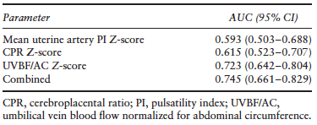
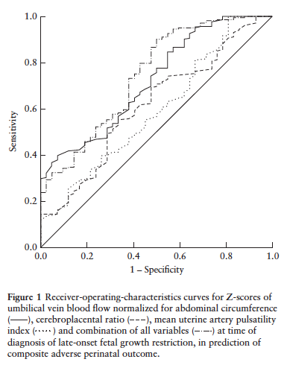
Role of Doppler ultrasound at time of diagnosis of late-onset fetal growth restriction in predicting adverse perinatal outcome: prospective cohort study
Rizzo et al., UOG 2020
Results
Diagnostic performance of Doppler parameters in predicting CAPO in pregnancies complicated by late-onset FGR:
A multiparametric model that included CPR, uterine artery PI and UVBF had an AUC of 0.745 (P=0.66 vs UVBF/AC) for the detection of CAPO.
UVBF/AC Z-score had an AUC of 0.723 for CAPO, demonstrating better accuracy compared with that of mean
uterine artery PI Z-score and CPR Z-score.

Slide 10
Role of Doppler ultrasound at time of diagnosis of late-onset fetal growth restriction in predicting adverse perinatal outcome: prospective cohort study
Rizzo et al., UOG 2020
Discussion – Main findings
Adverse perinatal outcome occurs in approximately one-third of pregnancies complicated by late-onset FGR.
Mean uterine artery PI was higher, while UVBF/AC, MCA-PI and CPR were lower in pregnancies that experienced CAPO compared with those that did not.
There was no difference in the mean values of UA-PI between the study groups.
On multivariable regression analysis, mean uterine artery PI, CPR and UVBF/AC were associated independently with CAPO.
Only UVBF/AC showed moderate accuracy in predicting CAPO while the diagnostic performance of both CPR and uterine artery PI was poor.

Slide 11
Role of Doppler ultrasound at time of diagnosis of late-onset fetal growth restriction in predicting adverse perinatal outcome: prospective cohort study
Rizzo et al., UOG 2020
Discussion
Main strengths
Sample size - One of the largest series exploring the role of fetoplacental Doppler in predicting the outcome of pregnancies complicated by late-onset FGR, at the time of diagnosis.
Design -
Prospective,
Only of cases affected by late-onset FGR,
Attending obstetricians were blinded to Doppler data (except UA Doppler).
Main limitation
Cross-sectional design - did not take into account serial changes in Doppler indices with progression of pregnancy from diagnosis to delivery.

Slide 12
Role of Doppler ultrasound at time of diagnosis of late-onset fetal growth restriction in predicting adverse perinatal outcome: prospective cohort study
Rizzo et al., UOG 2020
Implications for clinical practice
UVBF/AC recorded at the time of diagnosis of late-onset FGR has moderate predictive accuracy for adverse perinatal outcome.
Despite these promising results, the clinical role of UVBF deserves further investigation.
UVBF may be difficult to sample and inter- and intraobserver reproducibility of measurement in this vessel has not yet been reported consistently in the published literature.
Small errors in the components of UVBF may result in larger errors in the absolute flow calculation, particularly for UV diameter.
In this study, UV flow was evaluated using a semiautomated method for
measurement of UV diameter which may allow easier application in clinical practice.

Slide 13
Role of Doppler ultrasound at time of diagnosis of late-onset fetal growth restriction in predicting adverse perinatal outcome: prospective cohort study
Rizzo et al., UOG 2020
Conclusions
CPR, uterine artery PI and UVBF/AC recorded at the time of diagnosis of late-onset FGR are associated independently with CAPO.
UVBF/AC shows the best diagnostic performance for CAPO, although its actual usefulness as a standalone predictor of adverse pregnancy outcome requires further evidence.
Future studies are needed in order to build a multiparametric prediction model integrating UVBF assessment, uterine artery Doppler and other pregnancy characteristics able to identify accurately pregnancies affected by late-onset FGR at higher risk of short- and long-term morbidities.

Slide 14
Role of Doppler ultrasound at time of diagnosis of late-onset fetal growth restriction in predicting adverse perinatal outcome: prospective cohort study
Rizzo et al., UOG 2020
Points for discussion
Will sharing the Doppler indices with attending obstetricians reduce CAPO in fetuses with late-onset FGR?
Is UVBF/AC a good predictor for long-term complications is fetuses with late-onset FGR?

