Slide 1

Title area of
The logo of your unit, university or hospital
slide to go in
this area
Presenter in bold
Other authors in regular
Fetal Medicine Unit, Department of Obstetrics, St. Elsewhere University Hospital

Slide 2
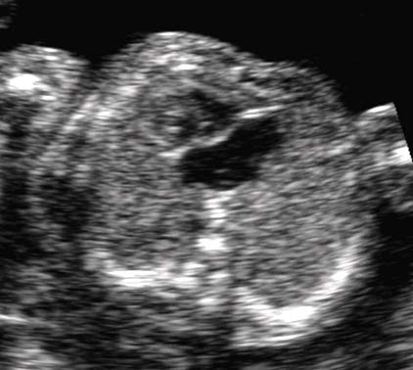
Aims and Methods
Remember
Large and clear font
Fewer words allow for a clearer presentation Do not write down your whole abstract
you only have 3 minutes for the oral presentation
If you over-run
You are being unfair to other presenters You will not get questions
The chairperson will stop you
For ultrasound images
Ensure highest possible resolution Crop the image to the area of interest Ensure patient anonymity!

Slide 3
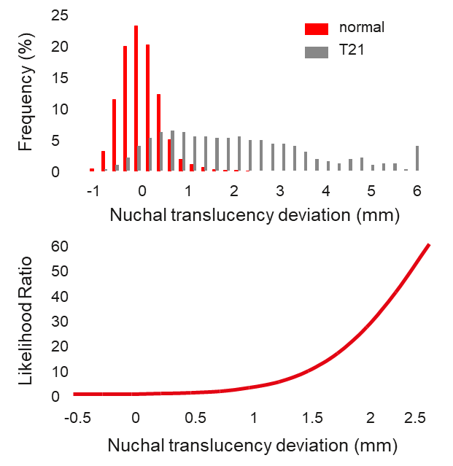
Results
Give main results first
Basic numbers before complicated results Keep font size and spacing uniform
Never less than 16 point font size
Graphs
Ensure all axes are labelled
Avoid using overcomplicated graphs
Ensure all figures are aligned

Slide 4
Conclusions
Have a simple conclusion – usually one sentence
Ensure it answers the aims You may want to discuss
limitations of your study
future directions

