Slide 1
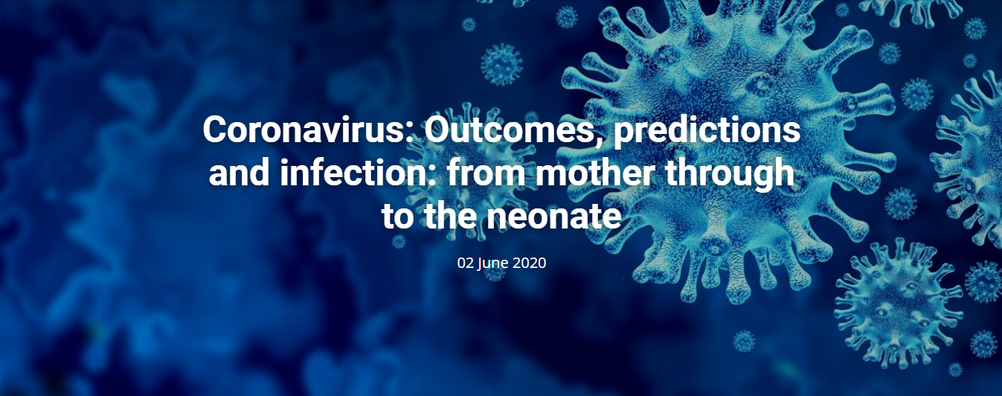

Lessons learned from the ISUOG Webinar on 2nd June 2020
Summary by A. Dall’Asta, M. Sanz Cortes

Slide 2
Coronavirus: Outcomes, predictions and infection: from mother through the neonate
The full symptom complex of COVID-19: how to predict infection without a test. Lessons from the ZOE study of over 3 million participants. – Prof Spector (UK)
ZOE: prediction of symptomatic COVID-19 through an algorithm evaluating clusters and duration of symptoms. The model is validated and improved through swab testing arranged by the UK’s Dept of Health. 1 million users/day. Loss of smell has the highest OR (10) for a +ve SARS-CoV-2 swab and is associated with a 60% frequency of +ve swab. On its own, loss of smell accounts for a 2% difference of extra cases tested and for 60% of +ve cases without cough and fever.
The predictive performance of the model is currently around 80%. Symptoms can identify 5 clusters of SARS-CoV-2 infected people with different risk of hospitalisation. 10% of people with positive swab have symptoms for over 26 days and 5% for over 1 month.
Outcomes of pregnant women hospitalised with confirmed SARS-CoV-2 – data from the UK national cohort study. – Prof Knight (UK)
UKOSS SARS-CoV-2 study focused on symptomatic women hospitalised with SARS-CoV-2 infection. 427 women recruited up to 14/04/2020. Reported symptoms: mainly fever and cough, loss of smell less common in pregnancy. Patient characteristics: high proportion of women black or from other minority ethnic groups (56% compared to 20%), aged >35, obese or overweight, with pre-existing medical problems (mainly diabetes and hypertension). 95% of cases late second/third trimester.
Maternal outcomes: 9% ICU admission, 24% confirmed pneumonia on CT scan, 5 deaths (1%) → similar outcomes for the general population of reproductive age.
Fetal and neonatal outcomes: 3 stillbirths, 26% NICU admission, <5% delivery <32 weeks, 4% had positive SARS-CoV-2 swab within 24 hours from birth.
Update on the evidence for vertical transmission for SARS-CoV-2. – Prof Ville (France)
Blood borne transmission: SARS-CoV-2 viraemia is rare (1%) and restricted to very symptomatic adults; only 1 case of +ve RT-PCR on amniotic fluid, but negative neonate; non convincing demonstration of IgM in a neonate who tested negative after 1 week (more likely non-specific reaction).
Ascending infection: vaginal secretions always negative for SARS-CoV-2; stools are positive in 40-50% of the SARS-CoV-2 positives but may not be infective.
The inflammatory syndrome with thrombosis, the vasoconstriction due to the interaction SARS-CoV-2/ACE2 and the prolonged maternal hypoxemia may impact on the development of the fetal CNS. Uncertain whether cytokines may be transferred through the placenta and cause direct/indirect brain injury to the fetus.
Neonatal aspects of SARS-CoV-2 infection and data collection to inform our understanding. – Prof Modi (UK)
Albeit in the absence of evidence the risk of symptomatic and severe COVID-19 in the newborn seems to be low, as seems to be the risk of vertical transmission or immediate postnatal mother-to-fetus transmissiom and of infection of the Neonatal healthcare staff undertaking AGP. The risk/benefit assessment for SARS-CoV-2 and breastfeeding is currently strongly in favour of breastfeeding, even though 2 cases of breastmilk positive for SARS-CoV-2 have been reported.
SARS-CoV-2 is neurotropic and there is concern that intrauterine and/or early postnatal infection may impact on the developing brain.
The SARS-CoV-2 pandemic has highlighted the need for global infrastructure for rapid data acquisition and evidence generation. Plea for data merging, linkage and sharing in order to improve outcome reporting and reduce the burden on data capture in conditions where the clinical staff is busy in facing the pandemic.

