Slide 1



UOG Journal Club: January 2018
Misoprostol treatment vs expectant management in women with early non-viable pregnancy and vaginal bleeding: a pragmatic randomized controlled trial.
Fernlund, L. Jokubkiene, P. Sladkevicius and L. Valentin
Volume 51, Issue 1, pages 24–32
Journal Club slides prepared by Dr Fiona Brownfoot
(UOG Editor for Trainees)

Slide 2
Misoprostol treatment vs expectant management in women with early non-viable pregnancy and vaginal bleeding: a pragmatic randomized controlled trial
Fernlund et al., UOG 2018
Introduction
First-trimester miscarriage is common, occurring in around one in five pregnancies.
Expectant or medical management avoids the small risks associated with anesthesia and surgery.
The drug most commonly used for medical management or miscarriage is misoprostol, a synthetic prostaglandin E1 analogue.
The success rate of expectant or medical management for the treatment of incomplete miscarriage has been reported to be comparable; however, this is based on short post-procedural follow-up.
Notes:
2

Slide 3
Misoprostol treatment vs expectant management in women with early non-viable pregnancy and vaginal bleeding: a pragmatic randomized controlled trial
Fernlund et al., UOG 2018
Aim of the study
To compare the effect of expectant management with vaginal misoprostol treatment in early non-viable pregnancy with vaginal bleeding with regard to complete uterine evacuation within 10 days.
Notes:
3

Slide 4
Misoprostol treatment vs expectant management in women with early non-viable pregnancy and vaginal bleeding: a pragmatic randomized controlled trial
Fernlund et al., UOG 2018
Study design
  Randomized controlled trial
Setting
  Single-center trial, Skane University Hospital, Malmo Sweden (September 2008 – December 2015)
Participants
  Included: Women presenting with a miscarriage, defined using the following ultrasound features:
    Prior to April 2014: intrauterine gestational sac >16 mm with no embryonic pole or gestational sac with an embryo with crown–rump length (CRL) ≥5mm without cardiac pulsations.
    After April 2014: intrauterine gestational sac ≥25 mm with no embryonic pole or embryo with CRL ≥7mm without cardiac pulsations.
    Or gestational sac with or without embryo without internal growth after 7 days.
  Hemoglobin > 80g/L, no contraindications to misoprostol treatment.
  Excluded: CRL > 33 mm

Slide 5
Misoprostol treatment vs expectant management in women with early non-viable pregnancy and vaginal bleeding: a pragmatic randomized controlled trial
Fernlund et al., UOG 2018
Methods
Test methods
  Open-label design with participants with a non-viable pregnancy with vaginal bleeding randomized to vaginal misoprostol or expectant management
  Dose of vaginal misoprostol was 800 μg given once.
  Follow-up visits:
    Day 10, 17, 24 and 31 after randomisation
    Transvaginal ultrasound and Hb were performed at each follow up visit.
  Complete miscarriage was defined as: no gestational sac in the uterine cavity and maximum anterioposterior diameter of the intracavity contents < 15 mm as measured by transvaginal ultrasound on a midsagittal view.

Slide 6
Misoprostol treatment vs expectant management in women with early non-viable pregnancy and vaginal bleeding: a pragmatic randomized controlled trial
Fernlund et al., UOG 2018
Methods
Outcome
  Primary outcome
    The number of patients with complete miscarriage without dilation and evacuation (D&E) within 10 days of randomization.
  Secondary outcome
    Number of participants with complete miscarriage without D&E within 17, 24 and 31 days after randomization
    Number of participants with complications from randomization until 4 weeks after the uterine cavity is judged to be empty (with and without D&E).
    Persistent incomplete 31 days after randomization.
    Pain, use of analgesics, duration of vaginal bleeding, side effects including nausea, diarrhea, vomiting, headache and dizziness) up to day 31.

Slide 7
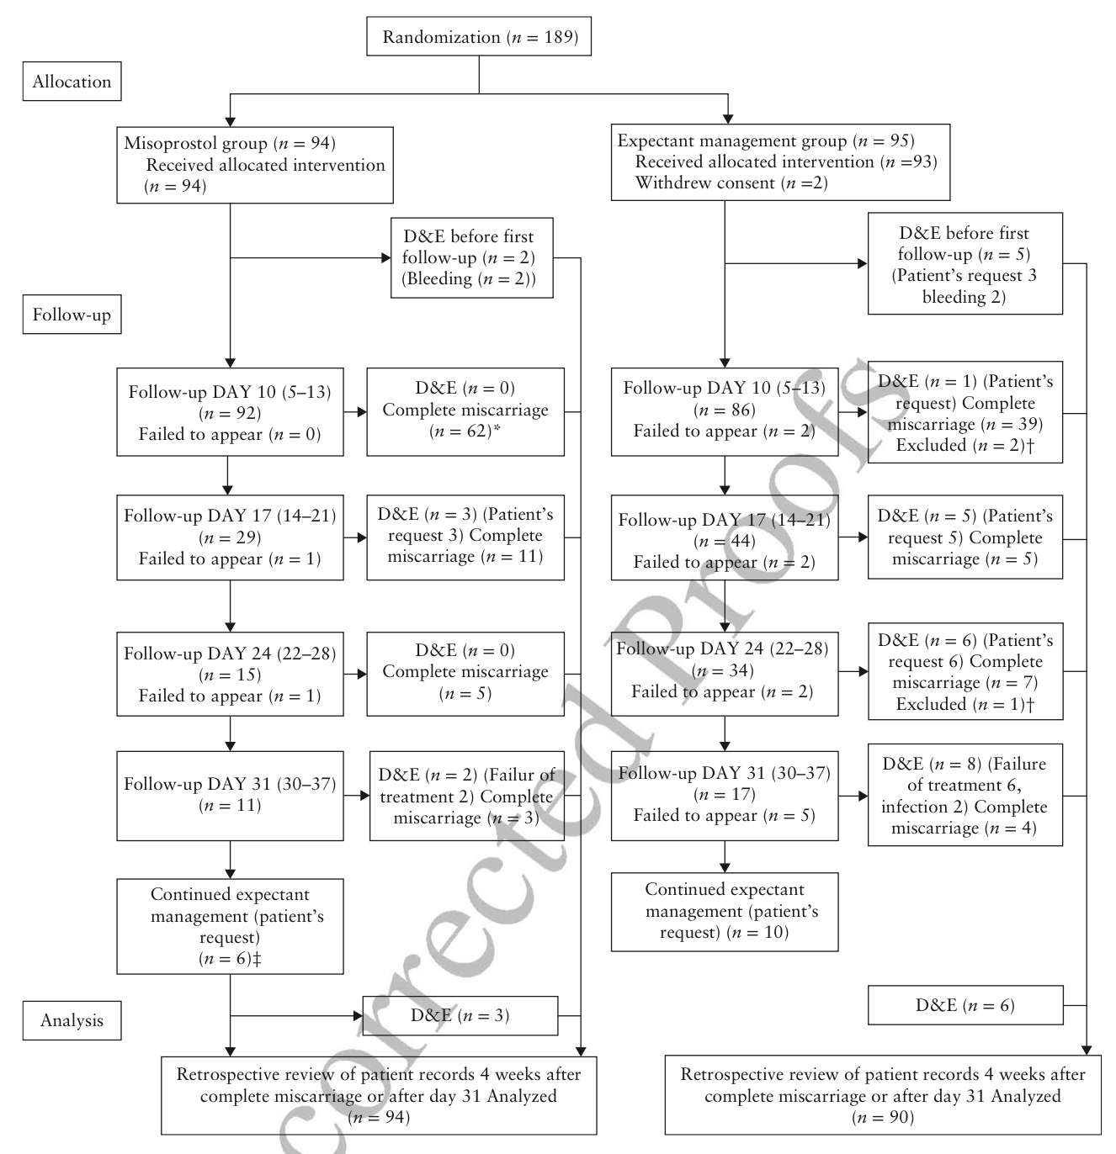
Misoprostol treatment vs expectant management in women with early non-viable pregnancy and vaginal bleeding: a pragmatic randomized controlled trial
Fernlund et al., UOG 2018
Results
Flowchart summarizing participant management
  189 randomized
    94 to misoprostol
    95 to expectant management (5 later withdraw consent or did not meet inclusion criteria).
Two groups
  Misoprostol group
    All women randomized participated, totaling 94
  Expectant group
    5 women withdraw consent or were not eligible
    Therefore, 90 participants were included in this group
Notes:
*** The baseline characteristics table is now in the supp file which I don’t have access to.

Slide 8
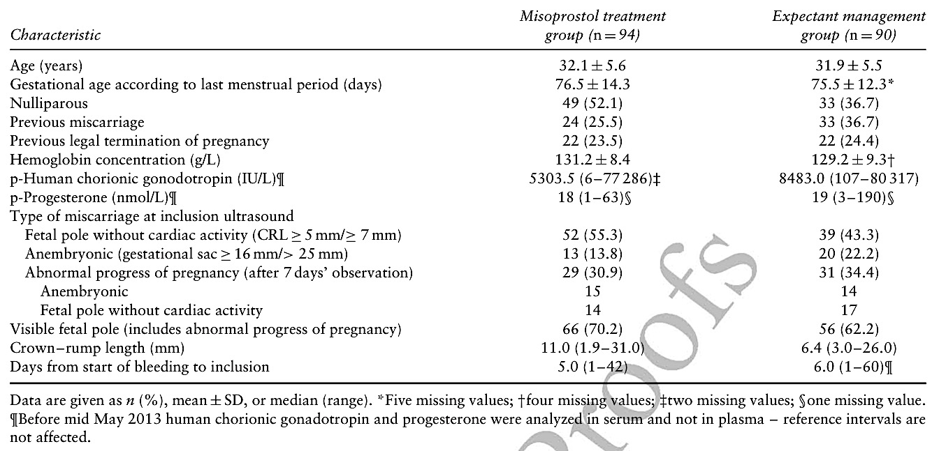
Misoprostol treatment vs expectant management in women with early non-viable pregnancy and vaginal bleeding: a pragmatic randomized controlled trial
Fernlund et al., UOG 2018
Results
Baseline characteristics
Nulliparity, larger CRL and lower hCG levels were present in the misoprostol group.
Notes:
*** The baseline characteristics table is now in the supp file which I don’t have access to.

Slide 9
Misoprostol treatment vs expectant management in women with early non-viable pregnancy and vaginal bleeding: a pragmatic randomized controlled trial
Fernlund et al., UOG 2018
Results
Primary outcome
 | Misoprostol treatment (n=94) | Expectant management (n=90) | Difference (95% CI)
Complete miscarriage ≤ 10 days ≤ 31 days | 66% 86.2% | 43.3% 61.1% | 22.6 (7.5 to 36.5) 25.1 (11.6 to 37.5)

Slide 10
Misoprostol treatment vs expectant management in women with early non-viable pregnancy and vaginal bleeding: a pragmatic randomized controlled trial
Fernlund et al., UOG 2018
Secondary outcomes
 | Misoprostol treatment (n=94) | Expectant management (n=90) | Difference (95% CI)
Total number of patients with D&E Patients undergoing emergency D&E Patients undergoing D&E on request D&E for failed management | 10.6% 2.1% 3.2% 5.3% | 34.4% 4.4% 16.7% 13.3% | -23.8 (-35.8 to -11.1) -2.3% (-9.7 to 4.5%) 13.5% (4.1 to 23.4%) 8.0% (-1.4 to 17.8)
Unscheduled visits | 28.7% | 55.6% | -26.8 (-40.3 to -11.8)
Vaginal bleeding, number of days | 12.7±6.6 | 15.0±8.2 | -2.3 (-4.6 to -0.6)
Patients with pain | 100% | 92.2% | 7.8 (1.0 to 16.8)
Patients having oral analgesia | 93.4% | 76.6% | 16.8 (5.2 to 28.7)
Notes:
10

Slide 11
Misoprostol treatment vs expectant management in women with early non-viable pregnancy and vaginal bleeding: a pragmatic randomized controlled trial
Fernlund et al., UOG 2018
Discussion
Findings
  Treatment with misoprostol is more effective than expectant management in evacuating the uterus for early non-viable pregnancy and vaginal bleeding.
  More patients in the expectantly managed group had a D&E and were seen in out of protocol visits.
  More patients treated with misoprostol experienced pain and took analgesia
Study limitations
  This study only assessed patients with vaginal bleeding therefore these results cannot be generalized to patients with missed miscarriage
  This trial was not blinded
Notes:
11

Slide 12
Misoprostol treatment vs expectant management in women with early non-viable pregnancy and vaginal bleeding: a pragmatic randomized controlled trial
Fernlund et al., UOG 2018
Discussion
Implications for practice
  Misoprostol treatment of incomplete miscarriage is more efficacious than expectant management, but more women reported pain.
  Misoprostol treatment results in fewer D&E and emergency presentations.
Conclusions
Misoprostol is more efficacious than expectant management for the treatment of incomplete miscarriage

Slide 13
Misoprostol treatment vs expectant management in women with early non-viable pregnancy and vaginal bleeding: a pragmatic randomized controlled trial
Fernlund et al., UOG 2018
Future perspectives
An understanding of the success rates of misoprostol compared with expectant management in patients with incomplete miscarriage is required to counsel patients appropriately
Discussion points
It would be interesting to examine clinical features associated with successful expectant or medical management so care could be individualized.
The definition of complete miscarriage may need revision with ultrasound appearance rather than anterioposterior diameter being included or a clinical definition.
Notes:
13

