Slide 1



UOG Journal Club: May 2020
Should cell-free DNA testing be used in pregnancy with increased fetal nuchal translucency?
J. MIRANDA, F. PAZ Y MINO, V. BOROBIO, C. BADENAS,
L. RODRIGUEZ-REVENGA, M. PAUTA and A. BORRELL
Volume 55, Issue 5
Journal Club slides prepared by Dr Alessandra Familiari
(UOG Editor for Trainees)

Slide 2
Should cell-free DNA testing be used in pregnancy with increased fetal nuchal translucency?
Miranda et al, UOG 2020
Introduction
The introduction of fetal cell-free DNA (cfDNA) as a screening test for fetal aneuploidy questionned the utility of the components of first-trimester combined screening, such as nuchal translucency (NT) measurement.
Fetuses with increased nuchal translucency (NT) thickness are at increased risk of chromosomal and cardiac anomalies.
Increased NT is a marker for cardiac and other structural anomalies, microdeletion syndromes and some single-gene disorders that cannot be detected by cfDNA.
There is uncertainty over the role of cfDNA testing in fetuses with increased NT.
Notes:
2

Slide 3
Should cell-free DNA testing be used in pregnancy with increased fetal nuchal translucency?
Miranda et al, UOG 2020
Aim of the study
The objective of this study was to evaluate which genetic and structural anomalies would be missed if only cfDNA testing was performed in fetuses with NT> 99th percentile in order to assess the suitability of cfDNA as the sole test in these high-risk pregnancies.
Notes:
3

Slide 4
Should cell-free DNA testing be used in pregnancy with increased fetal nuchal translucency?
Miranda et al, UOG 2020
Methods
Study design: retrospective cohort study.
Study population: 226 fetuses with NT > 99th centile at 11–14 weeks’ gestation.
All pregnancies with NT > 99th centile, were offered chorionic villus sampling (CVS) irrespective of the obtained combined risk. Quantitative fluorescence polymerase chain reaction (QF-PCR) was performed and, if normal, subsequent chromosomal microarray (CMA) analysis was carried out.
Results of both QF-PCR and CMA were evaluated to determine the rate of chromosomal or submicroscopic anomalies that would theoretically be missed by cfDNA testing.
Primary outcome: to compare the theoretical performance of two cfDNA testing models, targeted cfDNA (involving chromosomes13, 18 and 21) and extended cfDNA (involving chromosomes 13, 18, 21 and sex chromosomes), with that of cytogenetic testing and ultrasound assessment in the first and second or third trimesters.

Slide 5
Should cell-free DNA testing be used in pregnancy with increased fetal nuchal translucency?
Miranda et al, UOG 2020
Results
Included were 226 pregnancies (198 singleton and 28 twin) in which at least one fetus had NT > 99th percentile
QF-PCR revealed a typical aneuploidy that would be detectable by both targeted and extended cfDNA analysis in 68 (30%) fetuses.
CMA revealed 3 clinically relevant atypical chromosomal abnormalities and 5 submicroscopic pathogenic variants.
In two fetuses with a normal CMA result, persistence of increased NT prompted testing for, and diagnosis of, Noonan syndrome in the second trimester using stored fetal DNA.

Slide 6
Should cell-free DNA testing be used in pregnancy with increased fetal nuchal translucency?
Miranda et al, UOG 2020
Results
Of the 84 (37.2%) genetic anomalies identified in the study population:
- 68 would be detectable by targeted cfDNA testing;
- 74 would be detectable by the extended cfDNA approach.
This means that 19.0% (16/84) and 11.9% (10/84) of the fetuses with increased NT and a genetic anomaly detectable prenatally would be missed if the targeted and extended, respectively, cfDNA testing were used.

Slide 7
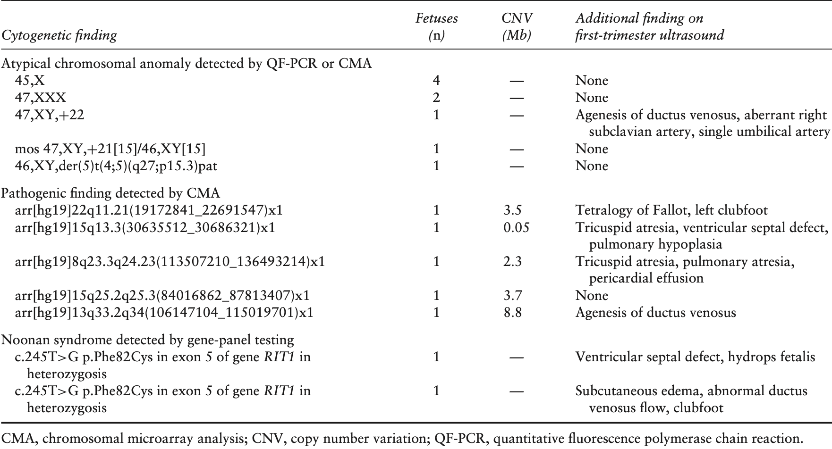
Should cell-free DNA testing be used in pregnancy with increased fetal nuchal translucency?
Miranda et al, UOG 2020
Results
Chromosomal, submicroscopic and monogenic anomalies undetectable by targeted cfDNA testing identified in the study population of fetuses with NT> 99th centile in first trimester.

Slide 8
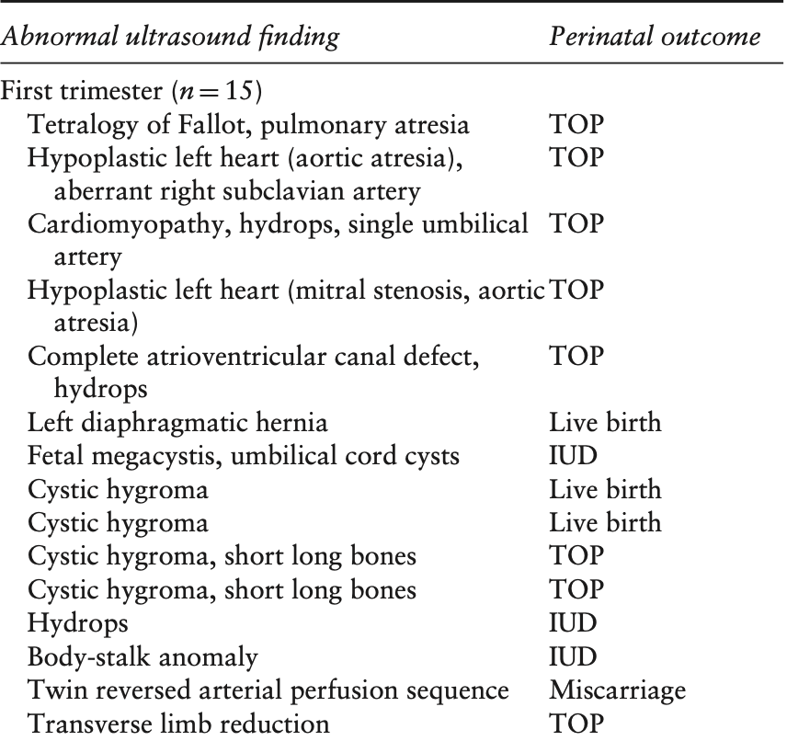
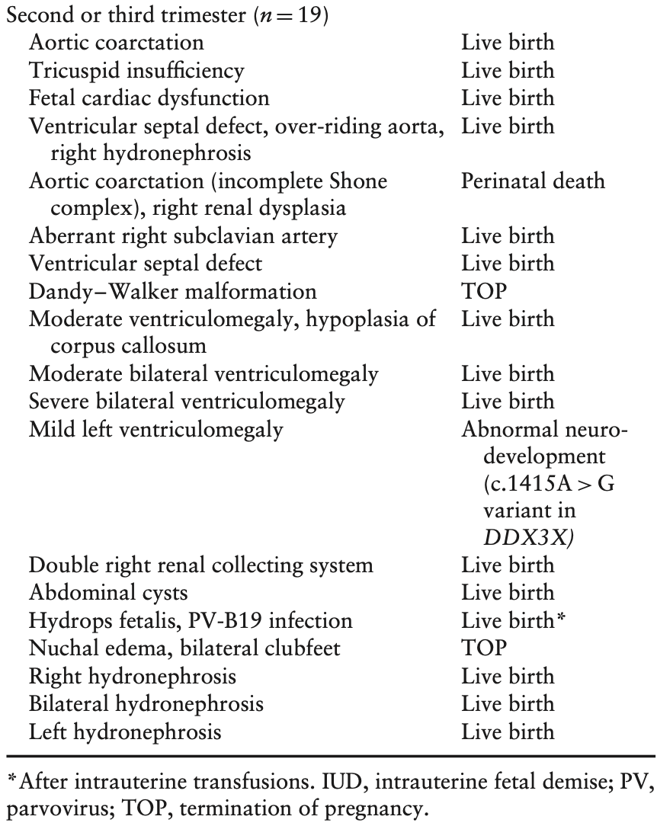
Should cell-free DNA testing be used in pregnancy with increased fetal nuchal translucency?
Miranda et al, UOG 2020
Major fetal malformations detected on first- and second- or third-trimester ultrasound, in fetuses with NT > 99th centile in first trimester and normal result on QF-PCR and CMA.

Slide 9
Should cell-free DNA testing be used in pregnancy with increased fetal nuchal translucency?
Miranda et al, UOG 2020
Results
In the 142 fetuses with no genetic anomalies identified:
Early anomaly scan and early fetal echocardiography identified structural defects in 15 (10.6%) fetuses, resulting in one miscarriage, eight terminations of pregnancy, three intrauterine fetal demises and three live births.
In the 127 remaining fetuses with normal first-trimester genetic testing and imaging findings, second-trimester imaging (fetal echocardiogram + anomaly scan) identified structural anomalies in 19 (15.0%).
The remaining 108/226 (47.8%) fetuses with increased NT in the first trimester had a normal perinatal outcome.
Notes:
9

Slide 10
Should cell-free DNA testing be used in pregnancy with increased fetal nuchal translucency?
Miranda et al, UOG 2020
Discussion
In fetuses with increased NT in the first trimester, conventional cfDNA testing does not appear to be a valuable test, since 12–19% of genetic abnormalities would be missed by such a test, accounting for 4.4–7.1% of the studied fetuses.
The first-trimester anomaly scan was able to identify additional structural anomalies in 11% of euploid fetuses with an enlarged NT in the first trimester and no genetic anomalies, accounting for 6.6% of the studied fetuses.
Second-trimester follow-up ultrasound assessment allowed identification of structural anomalies in a further 8.4% of the studied population.
Notes:
10

Slide 11
Should cell-free DNA testing be used in pregnancy with increased fetal nuchal translucency?
Miranda et al, UOG 2020
Strengths and limitations
A strength of this study is that genetic testing was performed consistently during the study using a protocol for increased NT that was updated in 2013 to replace karyotyping with CMA.
A limitation of the study is the retrospective design and the assumption of a theoretical detection rate of 100% for genetic anomalies detectable by cfDNA, when in clinical practice this rate ranges from 99% for trisomy 21 to 90% for monosomy X.
Conclusion
cfDNA testing misses 12–19% of genetic anomalies in fetuses with NT > 99th centile.
First-trimester ultrasound can identify a major structural abnormality in 11% of fetuses with NT > 99th centile and no genetic anomaly.

Slide 12
Should cell-free DNA testing be used in pregnancy with increased fetal nuchal translucency?
Miranda et al, UOG 2020
Discussion points
Does this paper change the present clinical practice in managing fetuses with NT> 99th percentile?
If cfDNA testing does not appear to be the appropriate genetic test in fetuses with NT > 99th centile, which population would benefit from this test?
Should the proposed clinical management protocol be extended to all high-risk pregnancies?
Do we need a study to better define the sensitivity of extended cfDNA testing?
Do the results of this study add information for an updated counselling to high-risk pregnancies?
Notes:
12

