Slide 1
Case of the Month
Author
Affiliation

Slide 2
PART I: The Challenge
Presentation
Medical history
See notes for example
Max 5 slides
Notes:
A 16-year-old woman, virgo, with increasing lower abdominal pain for three days and low-grade fever, not responsive to medical treatment, admitted to our emergency room.
She referred no significant family or personal medical history, menarche at 13 years and regular menstrual cycle.
Bloods revealed increased c-reactive protein value (33 mg/dL) and no leukocytosis.

Slide 3
PART I: The Challenge
Ultrasound images/videos
See notes for example
Notes:
At ultrasound scan uterine abnormalities were not visible and ovarian appeared normal bilaterally

Slide 4
PART I: The Challenge
Of which (differential) diagnosis are you thinking of?

Slide 5
Part II : The Solution
Description of the US findings and of the additional investigations
Ultrasound images/videos
Max 5 slides
These can be the same as before, but with captions
See notes for example
Notes:
The ultrasound scan revealed medially to left ovarian parenchyma, a unilocular cyst of 48x28x45 mm in size, with anechoic content, regular internal cyst wall and no vascularization at color Doppler examination

Slide 6
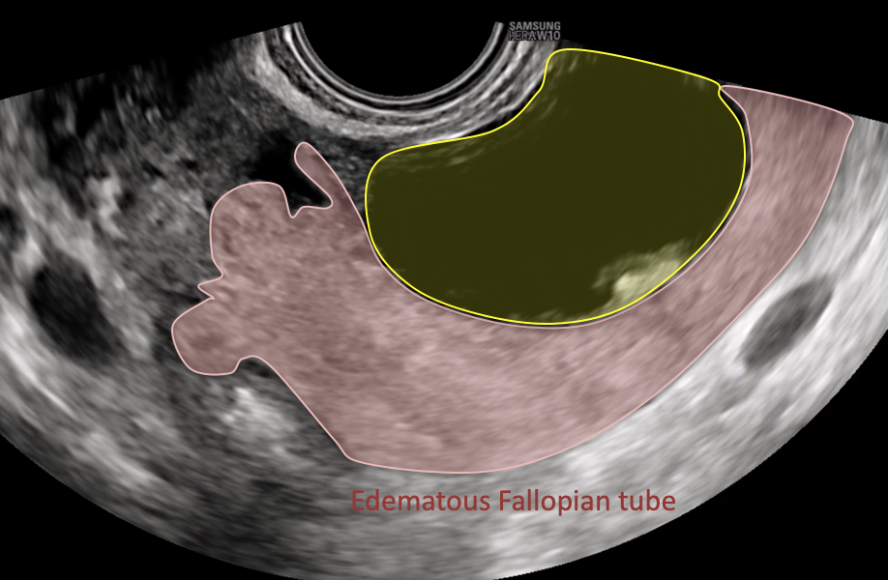
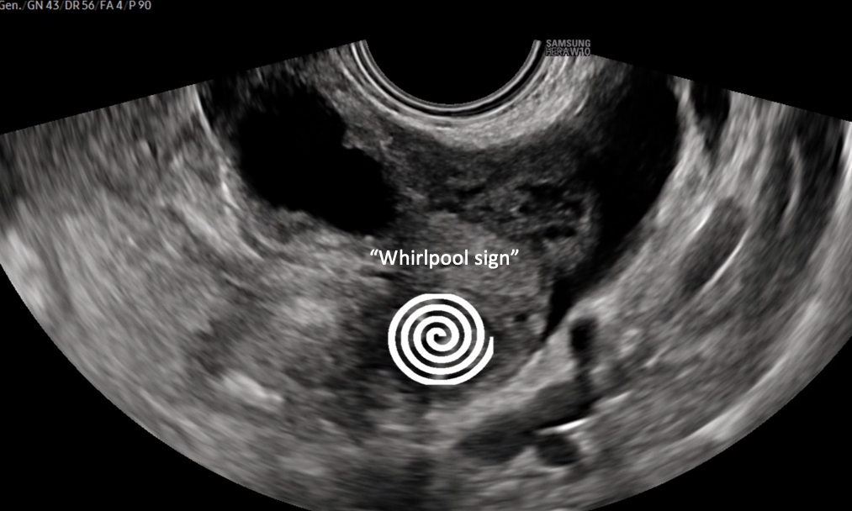
Summary of the relevant ultrasound findings
normal left ovarian parenchyma
left paraovarian cyst
left edematous Fallopian tube
whirlpool sign
Final Diagnosis:
Notes:
(this is an example. This slide is not mandatory)
Diagnostic Hypothesis.
Relevant ultrasound findings:
normal left ovarian parenchyma.
left paraovarian cyst.
left edematous Fallopian tube.
“Whirlpool sign”.
A suspicion of Isolated Left Tubal Torsion was made.

Slide 7
Follow-up
See notes for example
Notes:
Given the persistent abdominal pain, a diagnostic laparoscopy was performed, that confirmed the isolated left tubal torsion. Surgeon tried to perform a fertility sparing surgery, untwisting the tube to a neutral position, but as no change in color of the tube was observed therefore, necrosis was suspected and left salpingectomy was performed.

Slide 8
Discussion
See notes for example
Take home message (if necessary)
Please also view the VISUOG chapter on…
Notes:
ITT is rare, but should be suspected in young women with low abdominal pain and low grade fever not responsive to medical treatment
In case of ITT US scan shows a normal ipsilateral ovary, eventual paraovarian mass and whirlpool sign
The first treatment approach is a laparoscopic adnexal detorsion, but if necrosis is documented a salpingectomy is mandatory
A delayed diagnosis could reduce the possibility of a fertility sparing treatment

Slide 9
References

