Slide 1



UOG Journal Club: September 2018
妇产科超声杂志俱乐部：2018年9月
Longitudinal growth assessment for prediction of adverse perinatal outcome in fetuses suspected to be small-for-gestational age
预测可疑小于胎龄胎儿不良围产结局的纵向生长评估
Caradeux J, Eixarch E, Mazarico E, Basuki TR, Gratacos E, Figueras F
Volume 52, Issue 3
52卷，3期
Journal Club slides prepared by Dr Erkan Kalafat
(UOG Editor for Trainees)
杂志俱乐部幻灯由Erkan Kalafat博士准备
（UOG为学院编辑的内容）

Slide 2
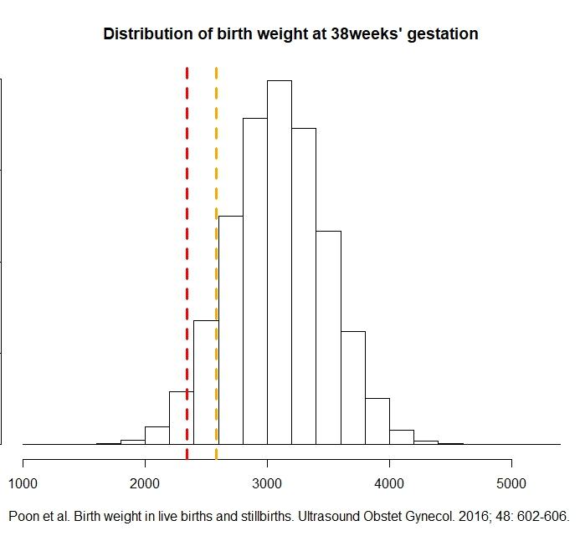
Longitudinal growth assessment for prediction of adverse perinatal outcome in fetuses suspected to be small-for-gestational age
Caradeux et al., UOG 2018
Introduction介绍
Fetal growth restriction (FGR) is an indicator of adverse pregnancy outcome including stillbirth, intrapartum fetal compromise, perinatal morbidity and mortality.
胎儿生长受限可提示不良妊娠结局，包括死产、产时胎儿受损、围产期发病率和死亡率
Depending on the definition & cut-off used, 3–10% of all pregnancies would appear to be at risk.
根据定义和截断值，3-10%的妊娠会有风险。
Yet the incidence of adverse outcome is much smaller.
但不良结局的发生率要小得多。
孕38周的出生体重分布
10%的病例存在风险（截断值=2579 gr）
10% of the population
under risk
(cutoff= 2579 gr )
3% of the population
under risk
(cutoff = 2342 gr )
3%的病例存在风险（截断值=2342 gr）

Slide 3
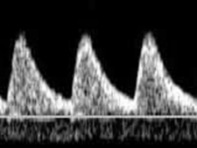
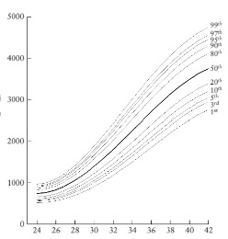
Longitudinal growth assessment for prediction of adverse perinatal outcome in fetuses suspected to be small-for-gestational age
Caradeux et al., UOG 2018
Introduction介绍
Late FGR definition*
晚期FGR的定义
There is a need for adjunct markers to identify small-for-gestational-age (SGA) fetuses at greater risk of adverse outcome.
需要辅助标记来识别具有较高不良结局风险的小于胎龄（SGA）的胎儿。
Doppler parameters such as umbilical artery (UA) pulsatility index (PI) or cerebroplacental ratio (CPR) have been suggested as candidates.
建议应用多普勒参数如脐动脉（UA）搏动指数（PI）或脑胎盘比（CPR）
Growth velocity has also been implicated as a marker for adverse outcome.
生长速度也是不良结局的标志
Abdominal circumference (AC)
Estimated fetal weight (EFW)
< 3rd centile
腹围（AC）
估计胎儿体重（EFW）
<第三百分位数
或
出现下列两项
OR
two of the following
脐动脉搏动指数>95th
脑胎盘比值<5th
UA-PI > 95th
CPR < 5th
AC/EFW crossing centiles > 2
quartiles on growth centiles
腹围/EFW交叉百分位数>生长
百分位数的第2百分位数
AC/EFW
< 10th centile
AC/EFW<第10百分位数
*Gordijn et al. Consensus definition of fetal growth restriction: a Delphi procedure. Ultrasound Obstet Gynecol. 2016; 48: 333-339.

Slide 4
Longitudinal growth assessment for prediction of adverse perinatal outcome in fetuses suspected to be small-for-gestational age
Caradeux et al., UOG 2018
Study Aim研究目的
To evaluate the utility of longitudinal assessment by means of estimated fetal weight (EFW) change in velocity for the prediction of adverse perinatal outcome in suspected late-SGA fetuses.
通过估计胎儿体重（EFW）的速度变化评估纵向评估的效能，以预测可疑晚期SGA胎儿的不良围产期结局。
Inclusion criteria入组标准
Exclusion criteria排除标准
EFW < 10th centile according to local reference values (customized growth chart).
根据当地参考值，EFW <10th 百分位数（生长曲线图）。
FGR diagnosis made after 32 weeks’ gestation.
妊娠32周后诊断的FGR。
Congenital malformation, including chromosomopathy, infection or maternal use of an illicit substance.
先天性畸形，包括染色体异常、感染或母体违禁药物的应用。

Slide 5
Longitudinal growth assessment for prediction of adverse perinatal outcome in fetuses suspected to be small-for-gestational age
Caradeux et al., UOG 2018
Methods方法
Study center: Fetal i+D Fetal Medicine Research Center, Barcelona.
研究中心：巴塞罗那 Fetal i + D 胎儿医学研究中心
Recruitment period: 2008–2016. 招募时间：208-2016
Local screening protocol:当地筛查方案
Low risk for FGR (fundal-height measurement) FGR低风险（宫高测量）
If diagnosed
with late FGR during screening, invite for participation in the study
如筛查期间诊断为晚期FGR，则邀其参与此次研究
26w
32w – 34w
High risk for FGR (serial ultrasound) FGR高风险（连续超声检查）
28w
32w
37w

Slide 6
Longitudinal growth assessment for prediction of adverse perinatal outcome in fetuses suspected to be small-for-gestational age
Caradeux et al., UOG 2018
Study follow-up protocol研究随访方案
1 week
2 weeks
Doppler
Doppler
Doppler
EFW &
Doppler
EFW &
Doppler
Induction at 37 weeks
if CPR (< 5th) measured twice (12 h apart).
Induction at 40w otherwise.
如果两次测量（间隔12小时）CPR（<第5百分位数），则在37周时引产。否则在40w时引产
Enrolled in study
Suspected late FGR
(EFW < 10th centile
diagnosed > 32 weeks)
参与此次研究的可疑晚期FGR（EFW<第10百分位数，诊断时间>32周）
Doppler / every week
EFW / every 2 weeks
多普勒检查/每周
EFW/每两周

Slide 7
Longitudinal growth assessment for prediction of adverse perinatal outcome in fetuses suspected to be small-for-gestational age
Caradeux et al., UOG 2018
Outcome measures结局测量
Adverse perinatal outcome
(Primary)
围产期不良结局（主要）
Non-reassuring fetal status requiring emergency Cesarean section.
5-min Apgar score < 7 or neonatal metabolic acidosis at birth (defined as presence of pH ≤ 7.10 and base excess > 12 mEq/L at birth).
Need for admission to neonatal intensive care unit.
Perinatal death.
胎儿窘迫时需要紧急剖腹产。
5分钟Apgar评分<7或出生时新生儿代谢性酸中毒（定义为出生时pH≤7.10且碱过量> 12 mEq / L）。
需要进入新生儿重症监护病房。
围产期死亡。
Adverse neonatal outcome (Auxillary)
新生儿不良结局（辅助）
Neonatal intensive care unit for neonatal hypoglycemia (defined as a plasma glucose level of < 30 mg/dL in the first 24 h postpartum).
Neonatal hyperbilirubinemia (defined as a peak serum concentration > 95th centile).
Transient tachypnea (defined as onset of tachypnea (> 60/min) within 6 h after birth with any of the following: expiratory grunting, flaring of the nostrils or costal retractions).
新生儿因低血糖进入新生儿重症监护病房（定义为产后24小时血糖水平<30 mg / dL）。
新生儿高胆红素血症（定义为峰值血清浓度> 95th百分位数）。
短暂性呼吸急促（定义为出生后6小时内呼吸急促发作（> 60 / min），伴有以下任何一种：呼气呻吟、鼻孔扩张或肋骨回缩）。

Slide 8
Longitudinal growth assessment for prediction of adverse perinatal outcome in fetuses suspected to be small-for-gestational age
Caradeux et al., UOG 2018
研究人群
Results结果
失访
EWF<10th
EFW<3rd或多普勒异常
胎膜早破
胎儿窘迫
低Apgar评分
新生儿酸中毒
NICU住院
围产期死亡
正常
不良

Slide 9
Longitudinal growth assessment for prediction of adverse perinatal outcome in fetuses suspected to be small-for-gestational age
Caradeux et al., UOG 2018
Results结果
Statistically significant differences between study groups:
GA at delivery.
EFW z-score at diagnosis.
EFW z-score at last ultrasound.
Uterine, umbilical and middle cerebral artery PI z-scores.
CPR z-score.
EFW z-velocity in lowest decile.
FGR and SGA incidence.
研究组之间具有
显著统计学差异：
分娩时的孕周。
诊断时的EFW z-评分。
最后一次超声检查的
EFW z-评分。
子宫动脉、脐动脉和大脑
中动脉PI z-评分。
脑胎盘比 z-评分。
最低十分位数的EFW z-速度。
FGR和SGA发病率。

Slide 10
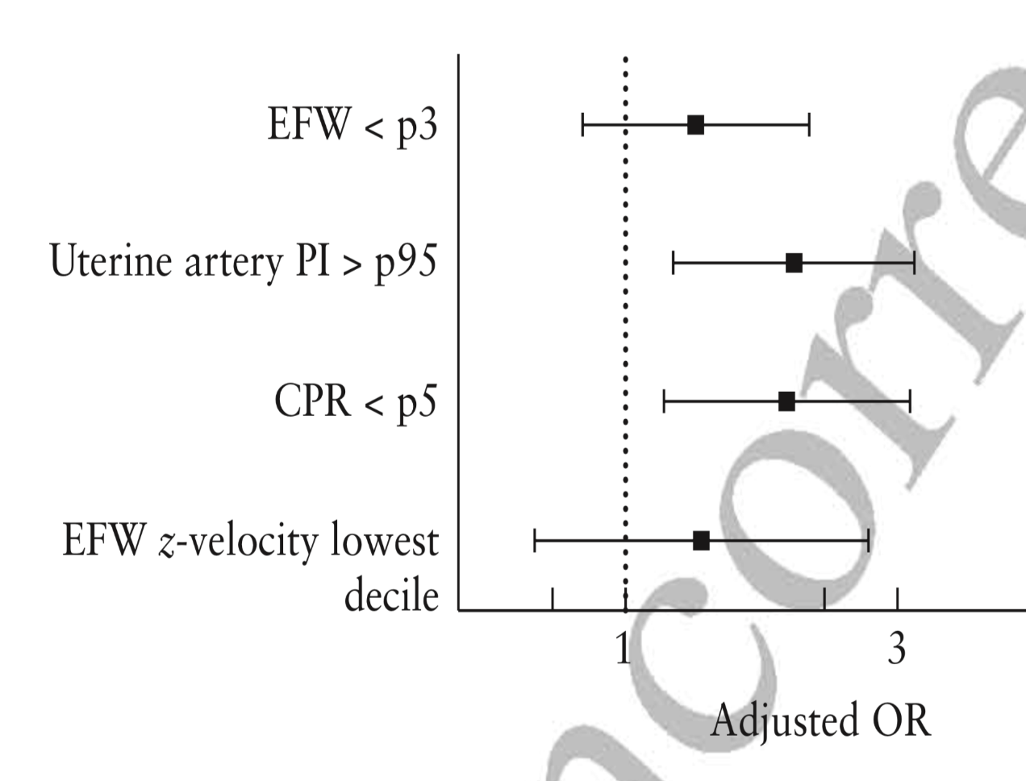
Longitudinal growth assessment for prediction of adverse perinatal outcome in fetuses suspected to be small-for-gestational age
Caradeux et al., UOG 2018
Results结果
OR: 1.36 (0.85–2.19) | P = 0.204
OR: 2.05 (1.24–3.40) | P = 0.005
OR: 2.00 (1.19–3.35) | P = 0.009
OR: 1.39 (0.69–2.81) | P = 0.354
Statistically significant
Results of multivariate logistic regression model:
According to adjusted ORs only, UA-PI > 95th and CPR < 5th were independently associated with adverse outcome.多变量logistic回归模型的结果：
仅根据校正后的OR值，UA-PI> 95th和CPR < 5th与不良结局独立相关。

Slide 11
Longitudinal growth assessment for prediction of adverse perinatal outcome in fetuses suspected to be small-for-gestational age
Caradeux et al., UOG 2018
Results结局
Results of multivariate logistic regression models:
Whether Doppler parameters were used as continuous or categorical variables, the significance of the results did not change across different models.
Fetal growth parameters (EFW or growth velocity) did not attain statistical significance.
多变量 logistic回归模型的结果：
无论多普勒参数是连续变量还是分类变量，在不同模型中都没有变化。
胎儿生长参数（EFW或生长速度）无统计学意义。

Slide 12
Longitudinal growth assessment for prediction of adverse perinatal outcome in fetuses suspected to be small-for-gestational age
Caradeux et al., UOG 2018
Discussion讨论
What do we know already?
Fetal growth velocity is implicated as a marker of adverse outcome and it was included as an auxiliary criterion for late FGR diagnosis in a recent Delphi consensus by Gordijn et al..
  The literature is conflicted about the value of growth velocity in improving the detection of adverse outcome and also about how best to evaluate growth velocity (conditional growth, growth rate or velocity, individualized growth trajectories).
  The studies of Sovio et al. and Karlsen et al. suggest growth velocity may improve the detection of adverse outcome in suspected SGA fetuses.
  However, the value of growth velocity in addition to Doppler assessment has been scarcely evaluated.
我们已经知道了什么？
胎儿生长速度被认为是不良结局的标志，Gordijn等人在最近的Delphi共识中认为其为晚期FGR诊断的辅助标准。
在关于如何最好地评估生长速度及生长速度预测不良结局方面的价值（生长条件、生长速率或速度、个体化生长轨迹）的方面，相关文献存在冲突。
Sovio等人和 Karlsen等人的研究建议生长速度可以提高可疑SGA胎儿不良结局的检出。
然而，除了多普勒评估之外，几乎没有其它更好的方法来评估生长速度。

Slide 13
Longitudinal growth assessment for prediction of adverse perinatal outcome in fetuses suspected to be small-for-gestational age
Caradeux et al., UOG 2018
Discussion讨论
What are the implications of current study?
Fetal growth velocity may not improve the detection of adverse perinatal outcome in suspected late FGR fetuses when used in addition to Doppler evaluation.
当前研究的意义是什么？
除了多普勒评估之外，胎儿生长速度的应用可能不会提高可疑晚期FGR胎儿的不良围产期结局的检出。

Slide 14
Longitudinal growth assessment for prediction of adverse perinatal outcome in fetuses suspected to be small-for-gestational age
Caradeux et al., UOG 2018
Strong points and limitations优势和局限性
Strengths优势
Prospective design limits the effect of intervention bias and also allows interpreting its impact on the results.
Largest published cohort so far which had longitudinal assessment.
前瞻性设计限制了干预偏倚的影响，并能解释其对结果的影响。
迄今为止已发表的进行纵向评估的最大队列。

Slide 15
Longitudinal growth assessment for prediction of adverse perinatal outcome in fetuses suspected to be small-for-gestational age
Caradeux et al., UOG 2018
Strong points and limitations优势和局限性
Limitations局限性
Results only apply to late FGR and not early FGR.
Longitudinal assessment only took two measurements into account (first and last).
Effect of longitudinal change was only evaluated via z-velocity change (more methods are available).
The effect of maternal characteristics was not evaluated.
Abdominal circumference change velocity was not evaluated.
结果仅适用于晚期FGR而非早期FGR。
纵向评估仅考虑了两个测量值（第一个和最后一个）。
仅通过z-速度变化评估纵向变化的影响（可获得更多方法）。
没有评估母体特征的影响。
未评估腹围变化速度。

Slide 16
Longitudinal growth assessment for prediction of adverse perinatal outcome in fetuses suspected to be small-for-gestational age
Caradeux et al., UOG 2018
Conclusion结论
Longitudinal assessment of fetal growth by means of EFW z-velocity does not add value to Doppler criteria in predicting adverse perinatal outcome in SGA-suspected fetuses.
通过EFW z-速度对胎儿生长进行纵向评估不会增加多普勒标准预测可疑SGA胎儿不良围产期结局方面的价值。

Slide 17
Longitudinal growth assessment for prediction of adverse perinatal outcome in fetuses suspected to be small-for-gestational age
Caradeux et al., UOG 2018
Discussion Points讨论要点
Considering that ultrasound measurements (biometry or Doppler) are subject to inter- and intra-rater variability and that short scanning intervals can lead to false-positive results:
What is the ideal time frame for scanning intervals?
What are the best methods for longitudinal assessment of fetal growth (growth velocity, conditional centiles, etc)?
What is the role of intervention bias (delivering according to a study protocol or unblinded assessment) on results?
考虑到超声测量（生物测量或多普勒）受到评估者之间和内部的变化，并且扫查间隔短可能导致假阳性结果：
理想的扫查间隔时间范围是多少？
对胎儿生长进行纵向评估的最佳方法是什么（生长速度，条件性百分位等）？
干预偏倚（根据研究方案或非盲评估分娩）对结果的影响是什么？

