Slide 1



UOG Journal Club: March 2020
Comparison of antral follicle count and serum anti-Müllerian hormone level for determination of gonadotropin dosing in in-vitro fertilization: randomized trial
H. W. R. LI, J. K. Y. KO, V. C. Y. LEE, S. S. F. YUNG, E. Y. L. LAU,
W. S. B. YEUNG, P. C. HO and E. H. Y. NG
Volume 55, Issue 3
Journal Club slides prepared by Dr Erkan Kalafat (UOG Editor for Trainees)

Slide 2
Comparison of antral follicle count and serum anti-Müllerian hormone level for determination of gonadotropin dosing in in-vitro fertilization: randomized trial
Li et al., UOG 2020
Introduction
Ovarian responsiveness to gonadotropin stimulation has important implications for the success of in-vitro fertilization (IVF).
Both antral follicle count (AFC) and serum anti-Müllerian hormone (AMH) level are good predictors of ovarian response during IVF.
Sonographic measurement of AFC is available immediately in most IVF centers, and is not laboratory dependent. However, the counting of antral follicles is operator dependent and is also influenced by the resolution of the ultrasound probe and machine.
AMH has the advantages of having less intra- and intercycle variation and of its determination not being operator dependent; however, it has an additional cost and there has been no standardization of AMH values measured by the different assay methods available.

Slide 3
Comparison of antral follicle count and serum anti-Müllerian hormone level for determination of gonadotropin dosing in in-vitro fertilization: randomized trial
Li et al., UOG 2020
Aim
To compare the proportion of women having a desired ovarian response following ovarian stimulation when gonadotropin dosing was based on AFC vs on serum AMH level, in women undergoing IVF using the GnRH antagonist protocol.

Slide 4

Comparison of antral follicle count and serum anti-Müllerian hormone level for determination of gonadotropin dosing in in-vitro fertilization: randomized trial
Li et al., UOG 2020
Methods
Randomization
Inclusion criteria:
  Undergoing first IVF cycle
Exclusion criteria:
  Body-mass index >30kg/m²
  Repeated IVF cycles
  Donor cycles
  Undergoing pre-implantation genetic diagnosis
Initial gonadotrophin dose was adjusted according to AMH or AFC count.
First 1-10 patients
Protocol A
N=10
Patients 11-20
Protocol B
N=10
Patients 21-30
Protocol A
N=10
Patients 31-40
Protocol B
N=10
AMH and AFC levels were measured 1 month prior to the treatment cycle.
Patients were randomized to AMH or AFC protocol 1:1.
Block randomization.
Block size = 10.

Slide 5
AFC
Comparison of antral follicle count and serum anti-Müllerian hormone level for determination of gonadotropin dosing in in-vitro fertilization: randomized trial
Li et al., UOG 2020
Methods
Patients were randomized to AFC or AMH protocol to decide the initial gonadotropin dose:
AMH
Initial dose
Gonadotrophin dose 150 IU/day
Doses were titrated 1 time only, depending on the treatment response
Gonadotrophin dose 225 IU/day
Gonadotrophin dose 300 IU/day

Slide 6
Comparison of antral follicle count and serum anti-Müllerian hormone level for determination of gonadotropin dosing in in-vitro fertilization: randomized trial
Li et al., UOG 2020
1 cycle of COC
previous
month
All patients were stimulated according to a standardized COH protocol

Slide 7
Primary outcome
Comparison of antral follicle count and serum anti-Müllerian hormone level for determination of gonadotropin dosing in in-vitro fertilization: randomized trial
Li et al., UOG 2020
Methods
Secondary outcomes
The proportion of women having a desired ovarian response.
Requirement for gonadotrophin dose change.
Total number of retrieved oocytes.
Follicular output rate (Count of dominant follicles >16 / AFC).
Planned subgroup analyses
Desired ovarian response:
retrieved oocyte count =
≥6 and ≤14.
AFC >5 and ≤ 5.

Slide 8
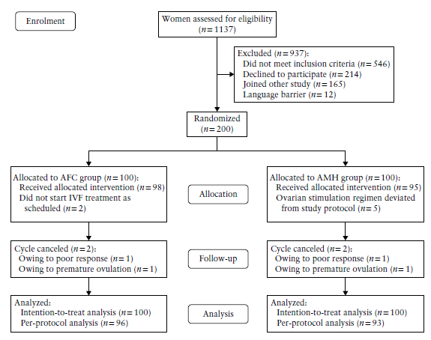
Comparison of antral follicle count and serum anti-Müllerian hormone level for determination of gonadotropin dosing in in-vitro fertilization: randomized trial
Li et al., UOG 2020
Results
No differences were found in the background demographic
or clinical characteristics between the
AFC and
AMH groups.

Slide 9
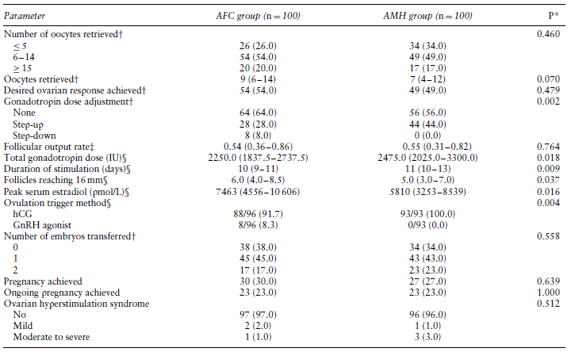
Comparison of antral follicle count and serum anti-Müllerian hormone level for determination of gonadotropin dosing in in-vitro fertilization: randomized trial
Li et al., UOG 2020
Results
No difference in
the primary outcome.
Increased need for dose
adjustment in AMH group.
Increased gonadotropin
dose in AMH group.
Lower serum peak estradiol
concentrations in AMH group.
Similar number of transferred
embryos, OHSS cases, clinical
and ongoing pregnancy rates.

Slide 10
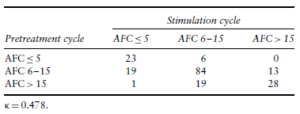
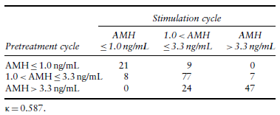
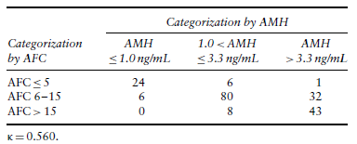
When classifying AFC values into low (≤ 5), normal (6–15) or high (> 15), there was moderate concordance between AFC categorization measured in the pretreatment vs in the stimulation cycle.
Comparison of antral follicle count and serum anti-Müllerian hormone level for determination of gonadotropin dosing in in-vitro fertilization: randomized trial
Li et al., UOG 2020
Results
When classifying AMH into low (≤1.0 ng/mL), normal (>1.0 and ≤3.3 ng/mL) or high (>3.3 ng/mL), there was moderate concordance between AMH categorization measured in the pretreatment vs in the stimulation cycle.
Concordance between categorization based on AFC and that based on AMH in the pretreatment cycle was observed in 73.5%, whereas in the remaining 26.5% patients, there was discordance if their dosing regimen was based on the alternative unassigned parameter.

Slide 11
Comparison of antral follicle count and serum anti-Müllerian hormone level for determination of gonadotropin dosing in in-vitro fertilization: randomized trial
Li et al., UOG 2020
Conclusions
The results show that there was no significant difference in the proportion of women achieving the desired ovarian response, as defined by the number of oocytes retrieved, when either AFC or serum AMH level was used for the determination of gonadotropin dosing in IVF.
The findings are in agreement with those of previous meta-analyses using receiver–operating characteristics curve prediction models, according to which both AFC and serum AMH level had comparable performance in predicting suboptimal ovarian response and excessive ovarian response.

Slide 12
Comparison of antral follicle count and serum anti-Müllerian hormone level for determination of gonadotropin dosing in in-vitro fertilization: randomized trial
Li et al., UOG 2020
Points for discussion
The peak estradiol concentrations were lower in the AMH group despite receiving a higher total dose of gonadotropin. What are the possible reasons for this and would it affect the interpretation of findings?
The AFC and AMH differed from randomization to treatment cycles. In which way this would bias the results?
What are the alternatives to block randomization and is it possible for randomization methods to influence the results in a RCT?

