Slide 1
UOG Journal Club: July 2018
Fetal Medicine Foundation fetal and neonatal population weight charts
K. H. Nicolaides, D. Wright, A. Syngelaki, A. Wright and R. Akolekar
Volume 52, Issue 1, pages 44–51
Journal Club slides prepared by Dr Maddalena Morlando
(UOG Editor for Trainees)

Slide 2
Fetal Medicine Foundation fetal and neonatal population weight charts
Nicolaides et al., UOG 2018
There is an apparent discordance in the relationship between ultrasound estimated of fetal weight (EFW) and actual birth weight (BW).
For a given gestational age, EFW and BW have similar medians, however, the lower bound of BW for babies born preterm is substantially lower than the EFW. This difference is likely to be the consequence of pathological fetal growth in a high proportion of preterm births.
Reference ranges of EFW are representative of the whole population, whereas in reference ranges of BW, particularly for gestational ages < 37 weeks, there is overrepresentation of pathological pregnancies.
One-third of preterm births are iatrogenic, due mainly to hypertensive disorders and/or FGR. There is also evidence of impaired placentation in a substantial proportion of spontaneous preterm births.

Slide 3
Fetal Medicine Foundation fetal and neonatal population weight charts
Nicolaides et al., UOG 2018
Objective
To develop fetal and neonatal population weight charts.
We propose that the reference population for BW charts, as in the case of EFW charts, should comprise all babies at a given gestational age, including those still in utero.

Slide 4
Fetal Medicine Foundation fetal and neonatal population weight charts
Nicolaides et al., UOG 2018
Methods
Development of the charts was based on the assumptions that:
For a given gestational age, the median BW is the same as the median EFW in the reference population.
Deviations from the median occur in both BW and EFW and these deviations follow a bivariate Gaussian distribution, with different levels of spread for BW and EFW.
These assumptions enable data on EFW derived from routine scans early in gestation to be combined with BW at term to produce reference charts for BW and EFW for gestational ages from 20 + 0 to 42 + 6 weeks.

Slide 5
Fetal Medicine Foundation fetal and neonatal population weight charts
Nicolaides et al., UOG 2018
Methods
Study population
Two sources of data were used: singleton pregnancy examined between January 2006 and December 2017, dating by fetal CRL at 11 + 0 to 13 + 6 weeks, availability of measurements of fetal HC, AC and FL, and live birth of phenotypically normal neonate.
Dataset 1 comprised 5163 paired measurements of EFW and BW.
Ultrasound examinations were carried out at 22–43 weeks
Birth occurred within 2 days of the scan.
Used to examine the relationship between EFW and BW – not to establish reference ranges.
EFW was derived from the HC, AC and FL measurements using the formula of Hadlock et al..

Slide 6
Fetal Medicine Foundation fetal and neonatal population weight charts
Nicolaides et al., UOG 2018
Methods
Dataset 2 was used to establish the reference ranges.
- Comprised of 95,579 pregnancies with EFW obtained at:
20 + 0 to 23 + 6 weeks (n = 45 034)
31 + 0 to 33 + 6 weeks (n = 19 224)
35 + 0 to 36 + 6 weeks (n = 31 321)
- All pregnancies undergoing routine ultrasounds were included.
- Excluded follow-up scans for maternal medical conditions or a suspected problem in fetal growth.
- Did not include scans from Dataset 1.

Slide 7
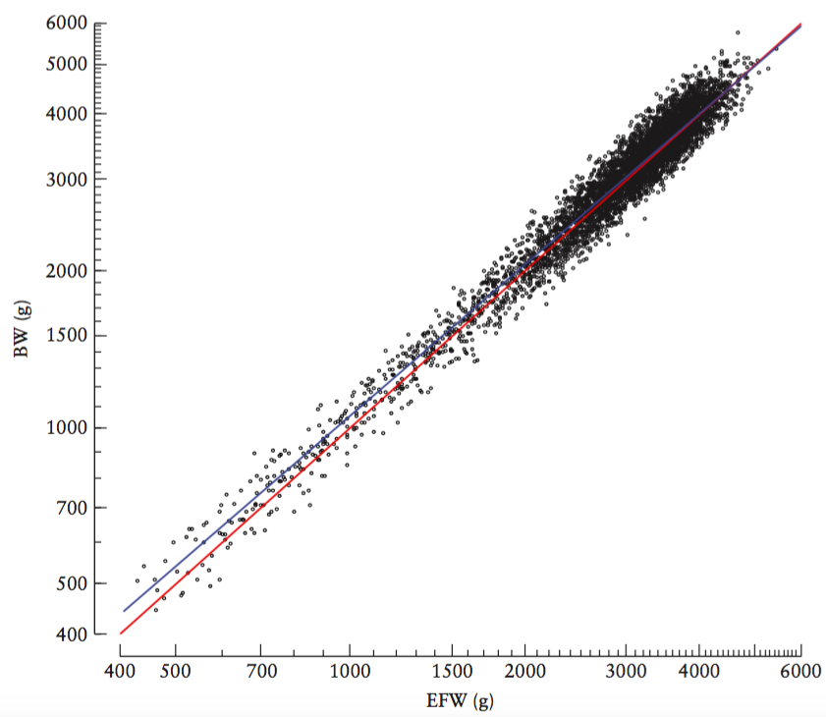
Fetal Medicine Foundation fetal and neonatal population weight charts
Nicolaides et al., UOG 2018
Results
Blue: regression line
Red: EFW = BW line
Figure shows the association between EFW and BW in the 5163 pregnancies of Dataset 1, in which birth occurred within 2 days of the ultrasound examination.
For a given gestational age, median EFW is the same as median BW.

Slide 8
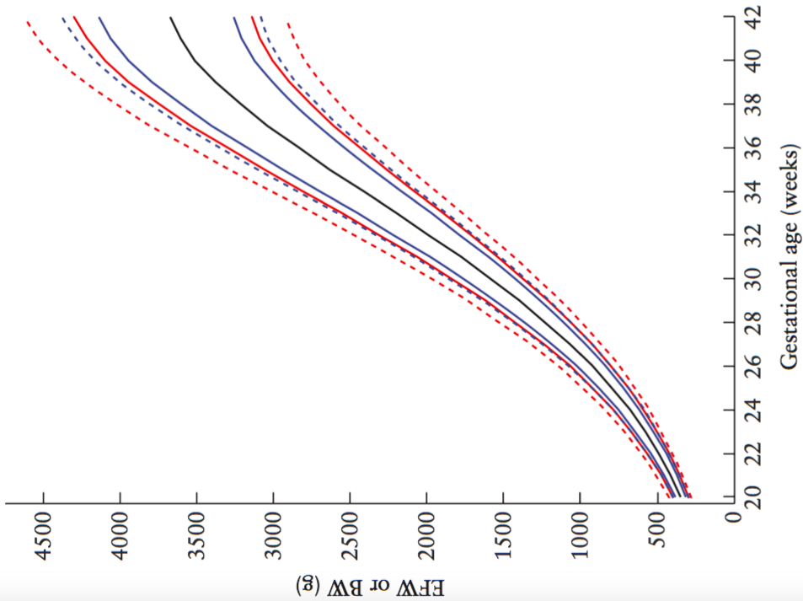
Fetal Medicine Foundation fetal and neonatal population weight charts
Nicolaides et al., UOG 2018
Results
Figure shows limits for both EFW (blue) and BW (red), assuming that EFW and BW have a common median (black line). The 10th and 90th percentiles (solid colored lines) and 3rd and 97th percentiles (dashed lines).
The distribution of EFW values was well balanced throughout the range of 20 + 0 to 36 + 6 weeks, whereas a good distribution of BW values was observed only in cases delivered > 39 weeks.

Slide 9
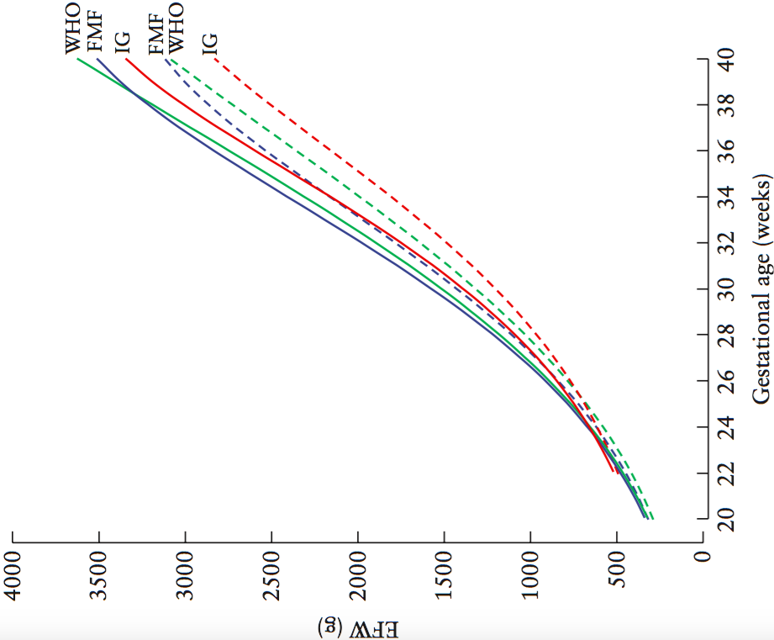
Fetal Medicine Foundation fetal and neonatal population weight charts
Nicolaides et al., UOG 2018
Results
Figure shows comparision of 50th (solid lines) and 10th (dashed lines) percentiles of EFW according to gestational age, between charts of World Health Organization (green), INTERGROWTH-21st (red) and this study (blue).
Median and 10th percentiles of the WHO chart, and more so those of the INTERGROWTH-21st chart, are substantially lower than the respective ones in the chart from this study between 24 and 38 weeks of gestation.

Slide 10
Fetal Medicine Foundation fetal and neonatal population weight charts
Nicolaides et al., UOG 2018
Results
For preterm births, particularly at 27–36 weeks, BW was below the 3rd, 5th and 10th percentiles in a very high proportion of cases.
This was particularly marked in cases delivered preterm due to iatrogenic causes (40.3%, 45.1% and 52.5% for BW < 3rd, < 5th and < 10th percentile, respectively). This was understandable because in 67.0% of 1790 cases of iatrogenic preterm birth, the indication for delivery was preeclampsia or FGR.
A high proportion of SGA neonates was also observed among spontaneous preterm births; the proportion of spontaneous preterm births with BW < 3rd, < 5th and < 10th percentiles was 8.6%, 12.4% and 19.8%, respectively.

Slide 11
Fetal Medicine Foundation fetal and neonatal population weight charts
Nicolaides et al., UOG 2018
Conclusions
This study has highlighted the necessity for BW charts to be based on all babies at a particular gestational age, including those still in utero.
There are variations in BW that depend on maternal characteristics, such as racial origin. However, adjustment for such characteristics may be inappropriate because it could result in underestimation of the increased perinatal risk in that group.
The value of adjustment for maternal weight, height and parity remains controversial.

Slide 12
Fetal Medicine Foundation fetal and neonatal population weight charts
Nicolaides et al., UOG 2018
Strengths
Production of BW reference charts for all babies, including those still in utero.. This avoids bias from SGA in the assessment of BW in babies born preterm.
Large study population, close proximity of the ultrasound examination to birth for Dataset 1.
In the establishment of reference ranges, the authors included all pregnancies and did not attempt to select only uncomplicated pregnancies from healthy mothers.
Limitations
Assumption that, for a given gestational age, EFW and BW have the same median.
Extent of extrapolation and interpolation resulting from use of EFW and BW data.

Slide 13
Fetal Medicine Foundation fetal and neonatal population weight charts
Nicolaides et al., UOG 2018
Discussion Points
Would it be accurate to use the charts from the current study in different countries?
Should we use the same reference ranges for women of different racial origin?
Should we adjust the reference range for maternal height, weight or parity?
In women from selected ethnic groups, how could we quantify the amount of babies smaller for pathological influences that would be masked by customized BW percentiles?

