Slide 1



UOG Journal Club: January 2020
Comparative analysis of 2-year outcomes in GRIT and TRUFFLE trials
GRIT和TRUFFLE研究2年结果比较分析
W. GANZEVOORT, J. G. THORNTON, N. MARLOW, B. THILAGANATHAN,
B. ARABIN, F. PREFUMO, C. LEES and H. WOLF,
for the GRIT Study Group and the TRUFFLE Study Group
Volume 55, Issue 1, pages 68–74
Journal Club slides prepared by Dr Alessandra Familiari
(UOG Editor for Trainees)
Ttranslators：Jingjing Wang, Prof. Qingqing Wu
翻译：王晶晶，吴青青

Slide 2
Comparative analysis of 2-year outcomes in GRIT and TRUFFLE trials
Ganzevoort w et al, UOG 2020
Introduction 前言
There is uncertainty over the optimal indication for timing of delivery in early-onset fetal growth restriction (FGR). 早发型胎儿生长受限 (FGR)的最佳生产时机尚未确定
Trials in this patient group are challenging to conduct because of the high risk of adverse pregnancy outcome.由于不良妊娠结局的高风险，这类患者的临床试验很难进行。
Only two large randomized trials have evaluated timing of delivery in early-onset preterm FGR: the Growth Restriction Intervention Study (GRIT) and the Trial of Umbilical and Fetal Flow in Europe (TRUFFLE). 仅有两个大型随机试验评估了早发性FGR早产的分娩时间: 生长限制干预研究(GRIT)和欧洲胎儿脐血流试验(TRUFFLE)。
An individual patient data meta-analysis (IPD-MA) would be the optimal solution to analyze the existing data from these two large cohorts. 独立研究原始数据荟萃分析(IPD-MA)是分析这两个大队列中现有数据的最佳解决方案。

Slide 3
Comparative analysis of 2-year outcomes in GRIT and TRUFFLE trials
Ganzevoort w et al, UOG 2020
Aim of the study 研究目的
The objective of this study was to evaluate and compare
the effect on perinatal outcome of different fetal monitoring strategies for early-onset FGR employed in GRIT and TRUFFLE, in order to identify the optimal method for fetal monitoring in these high-risk pregnancies.
研究目的：基于GRIT和TRUFFLE队列中早发型 FGR，评价并比较不同胎儿监护策略对围产期结局的影响，以确定高危妊娠中胎儿监护的最佳方案。

Slide 4
Comparative analysis of 2-year outcomes in GRIT and TRUFFLE trials
Ganzevoort w et al, UOG 2020
Methods 方法
Women were grouped according to intervention and monitoring methodinto: immediate delivery (GRIT) or delayed delivery with monitoring with conventional cardiotocography (CTG), or computerized CTG (cCTG) only (GRIT and TRUFFLE), or cCTG and ductus venosus (DV) Doppler (TRUFFLE). All women randomized between 26 and 32 weeks’ were included.根据干预和监护方法将产妇分为: 立即分娩(GRIT)、常规胎心监护(CTG)延迟分娩组(GRIT 和 TRUFFLE)、仅使用计算机化胎心监护延迟分娩组(cCTG)(GRIT 和 TRUFFLE)、cCTG和静脉导管(DV)多普勒监护延迟分娩组(TRUFFLE)。 所有26到32周的孕妇随机分配入组。
Individual cohort study 个体队列研究
Differences in inclusion criteria and study period between the two trials precluded an IPD-MA so a cohort analysis of individual participant data from the GRIT and TRUFFLE studies was performed.两个试验中纳入标准和时间上的差异使得IPD-MA无法进行，因此，对GRIT和TRUFFLE队列中的个体病例数据进行了队列分析。
Primary Outcome 主要结局
Survival without neurodevelopmental impairment (NDI) at 2 years of age.
2岁存活且无神经发育障碍（NDI）

Slide 5
Comparative analysis of 2-year outcomes in GRIT and TRUFFLE trials
Ganzevoort w et al, UOG 2020
Results结果
238 women from GRIT and 502 women from TRUFFLE were included.
包含GRIT中238名孕妇和TRUFFLE中502名孕妇。
Gestational age at inclusion and at delivery, and birth weight, were similar between all subgroups. 在所有亚组中，入组和分娩时的孕龄、出生体重均相似。
More women had absent or reversed end-diastolic (ARED) flow at study entry in GRIT than in TRUFFLE (70% vs 41%; P < 0.01). If later measurements were included, rates of umbilical artery ARED flow were comparable between the groups (64% on average).
GRIT中入组时的脐动脉舒张期血流消失或反向(ARED)比例高于TRUFFLE（70% 、 41%; P < 0.01）。如果包括后期测量，两组间脐动脉ARED是可比的（平均为64%）。

Slide 6
Comparative analysis of 2-year outcomes in GRIT and TRUFFLE trials
Ganzevoort w et al, UOG 2020
Results结果
Because the study periods of GRIT and TRUFFLE differed (1993–2001 vs 2005–2010) and study period and monitoring strategy were strongly associated, it was not appropriate to combine these in one regression analysis, thus separate regression analyses for monitoring method and for year of inclusion were performed.
由于GRIT 和TRUFFLE研究时间不同(1993-2001年与2005-2010年) ，研究时间和监测策略密切相关，不宜将它们合并为一个回归分析，因此对监测方法和纳入年份进行了单独的回归分析。

Slide 7
Comparative analysis of 2-year outcomes in GRIT and TRUFFLE trials
Ganzevoort w et al, UOG 2020
Results结果
The interval to delivery was shorter in the GRIT delayed-delivery groups than in the TRUFFLE groups (median 3 days vs 8 days; P < 0.01).
GRIT 中延迟分娩组的分娩间隔时间短于TRUFFLE中延迟分娩组(中位数：3天、8天;P < 0.01)。
Fetal death rate was comparable between GRIT and TRUFFLE, but neonatal or late death was more frequent in GRIT (18% vs 6%; P < 0.01).
GRIT 和TRUFFLE中胎儿死亡率相当，但新生儿或晚期死亡在GRIT中更为常见 (18% 、 6%; P < 0.01)。

Slide 8
Comparative analysis of 2-year outcomes in GRIT and TRUFFLE trials
Ganzevoort w et al, UOG 2020
Results结果
Fetal death rate was similar in women monitored by conventional CTG and in those monitored by cCTG in GRIT (4.8% vs 5.5%), but perinatal mortality was lower in the GRIT cCTG group (13% vs 23%), although the difference did not reach statistical significance.
立即分娩组中，传统CTG 监测的胎儿死亡率与 cCTG监测的胎儿死亡率相似(4.8%、 5.5%) ，但cCTG立即分娩组中围产期死亡率低（13% 、23%），差异无统计学意义。
The rate of survival without NDI at 2 years was lowest in the immediate-delivery group and in pregnancies monitored by CTG without STV, with a higher rate in the cCTG groups and the highest rate in the cCTG + DV Doppler group.
立即分娩组及应用不含胎心率短期变异（STV）的CTG监测的孕妇中2岁无神经发育障碍存活率最低，cCTG组存活率较高，cCTG + DV 多普勒组存活率最高。

Slide 9
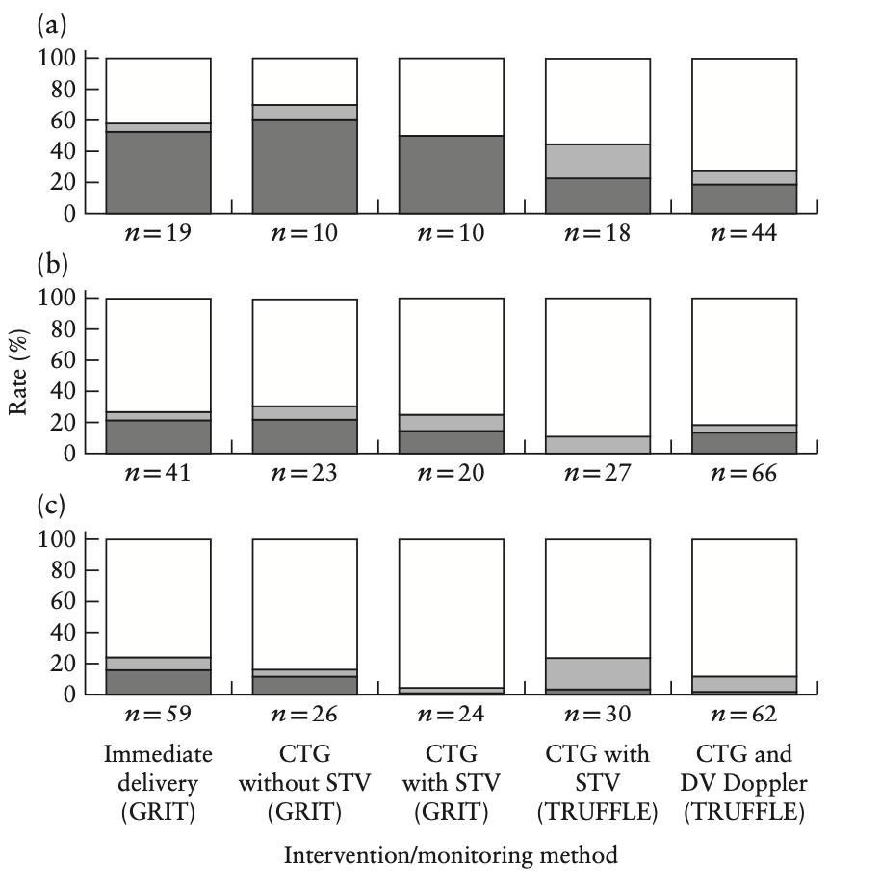
Comparative analysis of 2-year outcomes in GRIT and TRUFFLE trials
Ganzevoort w et al, UOG 2020
Results结果
Rates of normal development (white), NDI (light grey) and perinatal death (dark grey ) by 2 years of age in children born from pregnancies complicated by early-onset FGR included in GRIT and TRUFFLE studies, randomized at:
(a)26–27 weeks,
(b) 28–29 weeks,
(c) 30–31 weeks,
according to intervention/
monitoring method.
STV, short-term variation in fetal heart rate.
GRIT和 TRUFFLE 研究中妊娠合并早发型FGR的2岁儿童中不同干预措施/监测方法的正常发育（白色）、NDI（浅灰色）、围产儿死亡（深灰色）的比例，随机分成：（a） 26-27周，（b） 28-29周，（c） 30-31周。STV=胎心率短期变异。

Slide 10
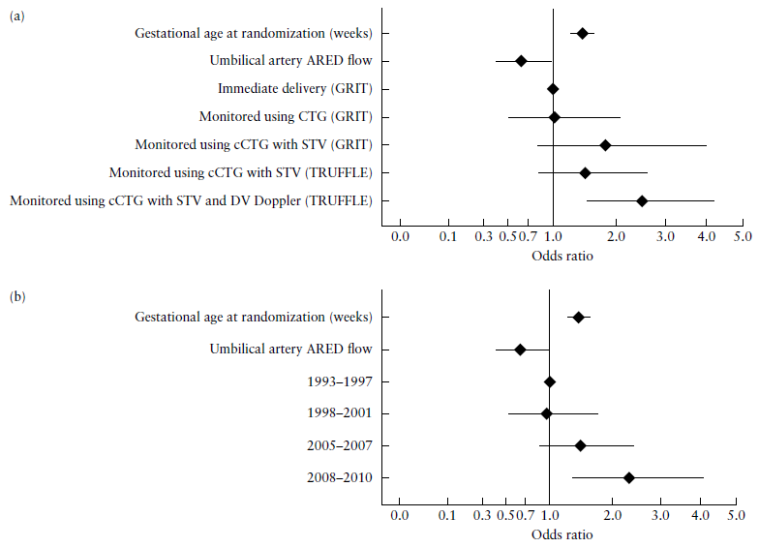
Comparative analysis of 2-year outcomes in GRIT and TRUFFLE trials
Ganzevoort w et al, UOG 2020
Results 结果
Odds ratios for survival without NDI at 2 years in children born from pregnancies complicated by early-onset FGR included in GRIT and TRUFFLE studies, calculated using multivariable regression model including (a) intervention/monitoring method (AUC, 0.69 (95% CI, 0.64–0.74)); (b) year of
inclusion (AUC, 0.68 (95% CI, 0.63–0.73)).
应用（a）干预/监测方法（AUC，0.69（95%可信区间，0.64–0.74））、(b) 纳入年份(AUC, 0.68 (95% CI, 0.63–0.73))建立的多变量回归模型计算GRIT和 TRUFFLE研究中妊娠合并早发型FGR的儿童2岁时无NDI生存的优势比

Slide 11
Comparative analysis of 2-year outcomes in GRIT and TRUFFLE trials
Ganzevoort w et al, UOG 2020
Discussion 讨论
The rate of survival without NDI at 2 years was highest in the group of fetuses monitored by cCTG + DV Doppler.
cCTG+DV多普勒监测组2年无NDI存活率最高。
A decreasing perinatal death rate was observed across the groups at different gestational ages at inclusion, which was most apparent for those included at the lowest gestational age (26–27 weeks).
纳入时不同孕龄组的围产儿死亡率均呈下降趋势，其中以孕龄最低（26-27周）组的围产儿死亡率下降最为明显。
Additional parameters associated significantly with survival without NDI at 2 years were gestational age at randomization, umbilical artery ARED flow, birth weight and birth-weight Z-score.
与2年无NDI生存率显著相关的其他参数是:随机分组的孕龄、脐动脉ARED血流、出生体重和出生体重Z评分。

Slide 12
Comparative analysis of 2-year outcomes in GRIT and TRUFFLE trials
Ganzevoort w et al, UOG 2020
Strengths and limitations 优点及局限性
This is the first work providing a comparative analysis of the effect on perinatal outcome of different monitoring techniques for early-onset FGR in the two existing randomized controlled trials (GRIT and TRUFFLE).
本研究首次在两个现有的随机对照试验（GRIT 和 TRUFFLE）中，比较分析不同的监测技术对早发型FGR围生结局的影响。
A limitation of the study is that it was not possible to perform an IPD-MA.
研究的一个局限是不能进行IPD-MA分析
Conclusion 总结
This analysis supports the idea that the optimal method for fetal monitoring in pregnancies complicated by early-onset FGR is a combination of cCTG and DV Doppler assessment.
本分析支持早发型FGR胎儿监护的最佳方法是cCTG和DV-Doppler联合评估。

Slide 13
Comparative analysis of 2-year outcomes in GRIT and TRUFFLE trials
Ganzevoort w et al, UOG 2020
Discussion points 讨论点
Does this paper change the present clinical practice in managing early-onset FGR pregnancies?
本篇论文是否改变了目前治疗早发型FGR妊娠的临床实践？
Should we rely first of all on the gestational age at diagnosis and the presence of umbilical artery ARED flow when planning the correct strategy of monitoring a FGR fetus?
在制定监测胎儿生长受限的正确策略时，我们应该首先依赖于诊断时的孕龄和的存在脐动脉ARED 血流吗？
Given the superiority of cCTG over conventional CTG for FGR, should we consider using the latter in all pregnancies?
鉴于在用于FGR中，cCTG优于传统CTG，我们是否应该考虑在所有妊娠中使用cCTG？

Slide 14
Comparative analysis of 2-year outcomes in GRIT and TRUFFLE trials
Ganzevoort w et al, UOG 2020
Discussion points讨论点
Is a study needed to better define cCTG and DV criteria for delivery?
是否需要一项研究来更好地定义cCTG和DV的分娩应用标准？
There is a need of an interventional trial taking into account fixed strategies and data regarding important factors such as corticosteroid and magnesium sulfate administration. Do these factor have an impact on decision-making ?
有必要进行一项干预性试验，考虑到确定的方案及重要因素数据（如皮质类固醇和硫酸镁的使用）。这些因素对决策会有影响吗？

