Slide 1



UOG Journal Club: June 2017
Multicenter screening for pre-eclampsia by maternal factors and biomarkers at 11–13 weeks’ gestation: comparison with
NICE guidelines and ACOG recommendations
N. O’Gorman, D. Wright, L.C. Poon, D.L. Rolnik, A. Syngelaki, M. De Alvarado, I.F. Carbone, V. Dutemeyer, M. Fiolna, A. Frick, N. Karagiotis, S. Mastrodima,
C. De Paco Matallana, G. Papaioannou, A. Pazos, W. Plasencia, K.H. Nicolaides
Volume 49, Issue 6, Date: June (pages 756–760)
Journal Club slides prepared by Dr Fiona Brownfoot
(UOG Editor for Trainees)

Slide 2
Multicenter screening for pre-eclampsia by maternal factors and biomarkers at 11–13 weeks’ gestation: comparison with NICE guidelines and ACOG recommendations N. O‘Gorman et al., UOG 2017
Introduction
Traditionally, clinical factors have been used to screen patients for their risk of developing pre-eclampsia (PE).
Recently, The Fetal Medicine Foundation (FMF) has developed a screening tool utilizing maternal risk factors, ultrasound findings (uterine artery pulsatility index - UtA PI) and biochemical markers (pregnancy-associated plasma protein-A - PAPP-A) and placental growth factor - PlGF) to identify patients at risk of PE.
The authors compare the accuracy of maternal clinical factors alone (as recommended by the NICE and ACOG guidelines) with the FMF algorithm to see which method has a superior positive predictive value for PE.
Notes:
2

Slide 3
Multicenter screening for pre-eclampsia by maternal factors and biomarkers at 11–13 weeks’ gestation: comparison with NICE guidelines and ACOG recommendations N. O‘Gorman et al., UOG 2017
Aim of the study
To examine the performance of different screening tools (NICE guideline , ACOG guideline and FMF algorithm) to predict the risk of PE.
Notes:
3

Slide 4
Multicenter screening for pre-eclampsia by maternal factors and biomarkers at 11–13 weeks’ gestation: comparison with NICE guidelines and ACOG recommendations N. O‘Gorman et al., UOG 2017
Methods
Study design
  Prospective, non-interventional, multicenter study
Setting
  Twelve maternity hospitals in five different countries including the UK, Spain, Belgium, Greece and Italy (February to September 2015).
Participants
  Included: women with a singleton pregnancy booking visit for routine pregnancy care at 11+0 to 13+6 weeks’ gestation
  Excluded: no exclusion criteria were documented

Slide 5
Multicenter screening for pre-eclampsia by maternal factors and biomarkers at 11–13 weeks’ gestation: comparison with NICE guidelines and ACOG recommendations N. O‘Gorman et al., UOG 2017
Methods
Parameters included to classify as high risk according to guideline:
  NICE
    One or more high-risk factors (to recommend aspirin use): history of hypertensive disease in previous pregnancy, chronic kidney disease, autoimmune disease, diabetes mellitus or chronic hypertension
    Two or more moderate-risk factors (to recommend aspirin use): first pregnancy, age ≥ 40 years, interpregnancy interval > 10 years, body mass index (BMI) at first visit of ≥ 35 kg/m² or family history of PE
  ACOG
    Risk factors, including nulliparity, age > 40 years, BMI ≥ 30 kg/m², conception by in-vitro fertilization, history of previous pregnancy with PE, family history of PE, chronic hypertension, chronic renal disease, diabetes mellitus, systemic lupus erythematosus or thrombophilia
    Use of aspirin should be reserved for women with history of PE in two or more previous pregnancies or PE requiring delivery < 34 weeks’ gestation
  FMF
    Maternal factors, mean arterial pressure (MAP), UtA-PI, serum PAPP-A and PlGF

Slide 6
Multicenter screening for pre-eclampsia by maternal factors and biomarkers at 11–13 weeks’ gestation: comparison with NICE guidelines and ACOG recommendations N. O‘Gorman et al., UOG 2017
Methods
Data collection
  Maternal factors at booking visit were recorded and MAP, UtA-PI, serum PAPP-A and PlGF were measured to determine the risk of PE using NICE guidelines, ACOG guidelines and the FMF algorithm.
Outcome
  The outcome measure was diagnosis of PE, as defined by the International Society for the Study of Hypertension in Pregnancy.
  Subgroup analysis was completed, assessing rates of PE delivering < 32 weeks, < 37 weeks and ≥ 37 weeks’ gestation.
Statistical analysis
  Statistical software package R was used for data analyses.

Slide 7
Multicenter screening for pre-eclampsia by maternal factors and biomarkers at 11–13 weeks’ gestation: comparison with NICE guidelines and ACOG recommendations N. O‘Gorman et al., UOG 2017
Results
Baseline characteristics
8775 women were included in the study
239 (2.7%) developed PE in total
17 (0.2%) <32 weeks, 59 (0.7%) < 37 weeks and 180 (2.1%) ≥ 37 weeks
Primary outcome
Detection rate, at a 10% false-positive rate, with delivery <32 weeks with PE: 100% by FMF algorithm, 41% by NICE guidelines.
Detection rate, at a 10% false-positive rate, with delivery <37 weeks with PE: 80% by FMF algorithm, 39% by NICE guidelines.
Detection rate, at a 10% false-positive rate, with delivery ≥ 37 weeks with PE: 43% by the FMF algorithm, 34% by NICE guidelines.

Slide 8
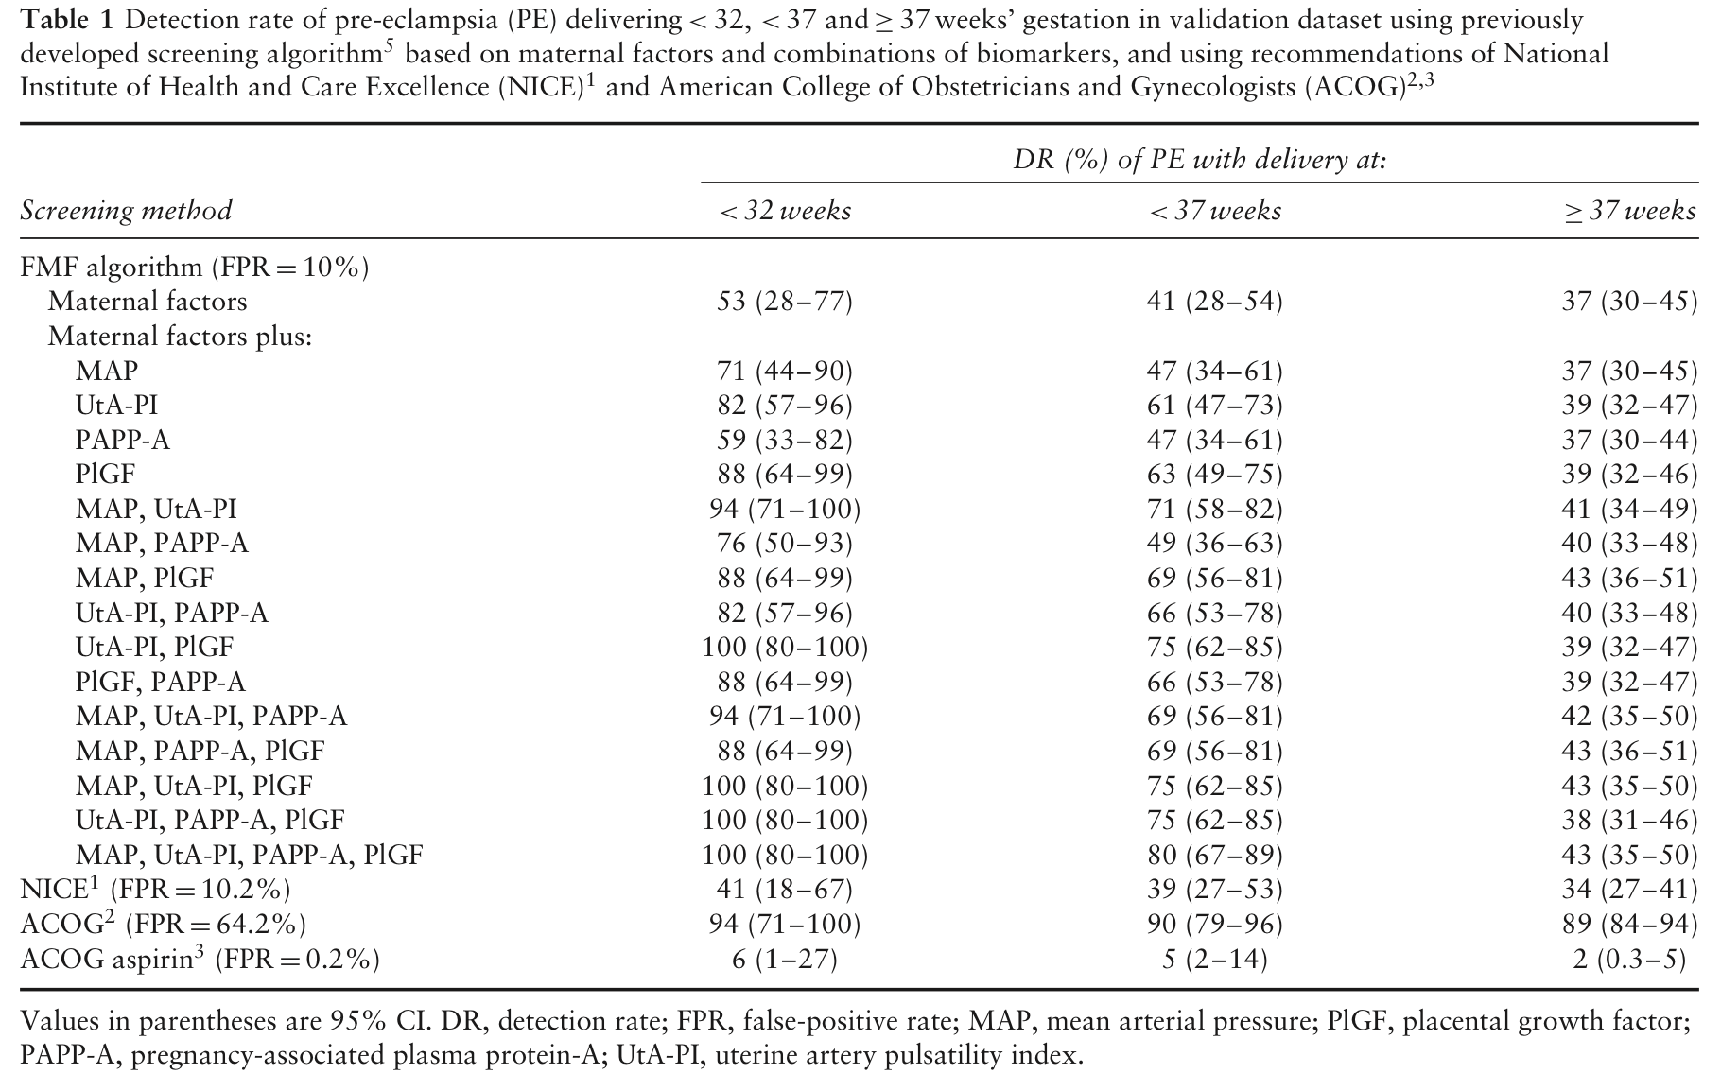
Multicenter screening for pre-eclampsia by maternal factors and biomarkers at 11–13 weeks’ gestation: comparison with NICE guidelines and ACOG recommendations N. O‘Gorman et al., UOG 2017
Notes:
8

Slide 9
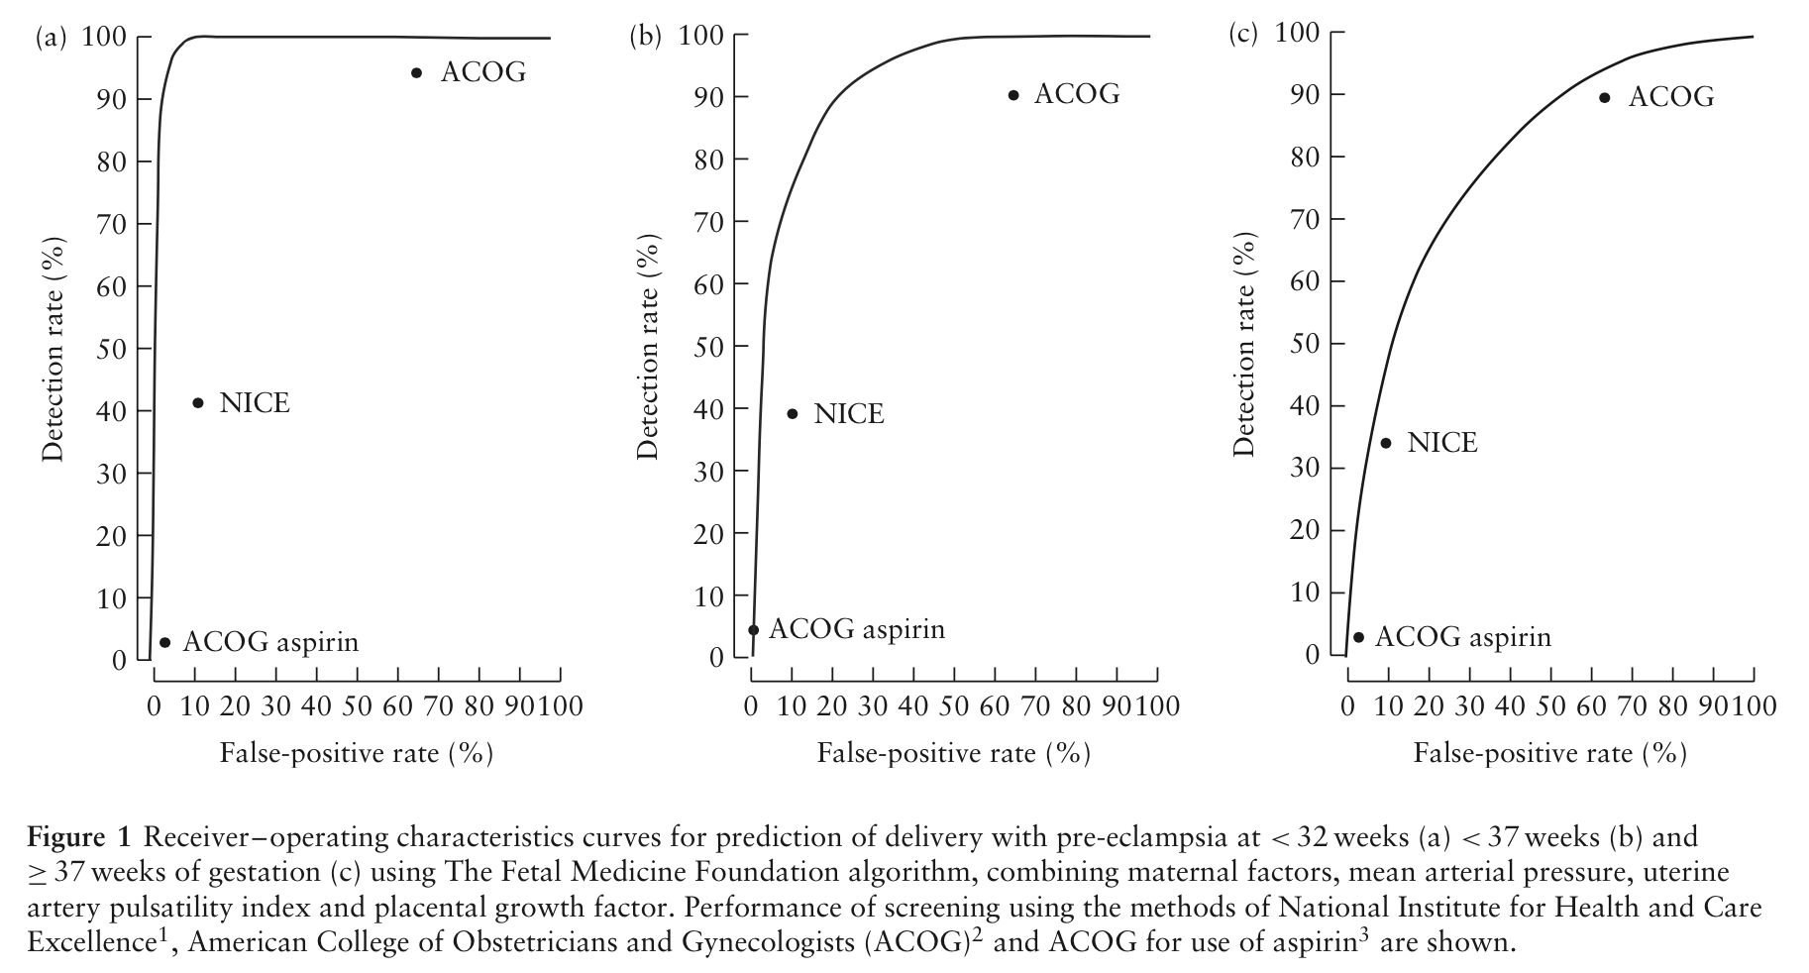
Multicenter screening for pre-eclampsia by maternal factors and biomarkers at 11–13 weeks’ gestation: comparison with NICE guidelines and ACOG recommendations N. O‘Gorman et al., UOG 2017
Results
< 32 weeks
< 37 weeks
> 37 weeks

Slide 10
Multicenter screening for pre-eclampsia by maternal factors and biomarkers at 11–13 weeks’ gestation: comparison with NICE guidelines and ACOG recommendations N. O‘Gorman et al., UOG 2017
Discussion
Finding
The performance of the FMF algorithm using a combination of maternal factors, MAP, UtA-PI, PAPP-A and PlGF had a higher detection rate of PE compared with the methods advocated by NICE and ACOG.
Study limitation
The low incidence of PE in this population resulted in wide confidence intervals obtained for performance of screening.
Notes:
10

Slide 11
Multicenter screening for pre-eclampsia by maternal factors and biomarkers at 11–13 weeks’ gestation: comparison with NICE guidelines and ACOG recommendations N. O‘Gorman et al., UOG 2017
Discussion
Implications for practice
The FMF algorithm could be used to identify more women at increased risk of developing PE in their pregnancy compared with NICE or ACOG guidelines
Administration of aspirin could be commenced to reduce the risk of PE.
According to the FMF and NICE, 10% of the pregnant population would receive aspirin and this population would contain 75% of those that will develop preterm PE if selection was based on the high-risk group from FMF and 39% if selection was based on the NICE guidelines.
In the case of the ACOG recommendations, 0.2% of the population would receive aspirin and only 5% of cases of preterm PE that would potentially benefit from such therapy would be targeted.

Slide 12
Multicenter screening for pre-eclampsia by maternal factors and biomarkers at 11–13 weeks’ gestation: comparison with NICE guidelines and ACOG recommendations N. O‘Gorman et al., UOG 2017
Conclusions
Use of the FMF algorithm results in a higher detection rate of patients at risk of PE compared with the current NICE and ACOG guidelines.
Future perspectives
There is a need to identify a more sensitive screening test to determine which patients are at risk of PE - especially at term - so that preventative therapies can be commenced in early pregnancy.

Slide 13
Multicenter screening for pre-eclampsia by maternal factors and biomarkers at 11–13 weeks’ gestation: comparison with NICE guidelines and ACOG recommendations N. O‘Gorman et al., UOG 2017
Discussion points
Why do conventional risk assessments, as recommended by ACOG or NICE, underperform?
Why does the FMF algorithm have better performance for early-onset PE compared with term PE?
Are UtA Doppler, PAPP-A, PlGF and blood pressure markers of placental development or maternal cardiovascular status?
Why are all prediction models equally poor (or good) for PE at term?
What risk assessment is used in your hospital?
Which algorithm should be used to decide on aspirin prophylaxis?
Notes:
13

