Slide 1
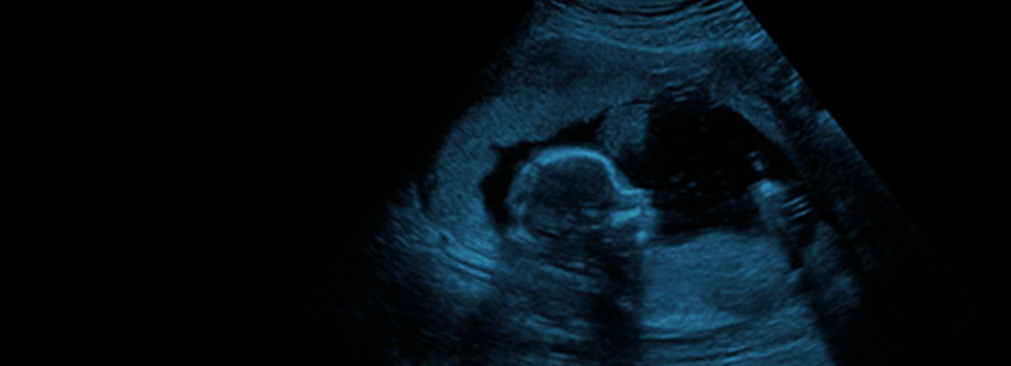




Exclusively for those in lower resource settings & southern Africa!
Day 1: Gynecology & Early Pregnancy
reproductive health
early pregnancy complications
ultrasound in low-resource settings
IOTA terms and definitions
cervical cancer
Day 2: Obstetrics
pre-eclampsia and PAS
preterm birth, fetal growth restriction
fetal echocardiography & neurosonography
multiple pregnancy
genetics (screening and diagnostics)
REGISTER FOR FREE NOW >

