Slide 1

Title area of slide to go in this area
The logo of your unit, university or hospital
Presenter in bold
Other authors in regular
Fetal Medicine Unit, Department of Obstetrics, St. Elsewhere University Hospital

Slide 2
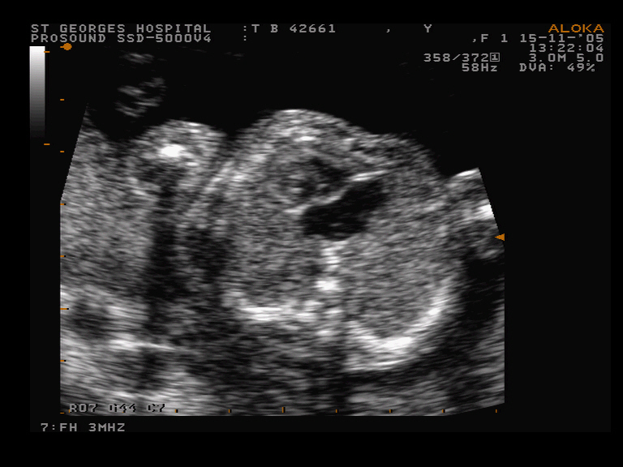
Aims and Methods
Remember
  Large and clear font
  Fewer words allow for a clearer presentation
  Do not write down your whole abstract
  you only have 3 minutes for the oral presentation
If you over-run
  You are being unfair to other presenters
  You will not get questions
  The chairperson will stop you
For ultrasound images
  Ensure highest possible resolution
  Crop the image to the area of interest
  Ensure patient anonymity!

Slide 3
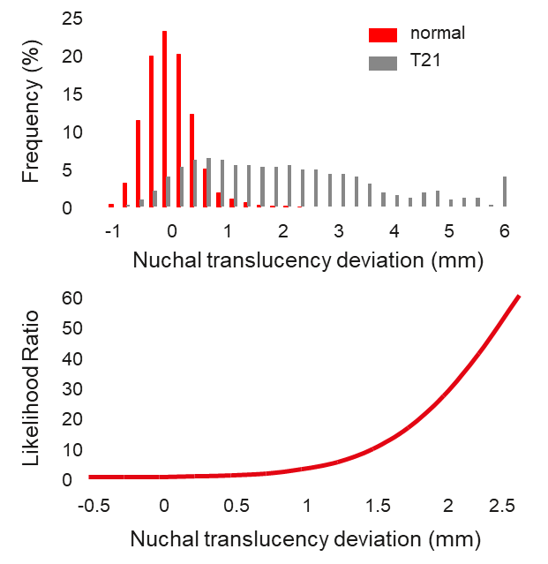
Results
Give main results first
Basic numbers before complicated results
Keep font size and spacing uniform
Never less than 16 point font size
Graphs
Ensure all axes are labelled
Avoid using overcomplicated graphs
Ensure all figures are aligned

Slide 4
Conclusions
Have a simple conclusion – usually one sentence
Ensure it answers the aims
You may want to discuss
limitations of your study
future directions

