Slide 1
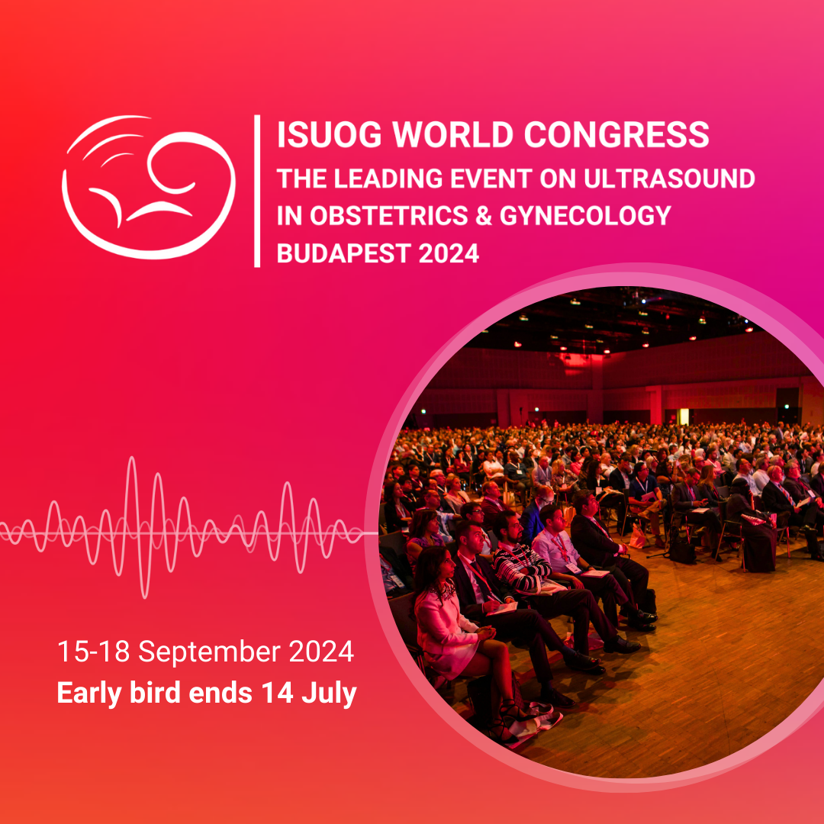
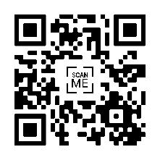
Attend the 34th ISUOG World Congress to:
Immerse yourself in our 4-day scientific program.
Hear the latest updates from world-renowned experts.
Share knowledge, ideas and expertise that relates to your practise.
Network with your professional peers.
98.3% of 2023 delegates would recommend the Congress to a colleague.
REGISTER NOW
Scan to learn more and register now

