Slide 1
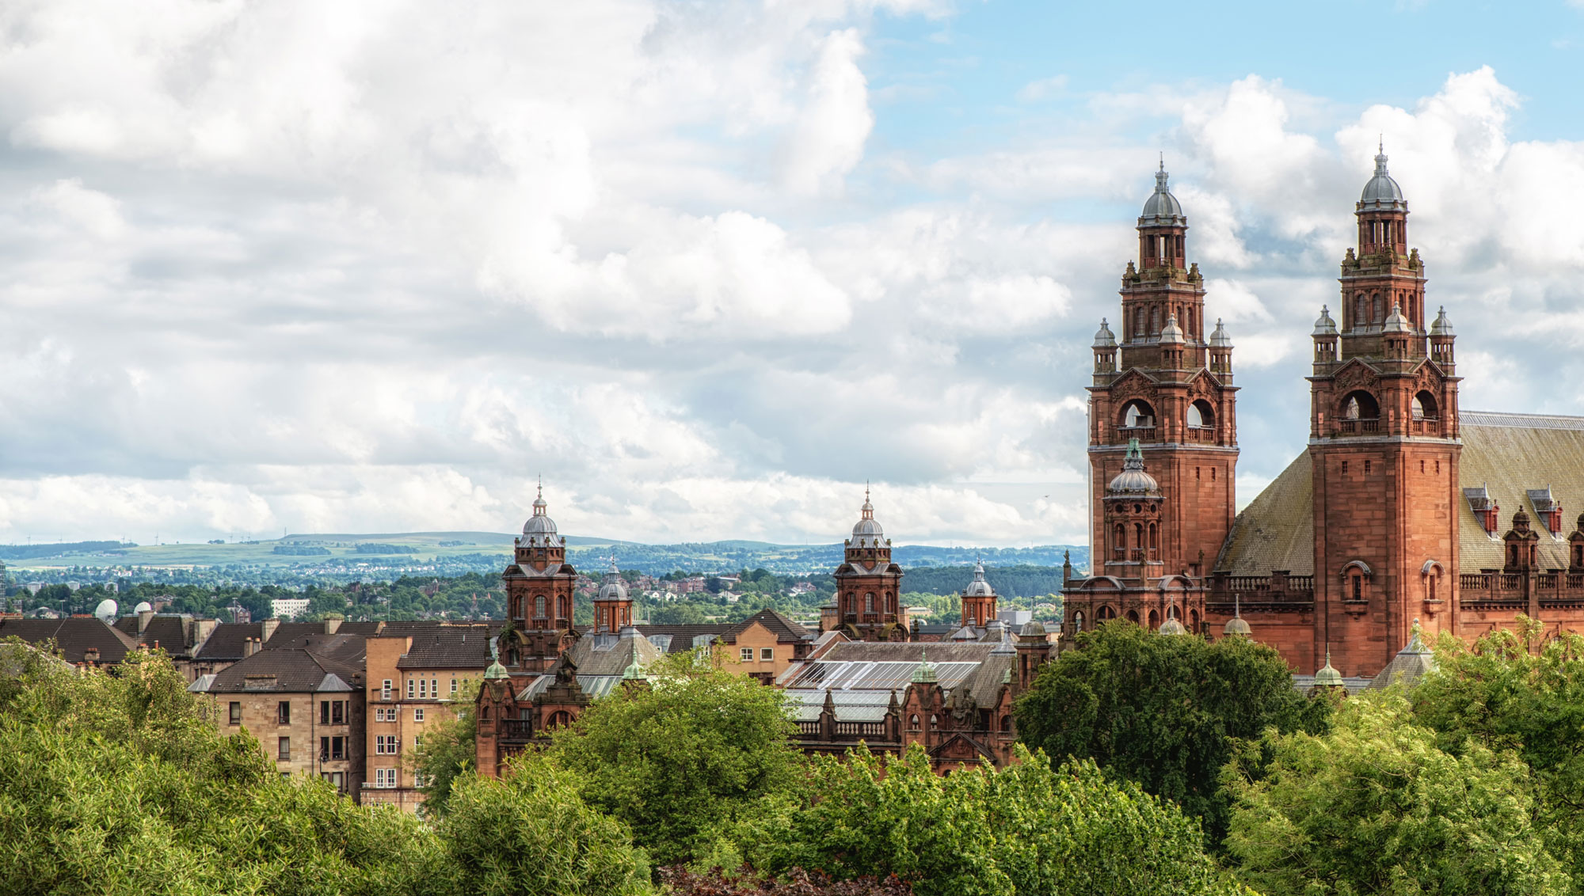
Visit www.isuog.org/events/world-congress-2020.html for full details

Slide 2
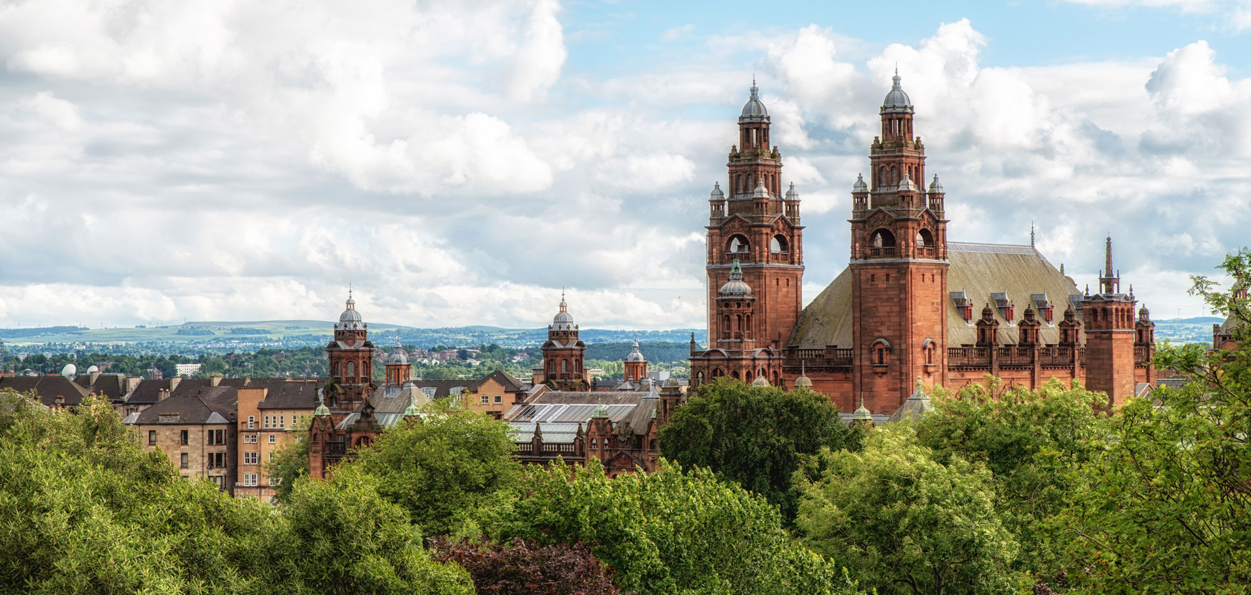
Save the date!
#ISUOG2020
Visit www.isuog.org/events/world-congress-2020.html for full details

