Slide 1
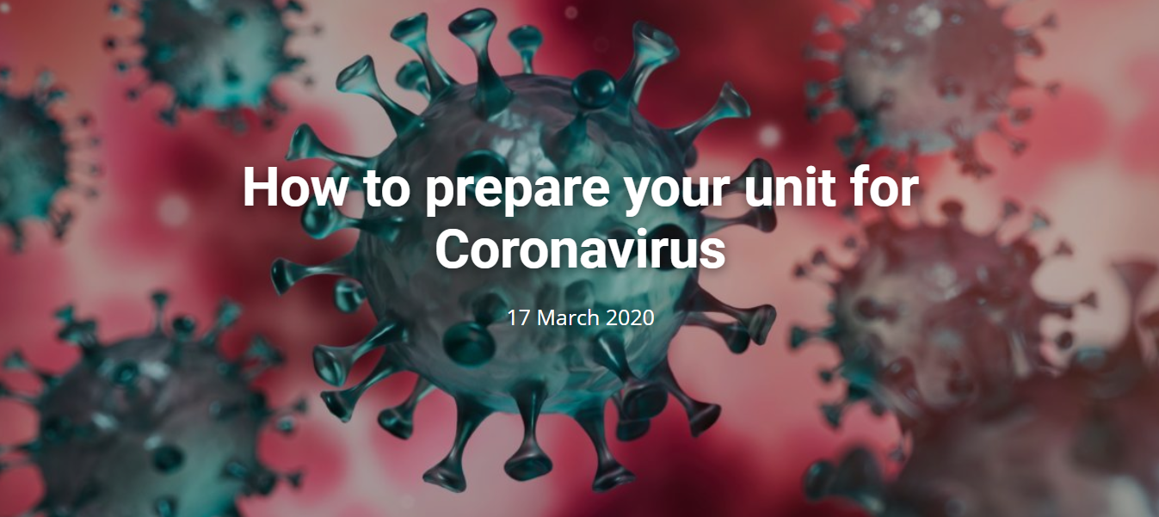
Lessons learned from the ISUOG Webinar
Summary by A. Dall’Asta, M. Gil and D. Rolnik

Slide 2
How to prepare your unit for Coronavirus - Lessons learned
COVID-19: preparedness and challenges. The lesson learned from the Lombardy region - F. Castelli, Italy
COVID-19 spreads rapidly and ramps very quickly in terms of epidemic curve
Hospitals need to have an emergency plan in terms of dedicated beds and staff as well as equipment and PPE
Departmental organization: what is needed, what needs to be cancelled - S. Chan, Hong Kong
Teaching, meetings, elective surgeries and other non-urgent business to be cancelled; husbands, visitors and unnecessary staff not allowed in delivery and consultation rooms.
Patients triaged with temperature check and checklist/questionnaire.
Good communication is essential; clear workflow and protocols to be adapted locally.
Obstetric management: immediate actions - L. Poon, Hong Kong
Delivery in tertiary referral centers to standardize care and management. Isolation of suspected/confirmed cases.
Confirmed cases to be monitored for fetal growth and AFI 2-4 weekly.
Intrapartum care: COVID-19 itself is not an indication for CS; individualize time and mode of delivery; shorten 2nd stage of labor; low threshold to expedite delivery; water birth not recommended; delayed cord clamping not recommended.
Protecting staff, PPE, staff wellbeing, levels of sickness to be expected - J. Lee, Singapore
Social distancing, PPE and hand hygiene are crucial. Frontline staff to use N95/FFP2 masks after training and fit test. Masks to be worn by patients with suspicious symptoms.
Mental and social health support are recommended given the high risk of burnout.

